Slide 1
Workpaper Development Training

Slide 2
Presenter | Topic | Start Time
Host IOU | Opening & Safety | 10:00
CPUC | Workpaper History & Regulatory Framework | 10:10
Martin Vu, RMS | Workpaper Development & Roles | 10:40
-- | LUNCH | 12:00
Martin Vu, RMS | Roles (Continued) | 12:45
Martin Vu, RMS | Process & Timing | 1:25
Host IOU | IOU Solicitation Workpaper Review Process | 2:25
Susan Haselhorst, EAR | Commission Workpaper Approval Process | 3:25
Ayad Al-Shaikh, CalTF | eTRM Demo | 4:10

Slide 3
Workpaper History and Regulatory Framework
Presented by CPUC
California Public Utilities Commission

Slide 4
What is a Workpaper?
A workpaper is a technical document that provides all necessary supporting information to develop forecasted values/ savings for deemed energy efficiency measures that are not completely covered by the Database of Energy Efficiency Resources (DEER)

Slide 5
What are deemed energy efficiency measures?
Estimates of energy savings for a single unit of an installed EE measure is –
developed from data sources (such as prior metering studies) and analytical methods
applicable to the situation under which the measure is being implemented.

Slide 6
What is DEER?
It is the database of energy efficiency resources
  Database on costs and benefits of energy-efficient measures.
What kind of information can you find in DEER?
  Measure ID/ IOU
  Energy Impacts
    Net-to-Gross reference
    Effective Useful Life (EUL)
    Gross Savings Adjustment reference (installation rate)
  Measure Application Type
  Delivery Type

Slide 7
Components of a workpaper
Workpaper
Proposal for new measure
Describes baseline and measure technologies
Describes program delivery method
Includes engineering calculations
Sometimes includes building simulations
Outputs energy savings, net-to-gross, effective useful life, measure cost estimates

Slide 8
Why do workpapers matter?
Workpapers are the only way program administrators can introduce new deemed measures into the portfolio
All deemed measures need an approved workpaper before they can be offered in a program
Lessons learned from program implementation and impact and market characterization studies can feed into workpaper updates
Ex ante estimates from workpapers feed into measure/program/portfolio cost-effectiveness analysis

Slide 9
Purpose of reviewing forecasted savings, including workpapers
The program administrators strive to meet energy savings goals that are cost effective on an overall portfolio basis.
The program administrators – primarily the utilities get credit for energy savings due to their efforts beyond what would have happened if they did nothing.
The question is how much did they contribute to obtaining these savings and how much would have happened anyways.

Slide 10
CPUC Regulatory Background
CPUC Decision (D.) 09-09-047
  Authority to review and approve workpapers
  Process for submittal, review and freezing of workpaper values.
Application 08-07-021 (a Ruling)
  Phase 1 and Phase 2 reviews and approval for workpapers (11/18/2009)
CPUC Decision (D.) 12-05-015
  Bus stop schedule
  Defines interim approval
  Encourages new measures and follow-up research

Slide 11
More Regulatory Background
CPUC Decision (D.) 15-10-028 (Rolling portfolio)
  Replaced a three year regulatory cycle with an annual cycle
Resolution E-4795 (DEER2017/2018 update)
  New Code Update or Code Update Not Covered in Previous DEER Updates
  Required changes in workpaper parameters
  Updates Based on Evaluation Results
Resolution E-4952 (DEER2019/2020 update)
  Updated DEER values including shift in peak power periods
  Addition of New Measures
  Required changes in workpaper parameters
  New Code Update or Code Update Not Covered in Previous DEER Updates
  Policy Directed Updates Supported by Prior Evaluation Reports and Findings

Slide 12
More Regulatory Background
Resolution E-4818 (T1WG)
  Adopts measure-level baseline assignments
  Adopts tiered approached to preponderance of evidence (POE) for accelerated replacement baseline treatment but not the proposed T1WG requirements.
Resolution E-4939 (T2WG)
  Adopts the standard practice baseline definition and baseline selection process
  Adopts a single preponderance of evidence (POE) requirement process for all accelerated-replacement measure types.
  Adopts a small-sized business customer definition pathway for accelerated replacements.

Slide 13
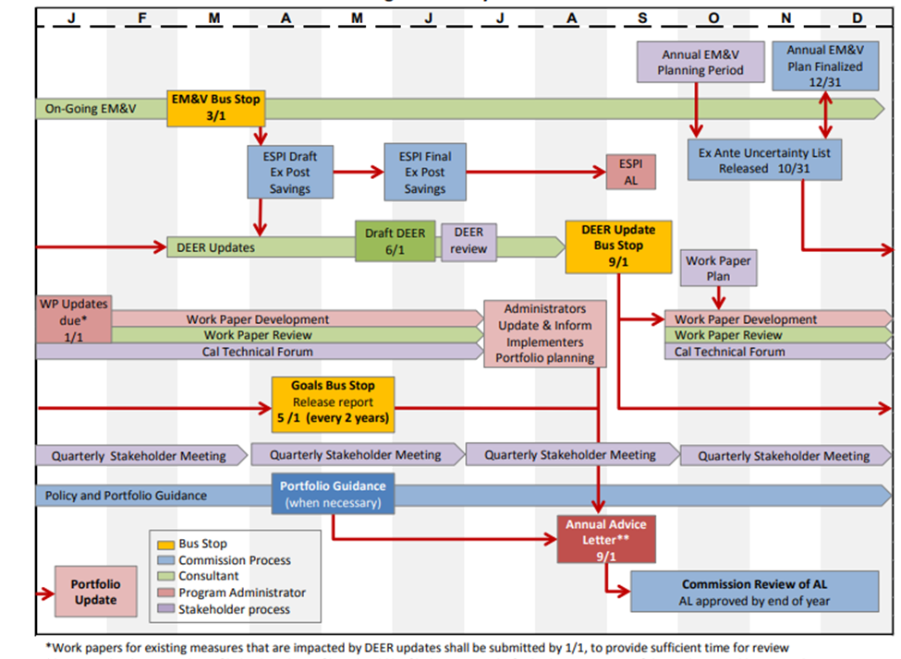
Rolling Portfolio Review Process

Slide 14
Why does the Rolling Portfolio Matter to the CPUC workpaper (ex ante) review team?
BUS STOPS were adopted in a Commission Decision
Define Workload management
If we miss the bus stop then wait and get on the next bus stop date

Slide 15
Role of CPUC staff
Not to supplement the utility reviewer
Review and help improve the PA’s internal review efforts to accomplish the Commission’s goals:
Improving the reliability of the savings estimate
Savings are a primary driver of program cost-effectiveness
Ensure compliance with CPUC rules and policies

Slide 16
CPUC Resources and Information
Energy Efficiency CPUC web site
  http://www.cpuc.ca.gov/egyefficiency/
Ex-ante Review material
  http://www.cpuc.ca.gov/General.aspx?id=4132

Slide 17
Dispute Resolution Process
Disputes over Staff Recommendations - D.12-05-015 (page 335) includes a dispute resolution process –
  CPUC staff and PA will meet to reach an agreement (bi-weekly PA and statewide meetings)
  Every six months Commission staff can draft –
    A resolution that identifies disputed values
    PAs can submit comments on the draft resolution

Slide 18
Dispute Resolution Process
Third parties disagree with the program administrators –
  Tap in to resources – CALTF, if still no resolution with the PA, then
  Third Parties can present their case to CPUC (ex ante supervisor and staff lead)
  CPUC Staff will discuss at the bi-weekly workpaper coordination meeting (Step a- previous slide)
  Ex ante team’s guidance and recommendation will be final until the program administrators submit the workpaper and if there is disagreement, then staff will follow Step b (previous slide).

Slide 19
Industrial/ Agricultural Programs and Portfolio Forecasting Section
Ex Ante Staff Lead
Peter Biermayer (Deemed) peter.biermayer@cpuc.ca.gov
Peter Lai (Custom) peter.lai@cpuc.ca.gov
Manisha Lakhanpal (Supervisor) manisha.lakhanpal@cpuc.ca.gov

Slide 20
Workpaper (WP)Development Training
Thursday November 29, 2018
3RD PARTY WORKPAPER DEVELOPMENT TRAINING

Slide 21

Agenda
Objectives:
  Introduce 3rd Party Implementers (3Ps) to the tools/information they need to develop their own Workpapers (WPs)
  Clarify roles & responsibilities around WP development
  Describe the process and timing for review and approval of 3P WP
3RD PARTY WORKPAPER DEVELOPMENT TRAINING

Slide 22
Tools/Information Needed to Develop WPs
Thursday November 29, 2018
3RD PARTY WORKPAPER DEVELOPMENT TRAINING

Slide 23

You Have an Innovative Idea…Now What?
HVAC
Lighting
Plug Load
Innovative Idea
Deemed
Custom
Technology 3
Technology 4
Technology 1
Technology 2
3RD PARTY WORKPAPER DEVELOPMENT TRAINING

Slide 24
WP Development Hierarchy
1.
Database for Energy Efficiency Resources (DEER)
2.
Existing CPUC Approved Non-DEER WPs
3.
3rd Party WP Creation
  Is there a similar measure in DEER?
  Is there an existing Non-DEER WP for this measure?
  Is it creating a new WP or modifying an existing WP?
3RD PARTY WORKPAPER DEVELOPMENT TRAINING

Slide 25

1. What is DEER?
DEER – Database for Energy Efficiency Resources
  Administered and Maintained by the CPUC
  Provides estimates of energy savings potential for typical energy efficiency measures commonly installed in the marketplace
  URL: http://deeresources.com/
3RD PARTY WORKPAPER DEVELOPMENT TRAINING

Slide 26
1. What is DEER?
DEER – Database for Energy Efficiency Resources
  URL: http://deeresources.com/
  DEER prototypes, underlying workbooks and calculators used with MAS Control system for core set of deemed/prescriptive measures
  READi tool provides an interface to DEER
  Developed, ran and maintained for the CPUC
3RD PARTY WORKPAPER DEVELOPMENT TRAINING

Slide 27
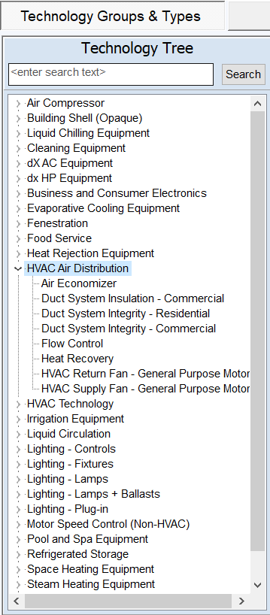
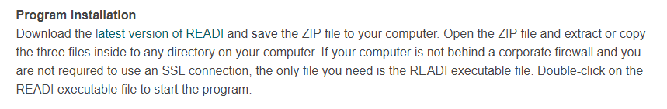
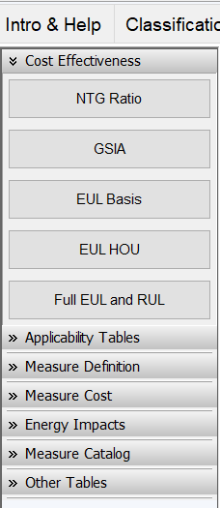
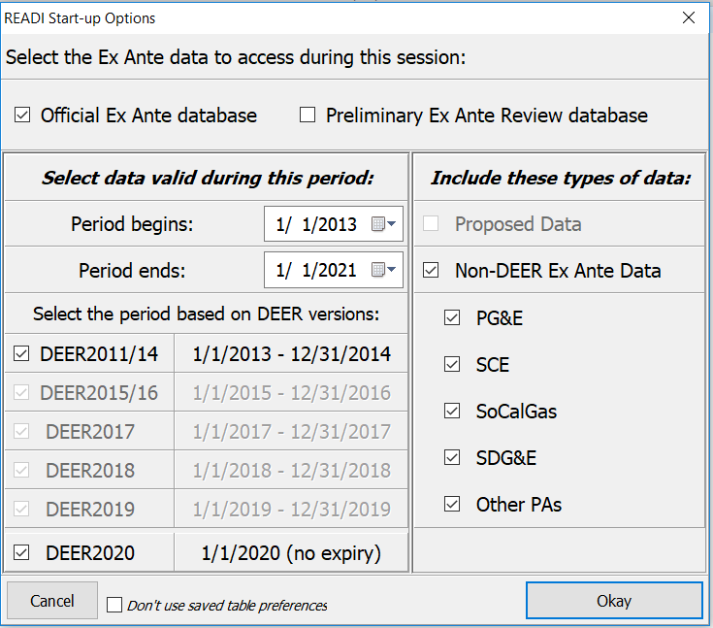
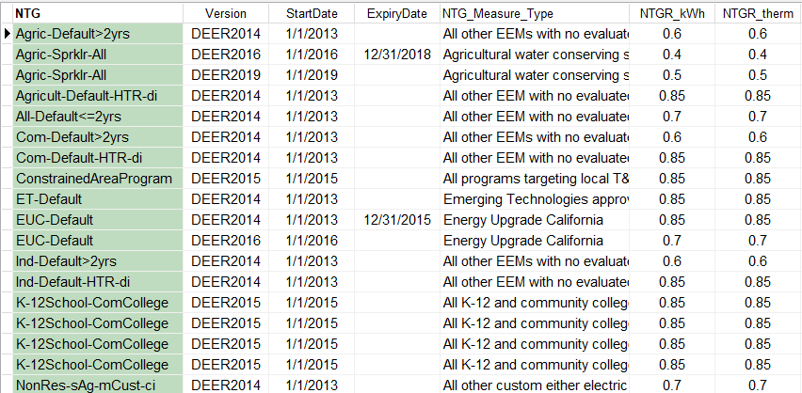
1. Where to Find DEER References?
URL: http://deeresources.com/index.php/deer-versions/readi
3RD PARTY WORKPAPER DEVELOPMENT TRAINING

Slide 28
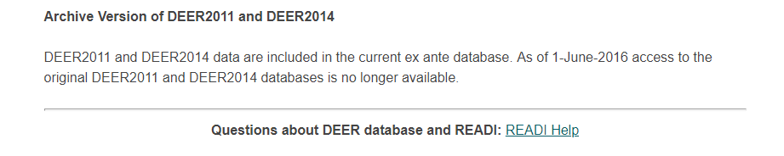
1. Questions About DEER and REAdi?
URL: http://deeresources.com/index.php/deer-versions/readi
3RD PARTY WORKPAPER DEVELOPMENT TRAINING

Slide 29

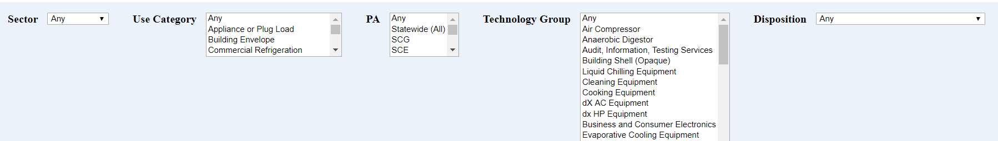
2. What is an Existing Non-DEER WP
Documentation prepared to substantiate the
  Data, methods, and rational used for ex-ante values
Ex-Ante Values:
  Estimated values used to support energy savings claims before impact evaluation is conducted
Non-DEER WPs are generated when
  DEER values, assumptions and methods are not available
URL: http://www.deeresources.net/
3RD PARTY WORKPAPER DEVELOPMENT TRAINING

Slide 30
2. What is an Existing Non-DEER WP
Document Archive of Ex-Ante Resources
  Workpaper Disposition & Archive Site
  URL: http://www.deeresources.net/
  Inventory of Non-DEER WPs and Dispositions
  CPUC selects and vets fully developed WPs, then dispositions or approves
  WP measures sometimes are migrated into DEEER (WP Retired)
=> Annual DEER Update process impacts both DEER and WPs
3RD PARTY WORKPAPER DEVELOPMENT TRAINING

Slide 31


3. Third Party (3P) WP Creation?
Create New or Modify Existing WP?
Considerations
1. Was the Hierarchy Followed?
2. Do I have sufficient data to support the wp for consideration?
3. Do I have the resources and expertise to do this?
3RD PARTY WORKPAPER DEVELOPMENT TRAINING

Slide 32


3. Third Party (3P) WP Creation?
Hypothetical
Considerations
1. Was DEER or CPUC Approved WPs Referenced?
2a. Deviating from DEER or WPs?
2b. Sufficient data to support the wp development?
3a. Appropriate staff and competency to develop the wp?
3b. Outsource?
3RD PARTY WORKPAPER DEVELOPMENT TRAINING

Slide 33
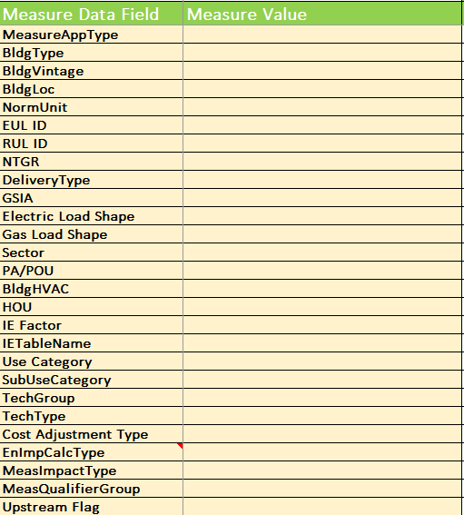


Mechanics for Development of Successful WP
Statewide WP Templates and Tools
  Word Document
  Excel Data Spec
  QA/QC Checklist
  PG&E Rulebook
3RD PARTY WORKPAPER DEVELOPMENT TRAINING

Slide 34
Important Note: Measure Application Type (MAT)
A categorization of energy efficiency measures based on measure attributes
Each MAT has its own baseline treatment, cost basis, eligibility, and documentation requirements. There are six approved measure application types, which include:
  Accelerated Replacement
  Add-On Equipment
  Behavioral, Retrocommissioning and Operational (BRO)
  New Construction/New Capacity,
  Normal Replacement
  Weatherization
3RD PARTY WORKPAPER DEVELOPMENT TRAINING

Slide 35
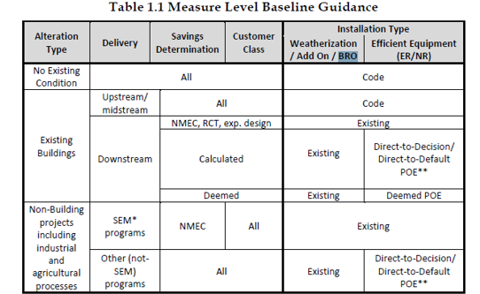
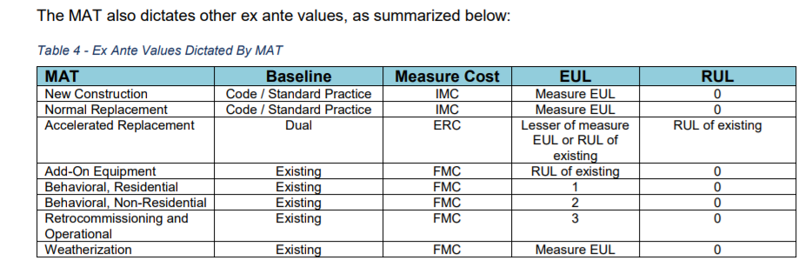
Important Note: Measure Application Type (MAT)
Resolution E-4818.
Measure level baseline assignment and preponderance of evidence (POE) guidance to establish eligibility for an accelerated replacement baseline treatment
3RD PARTY WORKPAPER DEVELOPMENT TRAINING

Slide 36
Walk Thru of Normal
Replacement (NR) Example
Thursday November 29, 2018
3RD PARTY WORKPAPER DEVELOPMENT TRAINING

Slide 37
Example Normal Replacement Measure
MAT: Normal Replacement (NR)
  Formerly Known as Replace on Burnout (ROB)
A majority of the deemed portfolio offering wps support this MAT
Example WP: Commercial Foodservice: Griddles
3RD PARTY WORKPAPER DEVELOPMENT TRAINING

Slide 38
Example Normal Replacement Griddle Measure
MAT: Normal Replacement (NR)
  Includes measure installations where the existing equipment has failed or no longer meets current or anticipated needs or is being replaced due to remodeling, upgrading, or replacement activities that are undertaken in the normal course of business.
  Measure installations where the existing equipment is still functional but does not qualify for Accelerated Replacement fall into this category.
  Commercial Foodservice Griddles are NR measures
3RD PARTY WORKPAPER DEVELOPMENT TRAINING

Slide 39
Walk Thru of Normal
Replacement (NR) Example – Data Fields
Thursday November 29, 2018
3RD PARTY WORKPAPER DEVELOPMENT TRAINING

Slide 40
Example Normal Replacement Griddle Measure (SUMMARY)
Building Type: Any
  Refers to applicable building types
Building Vintage: Any
  Refers to the applicable building vintage year
Building Location: Any
  Refers to the applicable CEC Climate Zones
EUL ID: Cook-ElecGriddleCook-GasGriddle
  Refer to the DEER Database EUL Support Tables
RUL ID: N/A
  Refer to the DEER Database EUL Support Tables
3RD PARTY WORKPAPER DEVELOPMENT TRAINING

Slide 41
Example Normal Replacement Griddle Measure
Building Type: Any
  Workpapers must indicate which building types are eligible for the measure and include the associated savings for each eligible building type.
  Eligible DEER building types can be found in the READI database.
  New building types may be proposed to the CPUC for consideration.
  Refers to applicable building types
3RD PARTY WORKPAPER DEVELOPMENT TRAINING

Slide 42
Example Normal Replacement Griddle Measure
Building Vintage: Any
  Refers to the applicable building vintage year
Building Location: Any
  Refers to the applicable CEC 16 Climate Zones
Normal Unit: Len-Ft.
  Refers to applicable cost and energy common unit type.
3RD PARTY WORKPAPER DEVELOPMENT TRAINING

Slide 43
Example Normal Replacement Griddle Measure
Effective Useful Life (EUL ID): Cook-ElecGriddleCook-GasGriddle
  An estimate of the median number of years that the measures installed under the program are still in place and operable.
  Refer to the DEER Database EUL Support Tables
RUL ID: N/A
  An estimate of the median number of years that a measure being replaced under the program would remain in place and operable had the program intervention not caused the replacement.
  Refer to the DEER Database EUL Support Tables
3RD PARTY WORKPAPER DEVELOPMENT TRAINING

Slide 44
Example Normal Replacement Griddle Measure
  Net to Gross Ratio (NTGR): Com-Default> 2yrs
  A ratio or percentage of net program impacts divided by gross or total impacts. Net-to-gross ratios are used to estimate and describe the free-ridership that may be occurring among energy efficiency program participant.
  Refers to appropriate net-to-gross ratio in DEER READI
3RD PARTY WORKPAPER DEVELOPMENT TRAINING

Slide 45
Example Normal Replacement Griddle Measure
  Delivery Channel: PreRebUp
  Upstream – rebate goes to the manufacturer
    Type of program delivery in which an incentive goes to the manufacturer to encourage production and promotion of energy efficiency products in the market.
    Incentive may or may not be passed to the end-use customer
  Delivery Channel: NonUpStrm
  Midstream – rebate goes to the retailer
    Type of program delivery in which incentive goes to the distributor or retailer to encourage promotion of energy efficiency products in the market.
    Incentive may or may not be passed to the end-use customer. Incentive may or may not be passed to the customer. Does not include programs partnering with contractors or installers
3RD PARTY WORKPAPER DEVELOPMENT TRAINING

Slide 46
Example Normal Replacement Griddle Measure
  Delivery Channel: PreRebDown
  Downstream – rebate goes to the end use customer
    Classification of program delivery in which program is delivered by agents or representatives (including installation contractors) that have direct interaction with end-use customers or through a program website.
  Delivery Channel: DirInstall
  Direct Install – Labor and material costs goes to the implementer
    Energy efficiency solutions provided directly to the customer at little or no cost through installation contractors provided and managed by an Implementer
3RD PARTY WORKPAPER DEVELOPMENT TRAINING

Slide 47
Example Normal Replacement Griddle Measure
  Gross Savings Installation Adjustment (GSIA): Def-GSIA
  The GSIA is a DEER adjustment factor that combines the Realization Rate and Installation Rate. It is dependent on both the measure technology and how the measure is delivered and represents the percentage of units for which incentives were paid but not installed.
  The default is typically 1.0 unless an ex-post impact evaluation, disposition, resolution or DEER Update indicate otherwise
3RD PARTY WORKPAPER DEVELOPMENT TRAINING

Slide 48
Example Normal Replacement Griddle Measure
Electric and Gas Load Shapes:
    Commercial Griddle Electric: Currently varies by PA
    Commercial Griddle Gas: Annual
  Load shapes are used for portfolio lifecycle cost analysis. A load shape indicates the distribution of a measure’s energy savings over one year.
  A load shape is a set of fractions summing to unity, with one fraction per hour (or other time period). Multiplying a savings value by the load shape value for any particular hour yields the energy savings for that particular hour.
  Implementers may use and report only load shapes provided in DEER.
  Alternatively, a weighted blend of DEER load shapes based on metered data may be calculated and provided.
3RD PARTY WORKPAPER DEVELOPMENT TRAINING

Slide 49
Example Normal Replacement Griddle Measure
Sector: Ag, Com, Ind
  Customer groups sharing common characteristics and barriers that are building blocks to each Program Administrators’ portfolios including:
    Residential (Res)
    Commercial (Com)
    Public (Pub)
    Industrial (Ind)
    Agricultural (Agr)
    Cross-Cutting (CC)
PA/POU: Any
  Identifies applicable program administrators participating in this deemed measure.
Bldg HVAC: Any
  Identifies applicable HVAC system for that building type
  Refer to the DEER Database for applicable HVAC systems
3RD PARTY WORKPAPER DEVELOPMENT TRAINING

Slide 50
Example Normal Replacement Griddle Measure
Hours of Use (HOU): Blank
  For applicable measures (i.e. lighting), hours of use or operation are documented.
  Use the operating hours values and methods from the most recent version of DEER if the measure values are available.
Interactive Effect (IE) Factor: No
  The secondary energy and demand impacts that result from a measure to a or Interactive Effects secondary system or equipment not directly involved in the retrofit activity (e.g., cooling or heating energy impacts resulting from the installation of efficient lighting fixtures).
Interactive Effects Table Name: Blank
  Identify the applicable IE table name, otherwise if not applicable leave blank.
3RD PARTY WORKPAPER DEVELOPMENT TRAINING

Slide 51
Example Normal Replacement Griddle Measure
Ex-Ante Data
  Estimated savings, cost, incentive, effective useful life, net-to-gross ratio, and other values that are the basis of the savings claim. These values reflect the Program Administrator’s (PA’s) reported savings, which may be revised with an impact evaluation
Additional Ex-Ante Data Fields
  Use Category: FoodServ
  SubUseCategory: Cooking
  TechGroup: Cook_equip
  TechType: Griddle
  Cost Adjustment Type: EL50 or None
  Energy Impact Calculation Type: Standard
  Measure Impact Type: Deemed, Standard or IOU-Deemed
  Measure Qualifier Group: None
  Upstream Flag: No Value
3RD PARTY WORKPAPER DEVELOPMENT TRAINING

Slide 52
Walk Thru of Accelerated
Replacement (AR) Example
Thursday November 29, 2018
3RD PARTY WORKPAPER DEVELOPMENT TRAINING

Slide 53
Example Accelerated Replacement Measure
MAT: Accelerated Replacement
  Formerly Known as Early Retirement (ER) or Retrofit (RET)
Very few deemed portfolio offering wps support this MAT
  Burden of Proof: Preponderance of Evidence (POE)
    Evidence shows a Perceptible Tipping of the Scales
Example WP: Residential Pool Pump VFD
3RD PARTY WORKPAPER DEVELOPMENT TRAINING

Slide 54
Example Accelerated Replacement Measure
MAT: Accelerated Replacement (AR)
  Early Retirement (ER)
      The ER category is a sub-type of the larger Accelerated Replacement category, which includes replacements of existing equipment with nominally higher efficiency equipment and where there is more evidence than not that
        a) the existing equipment would have remained in operation for at least the remaining life of the existing equipment, performing its current service requirement and
        b) the energy efficiency program activity induced or accelerated the equipment replacement. The existing equipment must have at least one year of remaining useful life to qualify as Early Retirement.
3RD PARTY WORKPAPER DEVELOPMENT TRAINING

Slide 55
Example Preponderance of Evidence Requirements
Thursday November 29, 2018
3RD PARTY WORKPAPER DEVELOPMENT TRAINING

Slide 56
Example Accelerated Replacement Measure
MAT: Accelerated Replacement (AR)
  Examples on How to Demonstrate POE Requirements for AR Measures
    Include dialogue from previous customer/IOU meetings showing how the IOU accelerated the early retirement of the existing measure.
      Include meeting dates and participant names.
      Provide details on the high efficiency measure/s that were proposed by the IOU.
      State some of the program features that the IOU educated the customer/s on that they were previously unaware of.
    Provide simple payback calculations with and without the IOU incentive.
    Provide documentation of any additional drivers for the project not related to energy efficiency.
    Provide documentation of any preliminary measurements performed for the customer by the IOU.
3RD PARTY WORKPAPER DEVELOPMENT TRAINING

Slide 57
Example Accelerated Replacement Measure
MAT: Accelerated Replacement (AR)
  Examples on How to Demonstrate POE Requirements for AR Measures
    General Customer Information
    Existing Equipment – collected for Early Retirement Install Type Only
      Brand
      Model Number
      Horsepower
      Filtration Settings
      Customer Acknowledgement of Pool Pump Settings
      Installation Contractor Declaration
3RD PARTY WORKPAPER DEVELOPMENT TRAINING

Slide 58
Example Accelerated Replacement Measure
MAT: Accelerated Replacement (AR)
  Examples on How to Demonstrate POE Requirements for AR Measures
    Preponderance of Evidence (POE) Questionnaire – collected for Early Retirement Install Type only
      Questionnaire to answer POE concerns related to the installation of the Pool Pump.
3RD PARTY WORKPAPER DEVELOPMENT TRAINING

Slide 59
Walk Thru of Accelerated
Replacement (AR) Example – Data Fields
Thursday November 29, 2018
3RD PARTY WORKPAPER DEVELOPMENT TRAINING

Slide 60
Example Accelerated Replacement
Residential Pool Pump VSD (SUMMARY SLIDE)
Building Type: MFm (Multifamily)
  Refers to applicable building types
Building Vintage: Any
  Refers to the applicable building vintage year
Building Location: Climate Zone 9
  Refers to the applicable CEC Climate Zones
EUL ID: OutD-PoolPump
  Refer to the DEER Database EUL Support Tables
RUL ID: OutD-PoolPump
  Refer to the DEER Database EUL Support Tables
3RD PARTY WORKPAPER DEVELOPMENT TRAINING

Slide 61
Example Accelerated Replacement
Residential Pool Pump VSD
Building Type: MFm (Multifamily)
  Workpapers must indicate which building types are eligible for the measure and include the associated savings for each eligible building type.
  Eligible DEER building types can be found in the READI database.
  New building types may be proposed to the CPUC for consideration.
  Refers to applicable building types
3RD PARTY WORKPAPER DEVELOPMENT TRAINING

Slide 62
Example Accelerated Replacement
Residential Pool Pump VSD
Building Vintage: Any
  Refers to the applicable building vintage year
Building Location: Climate Zone 9
  Refers to the applicable CEC 16 Climate Zones
Normal Unit: Pump
  Refers to applicable cost and energy common unit type.
3RD PARTY WORKPAPER DEVELOPMENT TRAINING

Slide 63
Example Accelerated Replacement
Residential Pool Pump VSD
Effective Useful Life (EUL ID): OutD-PoolPump
  An estimate of the median number of years that the measures installed under the program are still in place and operable.
  Refer to the DEER Database EUL Support Tables
RUL ID: OutD-PoolPump
  An estimate of the median number of years that a measure being replaced under the program would remain in place and operable had the program intervention not caused the replacement.
  Refer to the DEER Database EUL Support Tables
3RD PARTY WORKPAPER DEVELOPMENT TRAINING

Slide 64
Example Accelerated Replacement
Residential Pool Pump VSD
  Net to Gross Ratio (NTGR): Res-Default>2
  A ratio or percentage of net program impacts divided by gross or total impacts. Net-to-gross ratios are used to estimate and describe the free-ridership that may be occurring among energy efficiency program participant.
  Refers to appropriate net-to-gross ratio in DEER READI
3RD PARTY WORKPAPER DEVELOPMENT TRAINING

Slide 65
Example Accelerated Replacement
Residential Pool Pump VSD
  Delivery Channel: PreRebDown
  Downstream – rebate goes to the end use customer
    Classification of program delivery in which program is delivered by agents or representatives (including installation contractors) that have direct interaction with end-use customers or through a program website.
3RD PARTY WORKPAPER DEVELOPMENT TRAINING

Slide 66
Example Accelerated Replacement
Residential Pool Pump VSD
  Gross Savings Installation Adjustment (GSIA): Def-GSIA
  The GSIA is a DEER adjustment factor that combines the Realization Rate and Installation Rate. It is dependent on both the measure technology and how the measure is delivered and represents the percentage of units for which incentives were paid but not installed.
  The default is typically 1.0 unless an ex-post impact evaluation, disposition, resolution or DEER Update indicate otherwise
3RD PARTY WORKPAPER DEVELOPMENT TRAINING

Slide 67
Example Accelerated Replacement
Residential Pool Pump VSD
Electric and Gas Load Shapes:
    Residential Pool Pump VSD Electric: Residential Pool Pumps
  Load shapes are used for portfolio lifecycle cost analysis. A load shape indicates the distribution of a measure’s energy savings over one year.
  A load shape is a set of fractions summing to unity, with one fraction per hour (or other time period). Multiplying a savings value by the load shape value for any particular hour yields the energy savings for that particular hour.
  Implementers may use and report only load shapes provided in DEER.
  Alternatively, a weighted blend of DEER load shapes based on metered data may be calculated and provided.
3RD PARTY WORKPAPER DEVELOPMENT TRAINING

Slide 68
Example Accelerated Replacement
Residential Pool Pump VSD
Sector: Res
  Customer groups sharing common characteristics and barriers that are building blocks to each Program Administrators’ portfolios including:
    Residential (Res)
    Commercial (Com)
    Public (Pub)
    Industrial (Ind)
    Agricultural (Agr)
    Cross-Cutting (CC)
PA/POU: SCE
  Identifies applicable program administrators participating in this deemed measure.
Bldg HVAC: Any
  Identifies applicable HVAC system for that building type
  Refer to the DEER Database for applicable HVAC systems
3RD PARTY WORKPAPER DEVELOPMENT TRAINING

Slide 69
Example Accelerated Replacement
Residential Pool Pump VSD
Hours of Use (HOU): Blank
  For applicable measures (i.e. lighting), hours of use or operation are documented.
  Use the operating hours values and methods from the most recent version of DEER if the measure values are available.
Interactive Effect (IE) Factor: No
  The secondary energy and demand impacts that result from a measure to a or Interactive Effects secondary system or equipment not directly involved in the retrofit activity (e.g., cooling or heating energy impacts resulting from the installation of efficient lighting fixtures).
Interactive Effects Table Name: Blank
  Identify the applicable IE table name, otherwise if not applicable leave blank.
3RD PARTY WORKPAPER DEVELOPMENT TRAINING

Slide 70
Example Accelerated Replacement
Residential Pool Pump VSD
Ex-Ante Data
  Estimated savings, cost, incentive, effective useful life, net-to-gross ratio, and other values that are the basis of the savings claim. These values reflect the Program Administrator’s (PA’s) reported savings, which may be revised with an impact evaluation
Additional Ex-Ante Data Fields
  Use Category: Recreate
  SubUseCategory: Pool
  TechGroup: PoolSpa_eq
  TechType: PoolPump
  Cost Adjustment Type: M50
  Energy Impact Calculation Type: Standard
  Measure Impact Type: Deemed
  Measure Qualifier Group: None
  Upstream Flag: No Value
3RD PARTY WORKPAPER DEVELOPMENT TRAINING

Slide 71
Walk Thru of WP
Word Document Sections
Thursday November 29, 2018
Let’s revisit our tools and templates
3RD PARTY WORKPAPER DEVELOPMENT TRAINING

Slide 72
Roles and Responsibilities
Thursday November 29, 2018
3RD PARTY WORKPAPER DEVELOPMENT TRAINING

Slide 73
Roles and Responsibilities
Relevant Stakeholders
  CPUC Energy Division Staff and Ex-Ante Review (EAR) Team
  Program Administrators
    Investor-Owned Utilities (IOU)
    Regional Area Networks (RENs)
  California Technical Forum (CalTF) Members and Staff
    Serve as a support role at this time only
3RD PARTY WORKPAPER DEVELOPMENT TRAINING

Slide 74
Roles and Responsibilities
To Develop or Outsource WP Development?
  Develop
    Pros: In-house institutional knowledge gained
    Cons: 3P’s own time and money
  Outsource
    Pros: Consulting entity are familiar with content and process requirements
    Cons: Costs and no in-house institutional knowledge gained
PA WP Development Support (Scope Limited Solicitation Purposes Only)
    Pros: No costs to the 3P
    Cons: Timing of wp development may be shifted based on priorities
    Remember: This is a partnership between the PAs and the 3rd Party Implementer
3RD PARTY WORKPAPER DEVELOPMENT TRAINING

Slide 75
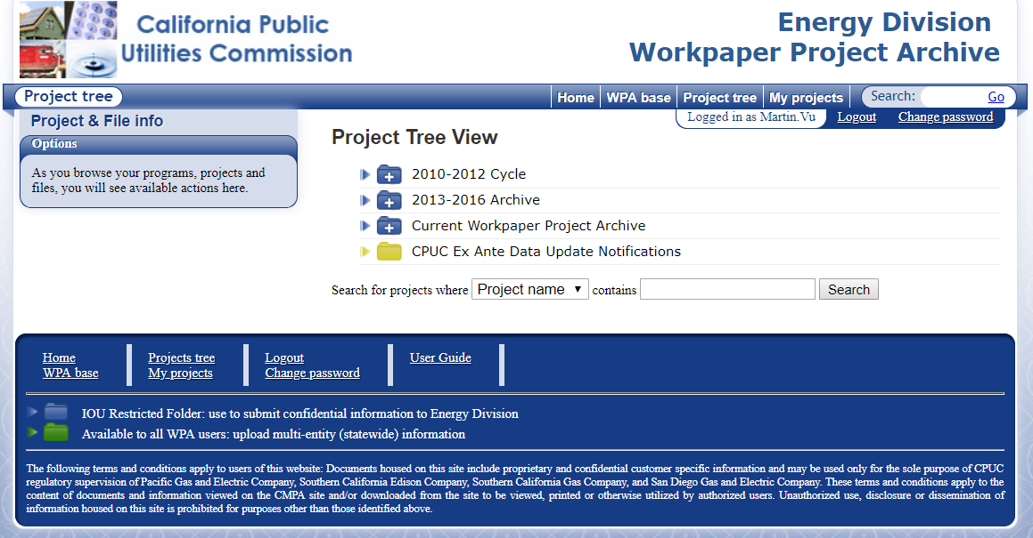
Roles and Responsibilities
Who Maintains the WP after Development and Approval
  Depends on New DEER, Code, Disposition or Resolution Updates
  4-Ex-Ante Tables
    PAs will maintain
    https://deeresources.info/wpa/tree
3RD PARTY WORKPAPER DEVELOPMENT TRAINING

Slide 76
Process and Timing of WP Review and Approval
Thursday November 29, 2018
3RD PARTY WORKPAPER DEVELOPMENT TRAINING

Slide 77
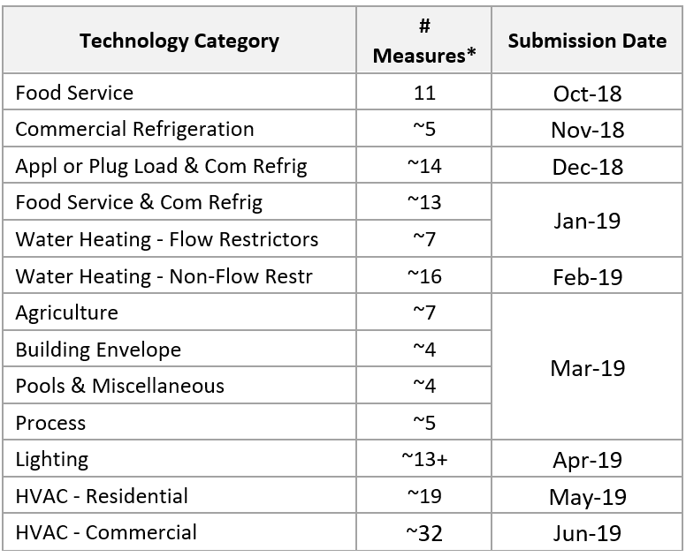
Process and Timing of WP Review and Approval
New Measures, Consolidated Measures
e-TRM Spec and Matrix
    Timing of Consolidated Measure List Release and Impact to 3P WP Development
3RD PARTY WORKPAPER DEVELOPMENT TRAINING

Slide 78
Process and Timing of WP Review and Approval
Consolidated Measures List
  Measures will be submitted in phases through beginning of 2019
  Expected approval of all by end of July 2019
    For use starting January 1, 2020
  3Ps will have access to this list after they are CPUC approved
  Approval is expected 45 days after (or 2 months)
  Conclusion: Consider waiting for approvals before using this in 3P submittal
3RD PARTY WORKPAPER DEVELOPMENT TRAINING

Slide 79

IOU Solicitation WP Review Process
Statewide Workpaper Process for Third Parties
November 2018

Slide 80
Workpaper (WP) Approval Timing
Question | Response
When are workpapers (WPs) for new measures required to be submitted and approved? Specifically, are approved measures required for program proposals? | Solicitation process for workpapers will vary by IOU. SCE: Solicitation respondents must use approved WP and/or DEER values to justify energy efficiency savings in their proposal. In the RFA stage, SCE may consider abstracts with non-approved workpapers (WPs) or WP updates that are currently in process. These RFA proposals will be reviewed on a case-by-case basis. WPs need to be approved by the CPUC prior to an RFP proposal being submitted. SCE will not contract 3rd Parties without CPUC approved WPs. SCG, PG&E, and SDG&E: Solicitation respondents must use approved WP and/or DEER values to justify energy efficiency savings at the time of program launch. In the RFA and RFP stage, SCG, PG&E, and SDG&E, may consider abstracts with non-approved workpapers (WPs) or WP updates that are currently in process. These RFA & RFP proposals will be reviewed on a case-by-case basis dependent upon risk of program delivery. WPs need to be approved by the CPUC prior to use in a program.
Notes:
Phase 2 Workpapers – 3.2.5 D11 decision – Non-DEER Measures not already identified as HIMs previously. How do we define HIM going forward? Do due diligence of phase 1 and phase 2. If > 1%, it’s HIM.
SDGE – WP approvals not necessarily needed at RFP contract award.
Statewide Programs – IOUs are different. Lead IOU will dictate requirements.
SCG – Want approved workpaper before 3rd parties offer in programs
RFP, Award, Launch – Timelines are different.
SCG & SCE – RFP submittal
SDGE & PGE – Launch, provided that majority
SCE & SCG: Solicitation respondents must use approved WP and/or DEER values to justify energy efficiency savings in their proposal. In the RFA stage, SCE and SCG may consider abstracts with non-approved workpapers (WPs) or WP updates that are currently in process. These RFA proposals will be reviewed on a case-by-case basis.
WPs need to be approved by the CPUC prior to an RFP proposal being submitted.
SCE and SCG will not contract 3rd Parties without CPUC approved WPs.
PG&E & SDG&E: Solicitation respondents must use approved WP and/or DEER values to justify energy efficiency savings at the time of program launch. In the RFA and RFP stage, PG&E and SDG&E may consider abstracts with non-approved workpapers (WPs) or WP updates that are currently in process. These RFA & RFP proposals will be reviewed on a case-by-case basis.
WPs need to be approved by the CPUC prior to program launch. If there are new measures/WPs, the program CET and savings cannot be primarily dependent of these measures due to the timing of the WP final CPUC disposition.
Per 11/7/18 Statewide Meeting

Slide 81
Workpaper (WP) Development Timing with IOUs
3rd Parties should plan enough lead time to work with IOUs to submit WPs to CPUC
WP development time should occur before July to allow IOUs to prepare and submit Annual Advice Letters.
Workpaper submissions to CPUC should be targeted for no later than July 1st.
Third-Party Solicitation Information
  Joint IOU Solicitation Timeline
Notes:
Phase 2 Workpapers – 3.2.5 D11 decision – Non-DEER Measures not already identified as HIMs previously. How do we define HIM going forward? Do due diligence of phase 1 and phase 2. If > 1%, it’s HIM.
SDGE – WP approvals not necessarily needed at RFP contract award.
Statewide Programs – IOUs are different. Lead IOU will dictate requirements.
SCG – Want approved workpaper before 3rd parties offer in programs
RFP, Award, Launch – Timelines are different.
SCG & SCE – RFP submittal
SDGE & PGE – Launch, provided that majority
SCE & SCG: Solicitation respondents must use approved WP and/or DEER values to justify energy efficiency savings in their proposal. In the RFA stage, SCE and SCG may consider abstracts with non-approved workpapers (WPs) or WP updates that are currently in process. These RFA proposals will be reviewed on a case-by-case basis.
WPs need to be approved by the CPUC prior to an RFP proposal being submitted.
SCE and SCG will not contract 3rd Parties without CPUC approved WPs.
PG&E & SDG&E: Solicitation respondents must use approved WP and/or DEER values to justify energy efficiency savings at the time of program launch. In the RFA and RFP stage, PG&E and SDG&E may consider abstracts with non-approved workpapers (WPs) or WP updates that are currently in process. These RFA & RFP proposals will be reviewed on a case-by-case basis.
WPs need to be approved by the CPUC prior to program launch. If there are new measures/WPs, the program CET and savings cannot be primarily dependent of these measures due to the timing of the WP final CPUC disposition.
Per 11/7/18 Statewide Meeting

Slide 82
Workpaper (WP) Development Timing with IOUs
The IOUs development timeline will vary by workpaper. In general, the workpaper development timeline is 8 – 10 months which includes the following activities:
IOU internal governance to assess measure viability for EE portfolio
Possible need for a workpaper plan (new workpapers are expected to propose a workpaper plan to CPUC before drafting workpaper)
Data collection or studies
Preparation of calculations
Preparation of write-up
QA/QC and additional internal governance to confirm measure viability for EE portfolio
Other items to be completed to be ready for CPUC (e.g., ex-ante data tables, IOU system readiness)
CPUC review and approval process
CPUC disposition follow-up
Notes:
Phase 2 Workpapers – 3.2.5 D11 decision – Non-DEER Measures not already identified as HIMs previously. How do we define HIM going forward? Do due diligence of phase 1 and phase 2. If > 1%, it’s HIM.
SDGE – WP approvals not necessarily needed at RFP contract award.
Statewide Programs – IOUs are different. Lead IOU will dictate requirements.
SCG – Want approved workpaper before 3rd parties offer in programs
RFP, Award, Launch – Timelines are different.
SCG & SCE – RFP submittal
SDGE & PGE – Launch, provided that majority
SCE & SCG: Solicitation respondents must use approved WP and/or DEER values to justify energy efficiency savings in their proposal. In the RFA stage, SCE and SCG may consider abstracts with non-approved workpapers (WPs) or WP updates that are currently in process. These RFA proposals will be reviewed on a case-by-case basis.
WPs need to be approved by the CPUC prior to an RFP proposal being submitted.
SCE and SCG will not contract 3rd Parties without CPUC approved WPs.
PG&E & SDG&E: Solicitation respondents must use approved WP and/or DEER values to justify energy efficiency savings at the time of program launch. In the RFA and RFP stage, PG&E and SDG&E may consider abstracts with non-approved workpapers (WPs) or WP updates that are currently in process. These RFA & RFP proposals will be reviewed on a case-by-case basis.
WPs need to be approved by the CPUC prior to program launch. If there are new measures/WPs, the program CET and savings cannot be primarily dependent of these measures due to the timing of the WP final CPUC disposition.
Per 11/7/18 Statewide Meeting

Slide 83
Workpaper (WP) Funding
Question | Response
Who funds the WP development for new measures? | IOUs will fund the development of new WPs and modification of existing WPs, provided that the workpaper is viable for the Energy Efficiency portfolio. For SDG&E only, WPs will be funded for 3rd parties provided that their proposal has been accepted and the contract has been awarded. If a 3rd party chooses to develop their own WP, they assume the cost of developing it. IOUs will assume the cost of reviewing, providing review comments, submitting the paper to the Energy Division, and maintaining the workpaper once CPUC approved.
Notes:
SDG&E – Funding if already proposal awarded
PGE, SCE – Provided workpaper viability – for the purpose of ensuring a cost effective portfolio

Slide 84
Workpaper (WP) Data Specifications
Question | Joint Response
Do you have IOU-specific data specifications? | Yes, IOUs each have unique data specifications to support internal IOU systems. However, IOUs will be responsible for their own unique data specifications. 3rd Parties developing their own workpaper must use the Statewide Workpaper Template, which is available on the CalTF website (http://www.caltf.org/tools/). If the proposed workpaper or workpaper update is viable for the Energy Efficiency portfolio, IOUs will separately develop their unique data specifications and create the CPUC’s required ex ante table specification.

Slide 85
Workpaper Requests - IOU Intake Process
Question | Joint Response
What is the intake process? | This is unique to each IOU. 3rd parties will need to comply with each IOU’s solicitation requirements. 3rd parties should also reference the Statewide IOU lead for workpaper requests.

Slide 86
Statewide IOU Leads
IOU | SW/Local | Sector | Description
PG&E | SW | Residential | Residential New Construction
PG&E | SW | Commercial | Non-Residential New Construction
PG&E | SW | Cross-cutting | WE&T Career and Workforce Readiness
PG&E | SW | Cross-cutting | WE&T K-12 Connections
PG&E | SW | Public | State of CA / Dept. of Corrections
PG&E | SW | Cross-cutting | Codes & Standards - Appliance Standards
SCE | SW | Residential | Residential Lighting Program
SCE | SW | Public | SW - Gov. & Inst. Partnerships and Water/Wastewater Pumping
SCE | SW | Crosscutting | Electric Emerging Technologies
SDG&E | SW | Commercial/Residential | Commercial/Residential HVAC
SDG&E | SW | Residential | PLA
SDG&E | SW | Residential | SW Downstream Residential HVAC Pilot
SoCalGas | SW | Cross-Cutting | SW - Gas Emerging Technologies
SoCalGas | SW | Commercial | SW - Foodservice POS
SoCalGas | SW | Commercial | SW - Midstream Water Heating

Slide 87
Public Posting of Workpapers in Progress
Question | Response
Is there a public process for listing which WPs/measures are under development? Will there be a central, public submission process so I know what measures are in development or in the process of updating? | To maintain the confidentiality of 3rd Parties during the RFP process, the workpapers/measures under development at the request of 3rd Parties will not be publicly listed, until the workpapers/measures are approved and posted to CPUC’s website, http://deeresources.net/workpapers. The IOUs will continue to be responsible for maintaining existing WPs. These WPs are public and as such, the IOUs will provide 3rd parties access to a running list that are under revision. IOUs will post a monthly update to updates to existing WPs or IOU new workpapers on the CalTF website (http://www.caltf.org/statewide-measure-list/)

Slide 88
Workpapers for a Proprietary Technology
Question | Response
Can I develop a workpaper for a proprietary technology? If you are working on a product, is it product centric or product category centric? | Yes. Third Parties may submit a workpaper for a proprietary technology. The workpaper should focus on the technology, rather than the product/brand. Once a workpaper is approved by the CPUC, the workpaper and supporting data are publicly available.

Slide 89
Confidentiality of Proprietary Data
Question | Response
How do I assure that my proprietary data (or program approach or modeling tool) will be kept confidential? | The IOUs take Intellectual Property protection very seriously and are fully committed to keeping bidder proposals confidential before, during, and after the two-stage solicitation process has concluded. In addition, the IOUs are no longer in the position of being the primary program designer, they have an obligation to dedicate a minimum of 60 percent of their portfolios to third-party proposed, designed, and delivered programs. Therefore, there would not be an opportunity for the IOUs to incorporate items from the solicitations into their own programs and meet these compliance requirements. The IOUs expect to need to justify any in-house implementation; it would be difficult for an IOU to justify implementing an offering that was substantially similar to a rejected proposal. Last, there is explicit language in the RFA/RFP and eventual contract that outlines the legal obligations around intellectual property that protects bidders from such an occurrence and provides an opportunity for recourse in the unlikely event there has been a breach. The IOUs will be hosting bidder’s conferences for each RFA to ensure that bidders are informed of these steps to protect intellectual property and have an opportunity to ask questions like this to the solicitation teams. With respect to a bidder’s workpapers, in particular, only Commission-approved WPs become public as they are implemented in approved programs and posted on the public website for all approved workpapers and reported in California Energy Data and Reporting System (CEDARS).

Slide 90
Q&A
Additional information can be found in Workpaper FAQs located here: https://www.pepma-ca.com/Public/Default.aspx

Slide 91
Commission WP Approval Process
Presented by CPUC
California Public Utilities Commission

Slide 92
Outline
WP Process
  WP submission cycle
  WP review and disposition cycle
  Outcomes
WP Review Content

Slide 93
Process: WP Submission Timing
The timing of WP submissions by PAs is regulated by Phase 1 and Phase 2 criteria

Slide 94
Workpapers and the rolling portfolio schedule
Workpaper are submitted and reviewed under two tracks: Phase 1 and Phase 2

Slide 95
Management of WP Submission Flow
November 18, 2009 ALJ Ruling in A.08-07-021 established the Phase 1 and Phase 2 as a method to manage the WP review process
Record of steady refinements in subsequent guidance.
Notes:
PAs are the submitting entity
All WPs affected by DEER updates and the resolution must be submitted by the PAs by January 1
These are Phase I workpapers
The trigger is the DEER update and resolution
All other WPs are submitted on a rolling basis on the 1st and 3rd Monday of the month
These are Phase II workpapers
The trigger is a new workpaper or a revision to an old WP due to non-DEER changes, including CPUC disposition guidance or new data
Phase I submission for PY2020 is an exception
Transition to statewide papers requires submission of the whole portfolio of WPs
Pending CPUC management approval, P1 PY2020 WPs extended to June 2019

Slide 96
What a 3P should know about WP submission timing
There is an orderly process for updating workpapers each year to reflect EM&V results, market, codes/standards and other changes
WP submissions are subject to review by CPUC’s Ex Ante Team
All existing WP are subject to revisions each year due to a DEER update or a resolution outcome
New WPs can be submitted March through December twice a month or as part of Phase 2

Slide 97
MYTH – Workpaper review takes a long time
A well-founded and complete workpaper
  Submitted to CPUC by Jan 1 as a Phase 1 workpaper
    Reviewed and approved by March 1.
  Submitted to CPUC March – December as a Phase 2
    Reviewed and approved or receives an interim approval within 25 days.
PAs procedures may add to the review cycle
  CPUC meets with PAs to discuss workpapers in bi-weekly meetings

Slide 98
Process:
Review Cycle and Outcomes

Slide 99
Review Cycle
The “Workpaper Archive” (WPA) maintains files and timestamps of record
Submissions are uploaded and acknowledged through WPA

Slide 100
Elements of the review cycle
- | Workpaper Purpose | PA Submission Schedule | CPUC Review Period | Effective Date
Phase I | Update WPs affected by DEER (years N+1 and N+2) and resolution changes New WPs with 1/1 PY N+2 start date | By Jan 1, but may also submit in November and December | CPUC has through Mar 1 to review. WPs that have not been reviewed receive interim approval. | Approved workpapers effective Jan 1
 | Contingency for late P1 WP or when guidance is issued for a P1 WP prompting a revision* *Pending CPUC management approval | PA may resubmit a WP revised due to P1 guidance 1st and 3rd Monday of month | CPUC has 25 days or by 3/1 to review, whichever is later. WPs that have not been reviewed receive interim approval. | Approved workpapers Effective Jan 1
 | For SW 2020 papers only, submission period has been extended beyond Jan 1 | Agreed upon monthly submission plan | CPUC has 45 days after WPA Monday time stamp to review. WPs that have not been reviewed receive interim approval. | Approved workpapers effective 1/1/2020, subject to further DEER or resolution updates in 2019
Phase II | New WP or WP revisions due to non-DEER/resolution changes | 1st and 3rd Monday of month with a holiday clause | CPUC has 15 days after WPA Monday time stamp to request additional information (a preliminary review) stopping the clock. The CPUC has an additional 10 days to issue a disposition when there is no outstanding preliminary review request. WPs that have not been reviewed receive interim approval. | Approved workpapers effective upon approval date or upon interim approval date
Notes:
Not the version of the slide for the WP training.

Slide 101
Outcomes of the review
CPUC Review Status Outcome | Description | Notification
Approval | CPUC issues disposition approving WP as submitted. May include direction for future revisions. | PA notified via WPA message. Uploaded to www.deeresources.net as an approved WP.
Interim approval | CPUC chooses not to review WP and the review period times-out. Workpaper subject to future CPUC review with prospective application of results. | Uploaded to www.deeresources.net as an approved WP.
Resubmission required | CPUC issues disposition identifying additional information or specific revisions or additions for ED to make an approval recommendation. May include direction for future revisions. | PA notified via WPA message. Disposition uploaded to WPA and selectively to www.deeresources.net
Rejection | CPUC concludes the measure does not fall within the definition of an energy efficiency measure or does not meet CPUC requirements for inclusion into a utility portfolio. | PA notified via WPA message. Disposition uploaded to WPA and selectively to www.deeresources.net

Slide 102
What a 3P should know about the WP review cycle
The PAs are the entity responsible for the quality of WPs they submit
Communications regarding WPs occurs between the submitting PA and the CPUC via the WPA system
WP review cycles vary in length depending upon the Phase and whether the review is a preliminary or detailed review
Review outcome may require further modification to the workpaper either immediately or in the future
Approved WPs are posted on www.deeresources.net
Notes:
Current process does not allow -

Slide 103
Phase 1 and Phase 2 Summary
Phase 1
Phase 2
Phase 1 WPs are
  Revised WPs due to DEER updates (both years) or resolution updates with a 1/1 start date in N+1
  New WPs with a 1/1 start date in N+2
All WPs are due by 1/1. Submission can occur Nov-Dec.
The Ex Ante Team review period is through 3/1. Those WPs without a formal disposition by 3/1 receive interim approval
Approved WP applies to claims beginning on 1/1 N+1
Phase 2 WPs are
  Revised WP due to non-Deer/resolution changes
  New WPs with a start date other than 1/1 for PY N+2
Submitted March – December
  Downloaded by CPUC 1st and 3rd Monday of the month at which time they are time stamped
  No P2 WPs accepted Jan-Feb
Ex Ante Team review can include
  Preliminary review (15 days after upload). The clock stops with a request for additional information
  Detailed review (25 days after upload)
  Interim approval granted if no guidance is issued
Applies to claims on the WP approval date

Slide 104
WP Review Content
Preliminary Review
Detailed Review
Ex Ante Team Considerations

Slide 105
Phase 2 - Preliminary and Detailed Review
Preliminary review
Detailed Review
Request additional information needed to complete a review of the WP
Preliminary review can also result in a disposition that approves, requires revisions, or rejects WP
Issuing a preliminary review disposition stops the review clock. A 25-day clock is restarted with submission of requested information.
Detailed review of one or more of the WP assumptions or methods
Detailed review can result in a disposition that approves, requires revisions, or rejects the WP
A single disposition may affect multiple workpapers
If a detailed review disposition is not completed before the clock times out, the WP receives interim approval

Slide 106
Structural considerations
Elements of this may be included in the preliminary review
Is this WP necessary?
  Is the measure captured in DEER or in another WP?
    Alternate estimates for existing WPs must meet a high bar for admittance as evidence
  Is this a good measure for a deemed approach?
Is the MAT (measure application type: NR, AR, etc.) applicable to this measure?
  Is the baseline consistent with the MAT?
What are the references?
  Is there a related WP and what is different in this WP?
  If this is a new measure, is it recognized by another authoritative sources?
  Was DEER used for EUL, NTGR, installation rate, other
  Was any previous related disposition guidance acknowledged and addressed

Slide 107
Technical considerations
A subject matter expert (SME) will review WPs.
DEER parameters used appropriately
Credible parameters
  Are the parameters representative of the target population?
  Is the source of population level data reasonable, large enough, and representative of the target population?
  Raw data should be included with WP submittal
Credible methods
  Is the methodology appropriate for the measure?
Preponderance of evidence (PoE)
  Viable data collection process which provides definitive evidence of pre-existing conditions

Slide 108
What a 3P should know about WP content
CPUC reviewers expect reviewable and credible data to support population average estimates
Modification to existing WP parameters and methods must be supported with data that is more recent and of similar or better quality than the prior WP

Slide 109
Questions?

Slide 110
eTRM Demo
Presented by Cal TF
California Technical Forum

Slide 111
Electronic Technical Reference Manual (eTRM):
Path to the New California
“Database of Record”
Ayad Al-Shaikh
Annette Beitel
November 29, 2018

Slide 112
The California Technical Forum (Cal TF)
  What is the Technical Forum?
  A group of in-state and out-of-state technical experts that work in a collaborative and transparent way to review new and updated energy efficiency measures and other technical information related to California’s integrated demand-side management portfolio.
Notes:
Created in 2014 by a broad group of stakeholders and is funded by participating program administrators.
Created to bring a peer review process to California
Realized that there was a need for a technical advisory committee
To bring broader input and perspectives from across our industry
Similar to the RTF in the Northwest
TF Composition:
35 members
Collectively, technical expertise with wide range of energy efficiency technologies, methodologies, modeling, etc.
Includes professionals from outside of California
Cal TF members are selected through a competitive RFQ process
CPUC provided input on selection criteria
with a ~50% selection rate
RFQ issued ~ every 2 years
Expect another RFQ to be issued late this year
Members are independent and don’t represent their entities.
So if a TF member leaves their company, the company doesn’t get to send someone else.
Asked to “render their best professional judgment” when they are selected and made their offer

Slide 113

















The Cal TF
A Broad Collaborative
CPUC Office of Ratepayer Advocates
Notes:
The Cal TF Policy Advisory Committee determines the Cal TF vision, mission, guiding principles, and annual Business Plan.
These are the PAC organizations
They are statewide energy efficiency stakeholders
The representatives are senior leaders from key organizations in the state
They are not independent – they represent their organizations
They don’t render technical judgement
The TF is also supported by Cal TF staff who facilitate the technical review process and maintain a website of Cal TF materials and TF recommendations.

Slide 114
What is the eTRM?
The California electronic Technical Reference Manual (eTRM) will be a single repository for all California statewide deemed energy efficiency measures
  Single repository for all approved deemed measures and associated information (DEER, non-DEER workpapers)
  Also includes POU TRM information
An online relational database, will significantly improve deemed measure transparency, development and updating.
Notes:
This is the California eTRM not to be confused with other uses of the term.
DEER is California’s current repository of deemed measures.
But it was developed in the early 1990s
and has been added onto as the needs have grown
But has never been completely overhauled
As a result, it is very difficult to find information
eTRM will us relational database structure which will link the different data elements together (savings, NTG, EUL, etc)
And allow us to present supporting information like calculations and references
It will also have workflow functions so developers can input measures, run them through their QA QC processes then send to the CPUC and EAR teams for their reviews
Cal TF is in the middle of consolidating all of the IOU and POU measures into single, statewide consistent measures
They will populate the eTRM and be available by mid-January
Once adopted, a measure currently only available in one service territory will be available statewide
One caveat, the utilities have the final say as to whether a measure is accepted in their service territories.
For instance, there are some measures that the POUs rebate but the IOUs don’t.
Need to work out where this is communicated
Measure Consolidation fulfills an old CPUC mandate to make measures statewide.
The time is ripe for a SW eTRM since we are transitioning to statewide and SW 3P programs.

Slide 115
The eTRM
Supports Policy Objectives
Since 2012, the Commission has directed utilities to prepare statewide workpapers.
We agree that similar measures delivered by similar activities should have single statewide values [emphasis added] unless recent evaluations show that a significant variation between utilities and that difference is supported by a historical trend of evaluation results. (D.12-05-015, p. 54)
Commission Staff guidance to utilities for 2017 workpapers in the Ex Ante Team 2017 Workpaper Guidance Memo:
Statewide Workpapers: Only one workpaper may be submitted for each set of programs/measures which are adopted by more than one program administrator; such workpapers have been termed “statewide workpapers” and program administrators have been directed to collaborate on such efforts. (p.7)
Direct regulatory support is contained in the Phase 2A decision in the Rolling Portfolio proceeding
“.. to improve the usability and transparency of all ex ante values… a common platform for all PAs to compose savings estimates transparently and consistent with Commission direction… should be focused on opportunities to facilitate transparency and collaboration. ”
Notes:
There are a number of policy objectives that the eTRM will fulfill
The big one is that since 2012 the Commission has wanted to see statewide measures instead of individual IOU measures.
This has come up a few times
The Commission has also asked for:
Transparency of ex ante values
A common platform for measures

Slide 116
Key eTRM Benefits
Single Repository for All Deemed Measures
  No more Steps 1,2,3
Single Set of Statewide, Deemed Measures
  No more multiple different workpapers for a single measure.
All Measures are Fully Documented and Reproducible
  All measure parameters for a single measure linked (savings, EUL, NTG, delivery, etc)
  Measure parameters linked to supporting sources
  Source documents are clearly cited and hosted in the eTRM
Notes:
Numerous benefits of the eTRM.
This is an overview of the benefits and I’ll break them down by user type in subsequent slides.
All Measures are Fully Documented and Reproducible
Part of the measure consolidation process has been to harmonize the text documents so they clear, complete and easy to understand
We’ve also tracked down all of the documents for the citations so you’ll have the actual document in the eTRM
Our editor took pains to make the language clear and also identified areas that needed support or explanation
Automates Measure Updates when Inputs Change—Weather Files, Code Updates, Etc.
Because it’s relational database, you can update a value or table and it will cascade down to every use of that value
Clear and Documented Workflow Management
Behind the scenes, there will be functionality for developing measures
The QA QC requirements will be baked in with roles for peer reviewer and manager review/approval
There will also be the ability for the CPUC staff and their EAR team to conduct their reviews
When the measure is fully approved, it will be published so it can be viewed and used.
Generates All Key Outputs (Ex Ante Data)
The current measure updating process is very resource intensive.
The updates happen in DEER
Then the IOUs have to comb through their work papers to change those parameters in their documents.
The eTRM will replace the individual IOU work papers
So the EAR team will be able to make the changes directly in the eTRM, it will effectively be making them for all the IOUs
The utilities will be able to access the updated information directly from eTRM through APIs that link the data to the utility reporting systems
Differential Access
I’ve alluded to this in a few places
There will be access levels for the different roles like
Members of the industry/public who just want to view the measure data
Engineering firms who are hired to develop measures
Cal TF staff who have to administer the system
Some IOU staff will likely have roles similar to the Cal TF staff so they can track progress of measures
CPUC staff and their EAR consultants will have review and approval rights.

Slide 117
Key eTRM Benefits
Automatic Updating
  No more manual updating of individual utility workpapers
  Changes that apply to multiple measures or all measures will occur automatically
  Includes clear update and revision histories for each measure
Clear and Documented Workflow Management
  Identifies who has updated and/or reviewed a measure
Statewide Consistency
  Consistent baselines and measure definitions, units, methods, adjustment factors, etc.
  Statewide naming conventions
  Consistent, detailed descriptions
Notes:
Slightly repetitive. This re-states the value proposition for program designers/implementers.
Statewide Applicability & Consistency
No gaps in utility service territories or climate zones
The measure offerings are consistent statewide: we’ve harmonized the baselines and measure definitions, units, methods, adjustment factors, etc.
I’ll also mention here that the POUs are on board with the eTRM so the measures extend all the way across the state
We’ve created statewide naming conventions
This will be essential for third-parties to effectively design and implement an increasing share of the EE portfolio
Transparent and Fully Documented
I mentioned in the last slide that the eTRM is a relational database so all of the values like NTG and EUL are linked together
The sources are linked and actual documents provided
It’s important to note that through the measure consolidation process, we’ve taken great care to create clear, concise explanations of impact and cost analyses and key measure information
Easily Accessible
It will be available via the web
Have a user-friendly interface
All measure values/information, review disposition, etc. in a single platform so you won’t have to search through multiple documents

Slide 118
Demo Summary
Single Repository for All Deemed Measure
Single Set of Statewide, Deemed Measures
All Measures are Fully Documented and Reproducible
Automatic Updating
Clear and Documented Workflow Management
Statewide Consistency

Slide 119
Feedback
We welcome your feedback on eTRM platform
www.CalTF.org

