Slide 1
R13-12-011 Water Nexus Pilot
San Diego Gas & Electric
January 19, 2016

Slide 2
R13-12-011 Water Nexus Pilot
San Diego Gas & Electric
Vision
SDG&E, in collaboration with key stakeholders, will create the foundation for an innovative pilot program to assess feasibility and scalability of using SDG&E’s Smart Meter network infrastructure to deliver water meter consumption data and events.
The pilot will study two network technologies to determine the most efficient and effective method of data delivery.
.

Slide 3
R13-12-011 Water Nexus Pilot
San Diego Gas & Electric
Roadmap
Pilot Stage 1: Network architecture for Pilot Stage 1 will utilize existing technology, Connected Grid Router(s) (field area router) to connect the water meters (NAN) to the existing SDG&E backhaul. Apply event analytics and pass through consumption data.
Pilot Stage 2: Network architecture for Pilot Stage 2 will utilize deploy a multi-channel, adaptable mode, communications card for under the glass cell relay technology to increase communication channels and communication modes allowing more versatile use of the robust SDG&E Smart Meter Network infrastructure

Slide 4
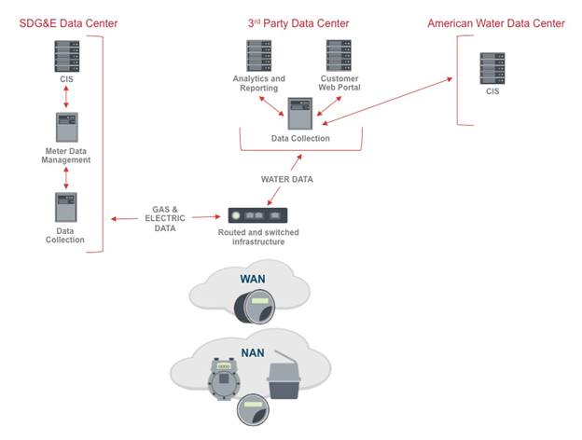
R13-12-011 Water Nexus Pilot
San Diego Gas & Electric

Slide 5
R13-12-011 Water Nexus Pilot
San Diego Gas & Electric
Benefits of a Shared Network
SDG&E’s standards-based multipurpose network was designed to enable secure, robust and reliable network communications for utility applications as well the new innovative Internet of Things (IoT) devices
The SDG&E network is a fully standards based, secure, multi-purpose network.
Leveraging SDG&E’s Smart Meter network for American Water’s AMI data would minimize implementation cost of American Water’s AMI system and take advantage of SDG&E’s expertise in operating and maintaining Smart Meter

Slide 6
R13-12-011 Water Nexus Pilot
San Diego Gas & Electric
Assumptions
Existing technologies can be implemented to provide adequate solution for Stage 1
Emerging technology will be available in Q2/2016 for testing and deployment for Stage 2 in Q4/2016
Customers will authorize SDG&E network device installations on their premise

