Slide 1

Planning for Operations Flexibility
Understanding Intra-Hour Needs is Critical
April 5, 2016

Slide 2
Why We Were Concerned
Increasingly steep, volatile, and uncertain ramps are correlated with renewables penetration
The over-generation problems the CAISO has identified will likely occur well before 2024
The system is operated on an intra-hourly basis and no analysis has looked at this level of granularity
If not managed, over-generation is a reliability problem
This changed planning paradigm has not been evaluated for the years between 2016 and 2024

Slide 3
What We Did
Analyzed the system in a way that closely represents how the CAISO operates the markets and the system
  Sequential operating decisions are made based on generator characteristics starting with day-ahead forecasts and ending with real-time system operation which includes dealing with forecast uncertainty
Used data that had 5-minute granularity (this required using data for 2019)
Used NREL renewable profiles of historical day-ahead and real-time generation to account for forecast error
Energy Exemplar used PLEXOS in a sequential simulation approach to reflect generator characteristics and forecast error as you go from the day ahead to real time
  Started with hourly simulation then did a 5-minute simulation that only allowed commitment changes to fast start units

Slide 4
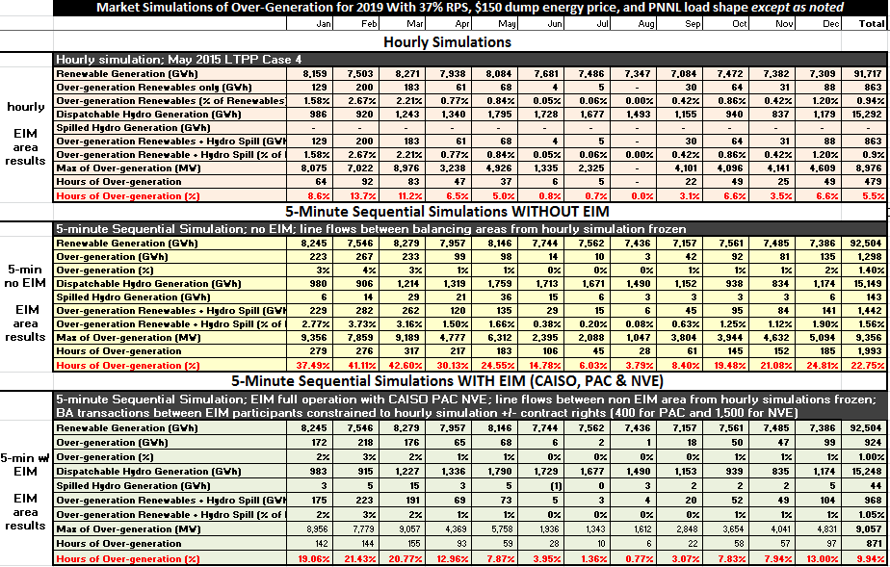
The Numeric Results

Slide 5
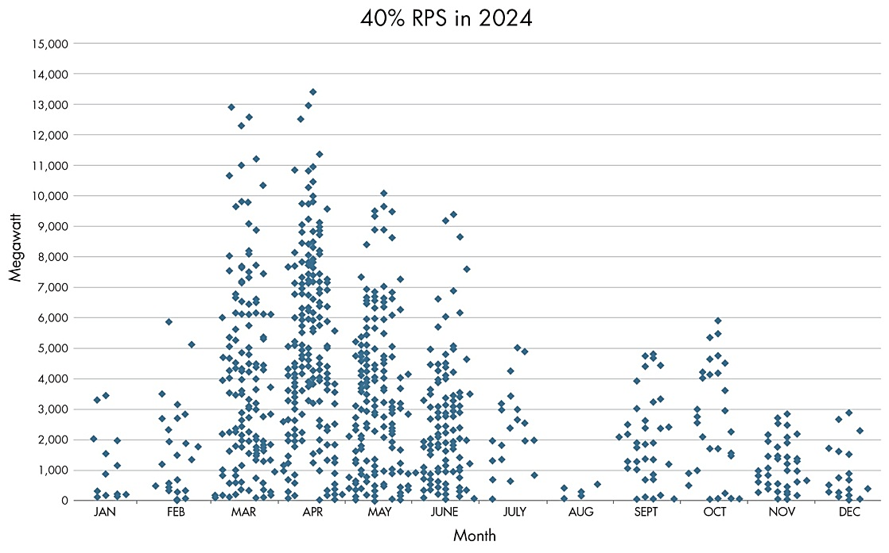
The CAISO’s Over-Generation Results
Our scatter plot would like similar but with many more points

Slide 6
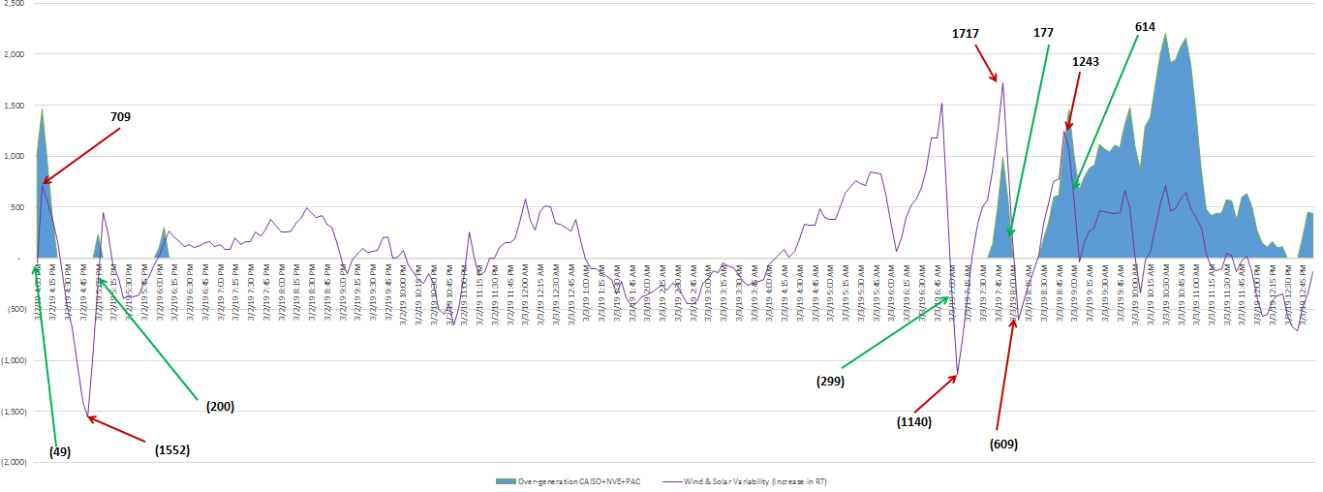
There is Significant Intra-hour Volatility
(-) MW +

Slide 7
What Do We Now Know
Significant over-generation problems are coming sooner than previously projected – analytically and in reality
Uncertainty in forecasts between day ahead and real time can be significant and intra-hour volatility adds to the need for flexible resources
Ordering renewables curtailment, the only option the CAISO has after market options, is i) contrary to CA policy, ii) will require higher effective-cost renewables to be procured, iii) may be administratively impossible, and iv) may lead to significant hardship/disruption to CA’s renewable development programs

Slide 8
Logical Next Steps
Include intra-hourly analysis in the planning that leads to procurement decisions
  Resource Adequacy, integrated planning, long-term procurement, storage and DER requirements, etc.
  Identify the operating requirements/characteristics and be non-discriminatory in applying to all resources that are procured to meet the needs
Look at years between now and 2024
  These years have not be evaluated for adequacy of the essential operating characteristics
  Request the CEC and CAISO to ensure that data sets are available to perform intra-hour analysis

Slide 9
QUESTIONS ??
Douglas Davie
Vice President
Wellhead Electric Company, Inc.
ddavie@Wellhead.com
(916) 447-5171

Slide 10
RPS Calculator Net Load Shapes
CPUC RA Workshop
April 5, 2016
  Nick Schlag, Managing Consultant

Slide 11
Resource Valuation in RPS Calculator
RPS Calculator’s resource selection algorithm is based on the “net market value” formulation used in Least Cost, Best Fit
Energy value and curtailment cost are evaluated endogenously by calculating net load shapes within the Calculator based on the evolving portfolio
RPS Calculator Valuation Framework
+
Levelized Cost of Energy
+
Transmission Cost
−
Capacity Value
−
Energy Value
+
Curtailment Cost
+
Integration Cost
=
Net Resource Cost

Slide 12
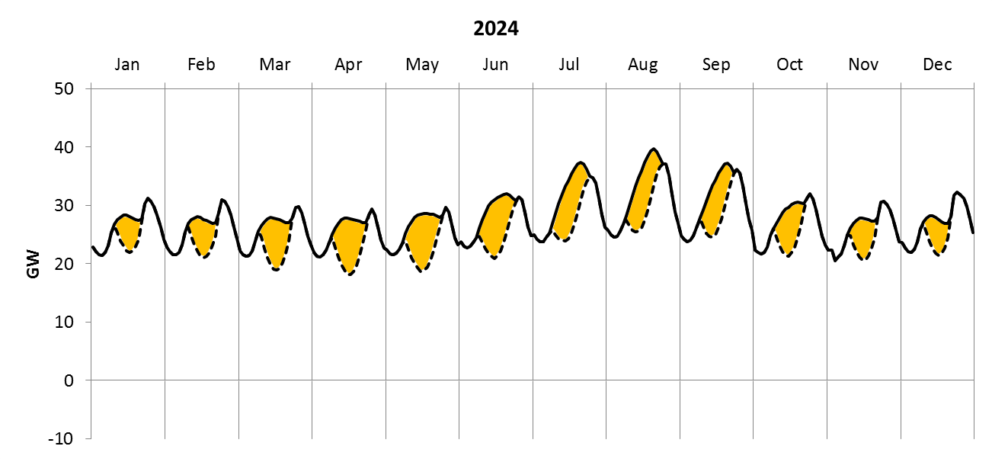
Calculating Average Net Load Shapes
Load shapes adjusted in each year to capture growing penetration of behind-the-meter solar PV
Behind-the-meter solar PV

Slide 13
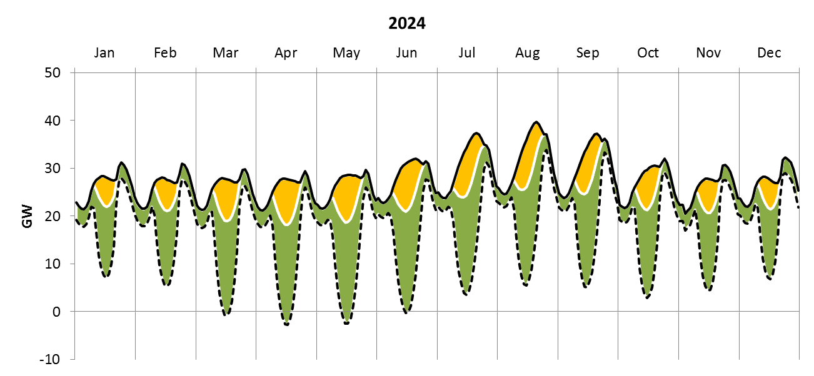
Calculating Average Net Load Shapes
Average renewable production shapes subtracted from load net of BTM PV to yield net load shape
Behind-the-meter solar PV
Existing & contracted renewables

Slide 14
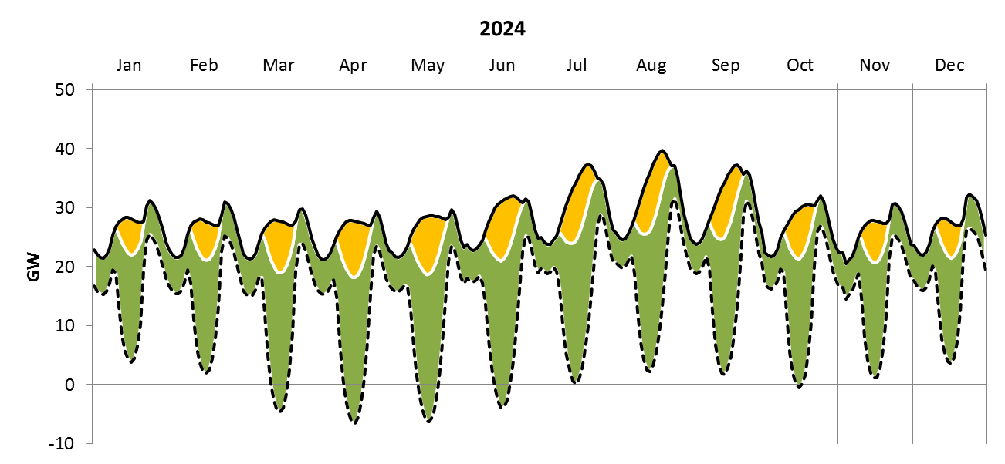
Calculating Average Net Load Shapes
Shape of net load adjusts as RPS Calculator adds resources to the portfolio to meet policy goals
Behind-the-meter solar PV
40% RPS renewables

Slide 15
Thank You!
Energy and Environmental Economics, Inc. (E3)
101 Montgomery Street, Suite 1600
San Francisco, CA 94104
Tel 415-391-5100
Web http://www.ethree.com

