Slide 1
Joint Utilities’ Approach to Safety Risk Assessment
JUA Safety Attribute Workshop 9/28/2017

Slide 2
Overview
The Joint Utilities’ Approach (JUA) Methodology
Timeline and Today’s Goal
Deep Dive Illustrative Example of Safety Risk Assessment: Overhead Conductor
  Steps for Selecting Mitigations
  Step 1: Comparability
  Step 2: Utility Data
  Step 3: Safety Comparators
  Step 4: Comparisons
  Step 5: Conclusion
Improvements Offered by the JUA Methodology
Results of Other Test Drives
Roadmap

Slide 3
Foundation of the JUA Methodology
The development of the JUA Methodology has been a collaborative process and the methodology will continue to evolve as we learn and obtain additional insights/input from the CPUC, the JIA, parties, industry practices, and utility partners.
The JUA Methodology was developed to rely on existing analysis and practices which are designed to use available data, augmented with subject matter expertise.
Utilities Probabilistic
Initiatives
JIA
Stakeholder Input
Regulatory
Guidance
Industry Standards and Practices
JUA

Slide 4
The Approach – A Safety Attribute & MAUT for RAMP Risks
JUA Safety Attribute
JUA MAUT
&
  Identify safety risks for inclusion in RAMP
  Evaluate and compare safety risks and mitigations within and across utilities
  Determine leading practices across utilities
Supports selection of top RAMP risks and mitigations, using a commission-directed approach*
*Pursuant to D.16-08-018
September Workshop
October Workshop

Slide 5
The Approach – A Safety Attribute & MAUT for RAMP Risks
Defining the measures and why they work.
JUA Safety Attribute
(Safety Comparator)
JUA MAUT
(Risk Spend Efficiency)
&
What is it?
Measure of safety risks at a point in time and safety risk reduction per mitigation
Why does it work?
Quantifies Safety Risks
Uses Natural Units (i.e., Safety Units: injuries and fatalities)
When normalized, allows for comparisons to other mitigations across risks and across utilities
What is it?
Utility’s overall risk reduction per mitigation
Why does it work?
Quantifies risks across multiple attributes
Captures risk reduction from likelihood and consequence across multiple attributes
Presents mitigation spend efficiency suitable for resource decision-making
September Workshop
October Workshop

Slide 6
Safety Attribute: Natural Units and Weighting
In Great Britain, the Health and Safety Executive (HSE) is the government body that regulates workplace health, safety, and welfare. One of its areas of regulation is gas supply and installation.
The HSE commissions an appraisal of the costs to society from workplace injuries and work-related illnesses in two categories:
  Human costs – those that affect an individual’s quality of life and those that come about from the loss of life
  Financial costs – secondary impacts, like healthcare and productivity costs
These costs for fatality and injury informed how the JUA calculated Safety Units:
Safety Unit = # of fatalities * (1) + # of injuries * (0.01)
JUA Safety Attribute and Sources of Data
 | Weighting | Employee | Contractor | Public
Fatality | 1 | OSHA Recordable | OSHA Recordable | CPUC Reportable
Injury | 0.01 | OSHA Recordable | OSHA Recordable | CPUC Reportable
Note: The table above shows the preferred source of data for each category of safety incidents. These sources of data may be supplemented by data from the insurance industry, other utilities, national public data, or subject matter experts.

Slide 7

How JUA Methodology Feeds into RAMP & GRC
RAMP
GRC
JUA
Top Safety Risks
(based on stochastic models)
Mitigations & Alternatives
Discussion: Mitigations, Risk Tolerance, and Leading Practices
Input to Resource Decisions
OH Conductor Wires Down
High Pressure Pipeline Failure
etc.
SDGE OHC 1, 2, 3
SCE OHC 1, 2, 3
PGE OHC 1, 2
SDGE HP 1, 2
etc.
Illustrative Sample Comparison
SDGE
SDGE Mitigations | Safety Comparator | MAUT RSE
SDGE OHC 1 | 4.0 | 2.1
SDGE OHC 2 | 3.2 | 2.0
SDGE OHC 3 | 2.0 | 6.0
SDGE HP 1 | 1.0 | 3.0
SDGE HP 2 | 0.2 | 5.2
… | … | …
Illustrative Sample Comparison
SDGE |  | SCE
SDGE Mitigations | Safety Comparator | SCE Mitigations | Safety Comparator
SDGE OHC 1 | 4.0 | SCE OHC 1 | 4.5
SDGE OHC 2 | 3.2 | SCE OHC 2 | 1.5
SDGE OHC 3 | 2.0 | SCE OHC 3 | 1.3
… | … | … | …
Db
September Workshop
October Workshop

Slide 8
JUA Activity Timeline (2017)
15
30
1
8
28-29
13
30
Feb
March
April
May
June
July
August
September
October
Acceptance Criteria
Summary
Report
Revised
Schedule
MAUT Report
MAUT Workshop
Meet & Confer Sessions
Inputs to Safety Attribute
Updated Safety Attribute Summary Report with Results
Safety Attribute Workshop
Inputs on MAUT req’d

Slide 9
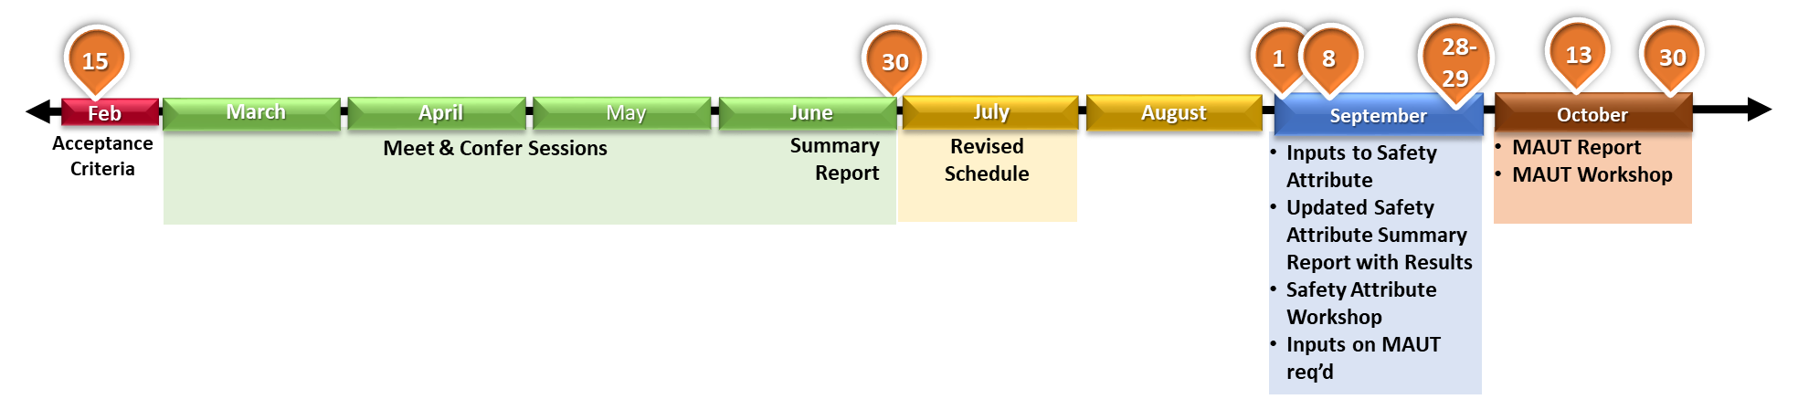
JUA Activity Timeline
  Probabilistic
  Safety–focused
  Simple / clear / transparent (understandable by non-experts)
  Uniform
  Comparable across risks and utilities
  Cost-effective modeling
  Accurate
Acceptance Criteria
Safety Policy Statement (July 10, 2014), Safety Action Plan and Regulatory Strategy (February 12, 2015), Policy and Planning Division and Safety Enforcement Division – Quantifying Risk: Building Resiliency into Utility Planning (January 23, 2014), Cycla Report (May 16, 2013), Liberty Consulting Report (May 6, 2013), Safety and Enforcement Division Risk Assessment section Staff Report on SoCalGas and SDG&E’s 2016-2018 GRC (March 27, 2015), Safety and Enforcement Division Risk Assessment section Staff Report on PG&E’s 2017-2019 GRC (March 7, 2016), Safety Enforcement Division Evaluation Report on the Risk Evaluation Models and Risked-based Decision Frameworks in A.15-05-002, et al (March 21, 2016), S-MAP Decision D.16-08-18 (August 18, 2016), S-MAP Scoping Memo and Ruling of Assigned Commissioner in A15-05-002 (December 13, 2016), and SED Report on SCE’s 2018-2020 GRC A.16-09-001 (January 31, 2017)
CPUC Docs

Slide 10
Goals of the JUA Safety Attribute Presentation
Demonstrate how the JUA Safety Attribute achieves the acceptance criteria
Provide a detailed example of one safety risk (Overhead Conductor)
Demonstrate how the Commission can use the JUA Safety Methodology and the information it generates
Show how the JUA Methodology enables the utilities to continue to innovate with respect to quantitative risk assessment

Slide 11
JUA Methodology for Selecting Safety Mitigations for RAMP

Slide 12
Steps Used in Test Drives for Selecting Mitigations for RAMP
STEP 1
Distribute comparability templates to utilities
Selecting Mitigations for RAMP
STEP 2
Utilities complete templates using their own methodology and data
JUA Methodology
STEP 3
Calculate Safety Comparators
STEP 4
Analyze the Safety Comparators and Investigate Differences
STEP 5
Discuss & Select Mitigations, considering:
Leading Practices
Risk Tolerance
Mandated

Slide 13
Step 1: Distribute Comparability Templates to Utilities
STEP 1
Distribute comparability templates to utilities
Selecting Mitigations for RAMP
STEP 2
Utilities complete templates using their own methodology and data
STEP 3
Calculate Safety Comparators
STEP 4
Analyze the Safety Comparators and Investigate Differences
STEP 5
Discuss & Select Mitigations, considering:
Leading Practices
Risk Tolerance
Mandated

Slide 14
Step 1: Comparability Worksheets
Walkthrough
STEP 1
A common template
  Provides details on the baseline risk and individual mitigations, which are used to develop the Safety Comparators
  Documents inputs and assumptions for transparency
  Helps identify leading practice in data inputs and impact of better data
Sample factors that affect the final Safety Comparators
  Why Safety Comparators for different mitigations of the same risk across the company are different or are comparable
  If risk scopes are slightly different, could encourage utilities to adopt the same set of risks or redefine risks
Provides continuously improving archive for data sources and SME assumptions
Able to evolve over time based on utilization
Tabs:
  Risk Information – outline of the current baseline risk, in its pre-mitigated state
  Individual Mitigations – details including the costs and anticipated benefits, of each mitigation

Slide 15
Step 2: Utilities Fill out Comparability Sheets with Risk and Mitigation Data
STEP 1
Distribute comparability templates to utilities
Selecting Mitigations for RAMP
STEP 2
Utilities complete templates using their own methodology and data
STEP 3
Calculate Safety Comparators
STEP 4
Analyze the Safety Comparators and Investigate Differences
STEP 5
Discuss & Select Mitigations, considering:
Leading Practices
Risk Tolerance
Mandated
Utility Examples: OH Conductor

Slide 16
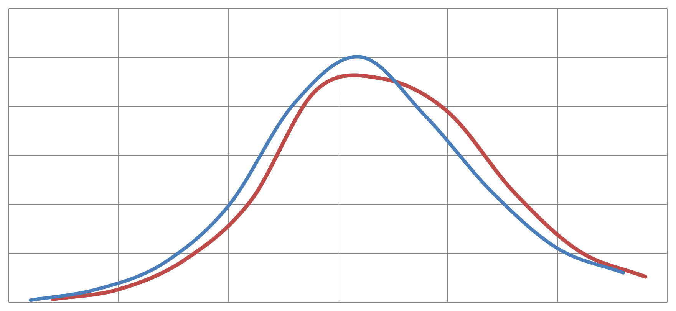
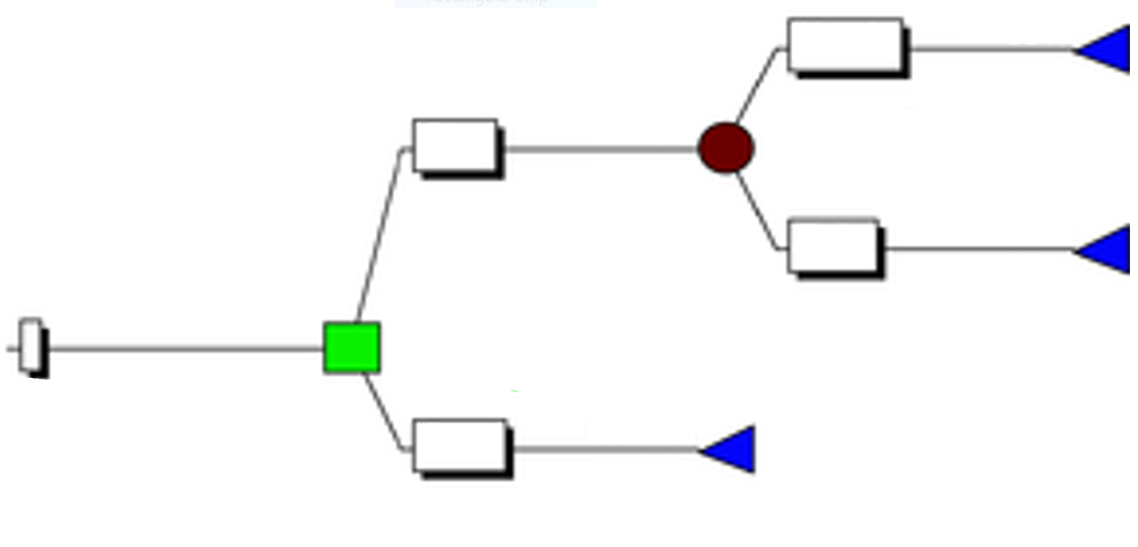
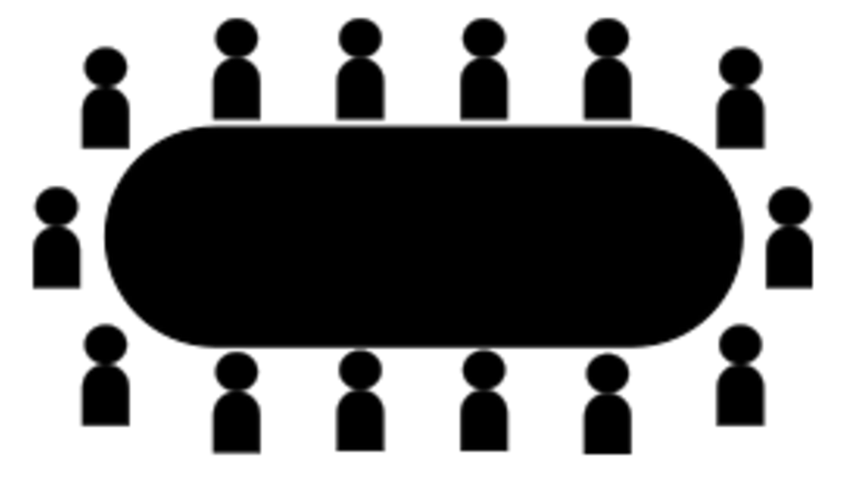
Quantitative Risk Assessment
STEP 2
Different risks warrant different levels of modeling sophistication based on various factors such as the significance of the risk, the cost effectiveness of modeling, data availability and feasibility. The JUA methodology is equally useful on any level of sophistication in these areas.
Risk
Methods for Quantitative Risk Assessment
Safety Risk Profile
Safety Risk Benefits
Safety Risk Plan
Risk Modeling Tiers
Stochastic Modeling
Fault/Event Tree
Safety Comparator
Individual risk assessments may vary based on the risks
Calibrated Subject Matter Expertise

Slide 17
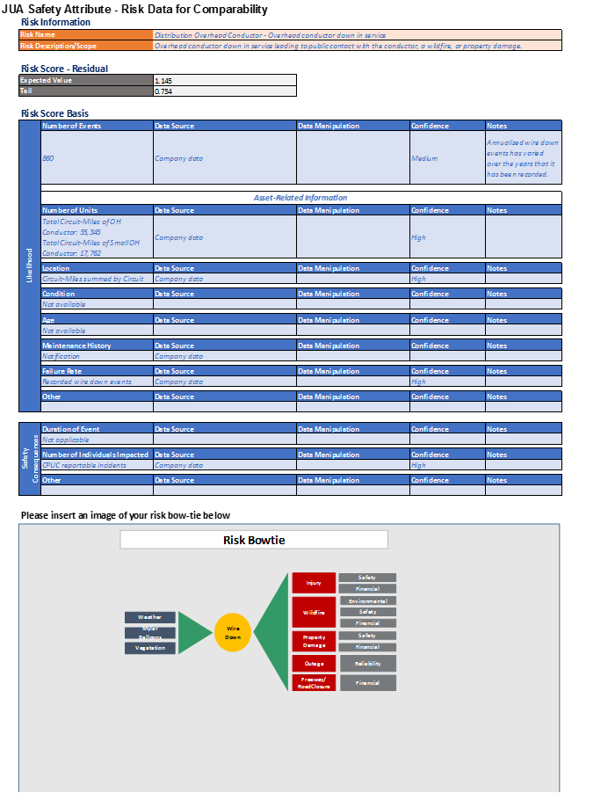
Tab: Risk Information
STEP 2
Four Sections
Risk Information – Name and description of the risk
Residual Risk Score – Baseline expected value and tail (results from each company’s own methodology)
Risk Score Basis – Describes the source of the information used to calculate the residual risk score
  Likelihood – Number of Events and other Asset Information
  Safety Consequence – Duration of Event and Number of Individuals Affected
Risk Bowtie – Presents the risk drivers (left), the risk (center, circle), and the consequences (right)

Slide 18
Tab(s): Mitigations
STEP 2
Four Sections
JUA Safety Attribute – Mitigation Data for Comparability
Mitigation Information – Name and Description of the Mitigation
Reconductoring the highest Safety Comparator circuits at a $100M per year pace
Mitigation Costs –
  Capital – one-time expenditure associated with the number of years of expected benefit
  O&M – usually an annual recurring expenditure
  O&M cost duration – number of years for recurrence
Cost breakdown is for 3 years of spend targeting the highest safety comparator circuits. Cost estimate is the weighted average cost for the identified miles of reconductor
Mitigation Benefits –
  Likelihood reduction – estimated effectiveness of the mitigation at reducing the likelihood of the risk event
  Safety Improvement – describes the estimated reduction in the safety consequence component of the risk
  Benefit Duration – number of years of estimated benefit, corresponding to the expenditure (i.e. spending x amount buys y years of estimated risk reduction benefits)
Based on the expected reduction in wire down events by reconductoring small conductor on the highest Safety Comparator circuits.
Forecasted Risk Score (Post-Mitigation)
Forecasted Risk Score – Post-mitigation expected value and tail scores

Slide 19
Deep Dive Risk Assessment Methodology: Overhead Conductor

Slide 20


Distribution Overhead Conductor
STEP 2
Example Methodology
SDG&E does not measure Distribution Overhead Conductor as a stand-alone risk; this was developed for purposes of the JUA test drive

Slide 21

OH Wire Down (on Distribution system from any cause except wildfire)
SDG&E
Illustrative
STEP 2
Inputs
  Company reliability database;
  Claims data
Method
  Stochastic modeling, Monte Carlo simulation
 | EV | $ (In Millions)
Baseline | 0.302 | -
Mitigation 1 | 0.264 | 150
Mitigation 2 | 0.217 | 450
Mitigation
  SDGE Targeted Reconductor
  Mitigation 1: Replace 100 miles per year for 3 years
  Mitigation 2: Replace 300 miles per year for 3 years
Effectiveness
  SME provides the estimated percentage reduction of incident rate
Developed for purposes of JUA Test Drive
Projects and dollar amounts are illustrative only. Expenditures are ongoing in an attempt to maintain current levels of safety.

Slide 22
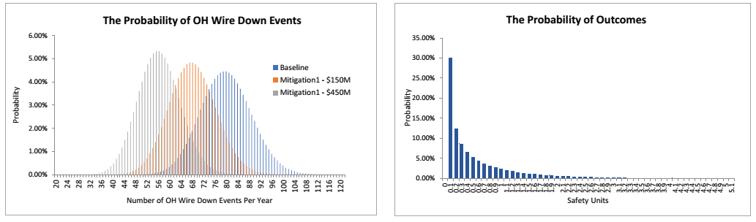
OH Wire Down (on Distribution system from any cause except wildfire)
SDG&E
Illustrative
STEP 2
Inputs
 | Baseline | Mitigation 1 | Mitigation 2
Number of Events | 80 per year | 68 per year | 56 per year
Fatal/injury events | Lognormal (0.006,0.2) 1 every 160 wire down events
Fatality/Injury (SU) | Gamma(0.5,1.2,RiskShift(0.01)) 0.01 – 4.00 SU
Developed for purposes of JUA Test Drive
Projects and dollar amounts are illustrative only. Expenditures are ongoing in an attempt to maintain current levels of safety.

Slide 23
OH Wire Down (on Distribution system from any cause except wildfire)
SDG&E
Illustrative
STEP 2
Outputs
 | Catastrophic | Extreme | High | Moderate | Low | EV
 | [10+) | [3-10) | [1-3) | [0.1-1) | [0-0.1)
Baseline | 0.0000 | 0.0167 | 0.0840 | 0.1985 | 0.7008 | 0.302
Mitigation1 | 0.0000 | 0.0148 | 0.0726 | 0.1735 | 0.7391 | 0.264
Mitigation2 | 0.0000 | 0.0102 | 0.0630 | 0.1497 | 0.7771 | 0.217
Developed for purposes of JUA Test Drive
Projects and dollar amounts are illustrative only. Expenditures are ongoing in an attempt to maintain current levels of safety.

Slide 24
OH Conductor Summary Details
SDG&E
Illustrative
STEP 2
 | Description |  |  |  | Data Source | Basis |  |  |  |  |  | EV (Safety Units)
Risk | Wires down on Distribution system from any cause (except wildfire) |  |  |  | Company Data | SDG&E considered the number of wire down events as the main trigger. The value of 80 per year is the number of wire down events. The mitigations shown only impact the reduction of wire down events, as opposed to any reduction in consequence given a wire down. |  |  |  |  |  | 0.302
 | Description | Effectiveness |  |  |  |  | Costs |  |  |  | Useful Life (yrs) | EV (Safety Units)
 |  | Risk Reduction | Data Source | Basis |  |  | Project Cost | Breakdown | Basis
Mitigation | SDGE Targeted Reconductor - $50M/yr | 15% (from 80 down to 68/year) | SME | 15% reduction is estimated based upon replacing 100 miles of system, and using subject matter expertise to determine how many fewer wires down there would be with that much OH replacement. |  |  | $150M | $686K/mi | Publicly available data from regulatory filing |  | 40 | 0.264
 | SDGE Targeted Reconductor - $150M/yr | 30% (Down to 56/year) | SME | 30% reduction is estimated based upon replacing 300 miles of system, and using subject matter expertise to determine how many fewer wires down there would be with that much OH replacement. |  |  | $450M | $686K/mi | Publicly available data from regulatory filing |  | 40 | 0.217
Developed for purposes of JUA Test Drive
Projects and dollar amounts are illustrative only. Expenditures are ongoing in an attempt to maintain current levels of safety.

Slide 25

Distribution Overhead Conductor
STEP 2
Example Methodology

Slide 26
Wire Down Bow Tie Diagram
STEP 2
Current model evaluates safety impacts of wire down events
  Contact with energized conductor
  Wildfire
  Property Damage
Future enhancements will evaluate the reliability and financial impacts
Probabilistic Model
Risk Valuation
Contact
Safety
Financial
Wildfire
Environmental
Weather
Wire
Down
Safety
Financial
Mylar Balloons
Property Damage
Safety
Vegetation
Financial
Outage
Reliability
Freeway/
Road Closure
Financial

Slide 27
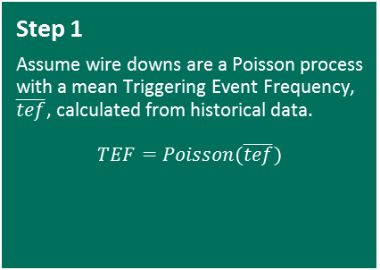
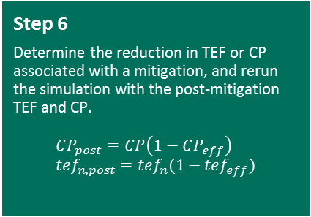


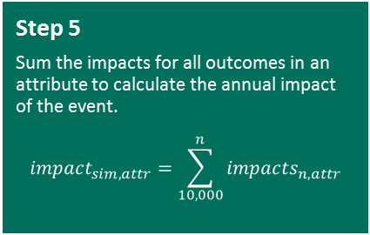

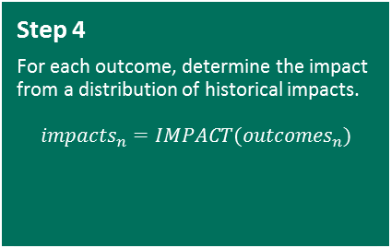

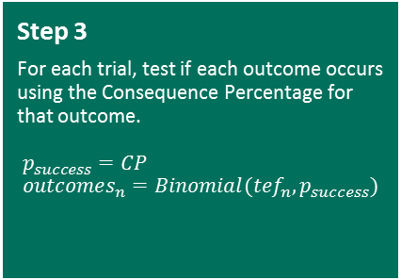

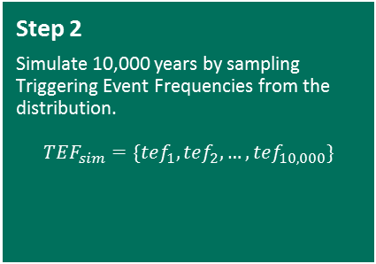
Modeling Approach
STEP 2
Step 1
  Assume wire downs are a Poisson process with a mean Triggering Event Frequency, $\overline{tef}$, calculated from historical data.
  $$TEF=Poisson(\overline{tef})$$
Step 2
  Simulate 10,000 years by sampling Triggering Event Frequencies from the distribution.
  $$TEF_{sim}=\{tef_{1}, tef_{2}, …, tef_{10,000}\}$$
Step 3
  For each trial, test if each outcome occurs using the Consequence Percentage for that outcome.
  $$p_{success}=CP \\ outcomes_{n}=Binomial(tef_{n}, p_{success})$$
$$TEF \sim Poisson\left(λ\right) \\ λ=860$$
$$TEF_{1}=823 \\ TEF_{2}=893 \\ … \\ TEF_{10000}=865$$
$$outcomes \sim Binomial\left(n, p\right) \\ n=TEF \\ p=CP_{SIF} \\ e.g, \\ outcomes_{1}=Binomial\left(823, 0.00073\right)$$
$=1$
Step 4
  For each outcome, determine the impact from a distribution of historical impacts.
  $$impacts_{n}=IMPACT(outcomes_{n})$$
Step 5
  Sum the impacts for all outcomes in an attribute to calculate the annual impact of the event.
  $$impact_{sim,attr}=\sum_{10,000}^{n}{impacts_{n,attr}}$$
Step 6
  Determine the reduction in TEF or CP associated with a mitigation, and rerun the simulation with the post-mitigation TEF and CP.
  $$CP_{post}=CP\left(1−CP_{eff}\right) \\ tef_{n,post}=tef_{n}(1−tef_{eff})$$
$$SIFs_{simulation}=\sum_{outcome_{simulation}}{SIFs} \\ e.g., \\ SIFs_{11}=1+2=3$$
$$SIF_{distribution}=\left[1, 1, 2, 3\right] \\ e.g., \\ outcomes_{11}=2 \\ SIFs_{11,1}=Random\left(SIF_{distribution}\right)=1 \\ SIFs_{11,2}=Random\left(SIFs_{distribution}\right)=2$$

Slide 28
Results – TEF Distribution
STEP 2
Input Data
Annual expected wire down events
  Source: SCE recorded data
TEF Effectiveness - 47% on each mitigated circuit
  Source: SCE SME and historical outage data
Mitigation Scenarios
Reconductor mitigation at various funding levels for 3 years
  $100M annual ($300M total)
  $150M annual ($450M total)
  $200M annual ($600M total)
Impact of Mitigation
$150M
(mean=735)
$200M
(mean=714)
Pre-Mitigation
(mean=860)
$100M
(mean=759)

Slide 29
Results – Contact with Energized Wire Down
STEP 2
Input Data
CP = 0.073% (SCE data)
Impacts = {1, 1, 2, 3 SIFs}
SME judgement and SCE data

Slide 30
Results – Property Damage
STEP 2
Input Data
CP = 0.015% (SCE data)
Impacts = Normal Distribution
Mean = 0.1
Std dev = 0.03
SME judgement and SCE data

Slide 31
Results – Wildfire
STEP 2
Input Data
CP = 0.002%
Impacts = Normal Distribution
Mean = 2.0
Std dev = 0.5
SME judgement and SCE data

Slide 32
Results – All Outcomes
STEP 2

Slide 33
OH Conductor Summary Details
SCE
STEP 2
 | Description |  |  | Data Source |  | Basis |  |  |  |  |  | EV (Safety Units)
Risk | Overhead conductor down in service leading to public contact with the conductor, a wildfire, or property damage. |  |  | Company Data |  | 860 Annualized wire down events has varied over the years that it has been recorded. |  |  |  |  |  | 1.145
 | Description | Effectiveness |  |  |  |  | Costs |  |  |  | Useful Life (yrs) | EV (Safety Units)
 |  | Risk Reduction | Data Source |  | Basis |  | Project Cost | Breakdown | Basis
Mitigation | Reconductoring the highest safety comparator circuits at a $100M per year pace. | 11.60% | SME-calibrated model |  | Based on the expected reduction in wire down events by reconductoring small conductor on the highest safety comparator circuits. |  | $300M | 669 miles @ 447k per mile | Average historical costs. Does not include transformer material costs. |  | 40 | 1.014
 | Reconductoring the highest safety comparator circuits at a $150M per year pace. | 14.44% | SME-calibrated model |  | Based on the expected reduction in wire down events by reconductoring small conductor on the highest safety comparator circuits. |  | $450M | 998 miles @ 447k per mile | Average historical costs. Does not include transformer material costs. |  | 40 | 0.984
 | Reconductoring the highest safety comparator circuits at a $200M per year pace. | 16.92% | SME-calibrated model |  | Based on the expected reduction in wire down events by reconductoring small conductor on the highest safety comparator circuits. |  | $600M | 1,340 miles @ 447k per mile | Average historical costs. Does not include transformer material costs. |  | 40 | 0.933

Slide 34
Distribution Overhead Conductor Primary
Example Methodology

Slide 35
Overhead Conductor Bow-Tie
Risk top-level drivers
30% potential to remain energized
Exposure
Frequency
Risk event(s)
Sub-Risk event(s)
Consequences
Overhead Miles of Distribution circuits:
[PG&E Data]
82k
Vegetation:
[PG&E data ]
Safety-Injuries
Equipment Failure - Conductor:
[PG&E data]
Safety-Fatalities
Equipment Failure - Connector/Hardware:
[PG&E data ]
Equipment Failure – Other:
[PG&E data]
Failure of overhead conductor
Overhead conductor
Stays Energized
3rd Party (WD):
[PG&E data]
Animal:
[PG&E data]
Natural Forces:
[PG&E data ]
Company initiated:
[PG&E data ]
Projects and dollar amounts are illustrative only. Expenditures are ongoing in an attempt to maintain current levels of safety.

Slide 36
Model Inputs
Exposure is Distribution Overhead Primary circuit miles. Note that this is PG&E Data.
Future projection of system growth based on 2012 vs. 2016 change, applied to 2017-2021 system miles
Wire Down Risk drivers or causes (2012-2016).
Note that this is PG&E Data.
30% potential remain energized.
Note that this percentage is developed using the a sample of post-event Distribution Engineer investigations at PG&E.
Number of historical PG&E specific CPUC reported Wire Down public safety events (2012-2016). (PG&E Data)
Projects and dollar amounts are illustrative only. Expenditures are ongoing in an attempt to maintain current levels of safety.

Slide 37
Mitigation Effectiveness for Targeted Conductor Replacement
Perform targeted conductor replacement of 4 Aluminum Conductor Steel Reinforced (ACSR) in Corrosion zones
Replace 210 incremental miles per year
Unit cost of $100 per foot
$110.8M per year (capital)
Mitigation applies to 210 miles or 0.3% of the total exposure (Based on PG&E data)
Estimated 1060% effective in reducing Equipment Failure – Conductor risk driver for applicable circuit miles (Based on PG&E data below)
  100% effective in reducing Equipment Failure – Conductor caused wire down events
  10.6x multiplier since WD/100 mile rate in corrosion zone is 5.3 compared to .5 in non-corrosion zones
Projects and dollar amounts are illustrative only. Expenditures are ongoing in an attempt to maintain current levels of safety.

Slide 38
Mitigation Effectiveness for Targeted Underground Conversion
Perform targeted underground conversion of overhead conductor
50 miles per year
Unit cost of $3M per mile (Based on CPUC WRO Rule 20 estimates)
$150M per year (capital)
Mitigation applies to 50 miles or 0.1% of the total exposure (Based on PG&E data)
Assumption of 100% standard effectiveness in reducing all wire down drivers
Estimated 791% effective in reducing Vegetation caused wire down events (Based on PG&E data below):
  13 worse performing circuits make up 11.31% of Vegetation wire down events and only 1.43% of total miles
  7.91x factor (11.31% events / 1.43% miles)
Projects and dollar amounts are illustrative only. Expenditures are ongoing in an attempt to maintain current levels of safety.

Slide 39
Mitigation Effectiveness for Overhang Clearing
Overhang Clearing Mitigation
Perform overhang clearing on all REAX Top 40% circuit miles over ten year period (1,650 miles total)
Unit cost assumption of $3,600 per mile
$5.94M per year
Mitigation applies to 1650 miles or 2.0% of the total exposure (Based on PG&E data)
Overhang clearing 16.9% effectiveness estimate (Based on multiplying the PG&E SME judgement below)
  70% reduction on branch outage on circuit miles worked
  24.18% of Vegetation wires down events are from branch caused outages
Projects and dollar amounts are illustrative only. Expenditures are ongoing in an attempt to maintain current levels of safety.

Slide 40
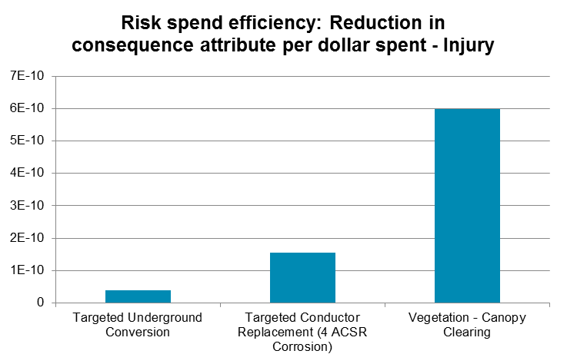

Output Comparison of Proposed Mitigations
Projects and dollar amounts are illustrative only. Expenditures are ongoing in an attempt to maintain current levels of safety.

Slide 41
OH Conductor Summary Details
PG&E
STEP 2
 | Description |  |  | Data Source |  |  | Basis |  |  |  |  |  | EV (Safety Units)
Risk | Failure of or contact with, energized electric distribution primary conductor results in public safety issues, significant environmental damage, prolonged outages, or significant property damage. |  |  | Company Data |  |  | Company data on wire down events by cause; Failure rates by conductor size and type in corrosion zones; Count of PUC reportable 3rd party events related to Distribution OH Primary conductor; assumption based on historical Distribution engineer investigations on Wire Down events that 30% of Wire Down events may remain energized. |  |  |  |  |  | 1.021
 | Description | Effectiveness |  |  |  |  |  | Costs |  |  |  | Useful Life (yrs) | EV (Safety Units)
 |  | Risk Reduction | Data Source |  | Basis |  |  | Project Cost | Breakdown | Basis
Mitigation | Targeted Conductor Replacement (4 ACSR) in Corrosion zone ($110.8M/yr) | 2.16% | Company Data |  | 0.8% (Exposure 630 miles (3 years) / system) * 25.5% (Equipment failure conductor connector / total wires down) * 1060% (effectiveness in reducing Equipment failure caused wire down events related to Conductor or Connector assets: 10.6x multiplier applied since WD/100 mile rate in corrosion zones are 5.3 compared to .5 in non-corrosion zone areas) |  |  | $332M | Replace 210 Miles a year at $100/ft, ($528k/mile) | Based on the average historical conductor replacement program costs |  | 40 | 0.998
 | Focus on highest risk circuits based on historical vegetation caused wire down events for underground conversion | 0.67% | Company Data |  | 0.2% (Exposure 150 miles 3 years worth/ system) * 42.4% (Vegetation caused / total wires down) * 791% (effectiveness in reducing Vegetation caused wire down events per mile: 13 worse performing circuits make up 11.31% of Vegetation wire down events and only 1.43% of total miles - 11.31% / 1.43% = 791%) |  |  | $450M | 50 Miles a year at $3M/mile | Based on the average historical underground conversion program costs |  | 100 | 1.014
 | Clear vegetation directly above OH Primary conductor | 0.43% | Company Data and SME Judgment |  | 6% (Exposure 4950 miles 3 years worth / system) * 42.4% (Vegetation caused / total wires down) * 16.9% (effectiveness in reducing Vegetation caused Wire Down events: 70% reduction on branch outage on circuit miles worked (per historical PS&R analysis), 24.18% of Vegetation wires down events are from branch caused outages (other categories included full tree failures, trunk failures, etc.), 70%*24.18% = 16.9%) |  |  | $5.94M /year | 1650 miles in top 40% REAX = 1650 miles a year at $3,600/mile | Based on the average historical vegetation clearing program costs |  | 5 | 1.016
Projects and dollar amounts are illustrative only. Expenditures are ongoing in an attempt to maintain current levels of safety.

Slide 42
Step 3: Calculating Safety Comparators
STEP 1
Distribute comparability templates to utilities
Selecting Mitigations for RAMP
STEP 2
Utilities complete templates using their own methodology and data
STEP 3
Calculate Safety Comparators
STEP 4
Analyze the Safety Comparators and Investigate Differences
STEP 5
Discuss & Select Mitigations, considering:
Leading Practices
Risk Tolerance
Mandated

Slide 43
Calculating Safety Comparators
STEP 3
Safety Comparator Input Variables per Mitigation
Pre-mitigation baseline risk EV
Post-mitigation EV
Useful Life of the Project
Capital Costs
O&M Costs
Safety Comparator
the change in safety units (SU) per dollar (millions)

Slide 44
Example Safety Comparator: OH Conductor
Illustrative
STEP 3
Benefit:
Targeted reconductoring of overhead conductor: $50M per year Capital spend, no O&M
Estimated benefit: reduce the risk likelihood by 15%
Useful life of the project: 40 years
Baseline Risk Score
0.3
Mitigation Risk Score
0.264
Life of Project
40 years
TOTAL BENEFIT
1.44 Safety Units Avoided
Cost: (no net present value discounting)
Capital Cost
over 3 years of GRC
$150M
One Time O&M
$0
Recurring Annual O&M * Life of Project
$0
TOTAL COST
$150M
TOTAL BENEFIT
1.44
0.0096
Safety Units Avoided /$1M
TOTAL COST
150

Slide 45
Step 4: Analyze Safety Comparators and Investigate Differences (Compare, not Conclude)
STEP 1
Distribute comparability templates to utilities
Selecting Mitigations for RAMP
STEP 2
Utilities complete templates using their own methodology and data
STEP 3
Calculate Safety Comparators
STEP 4
Analyze the Safety Comparators and Investigate Differences
STEP 5
Discuss & Select Mitigations, considering:
Leading Practices
Risk Tolerance
Mandated

Slide 46
Analyze Safety Comparators and Investigate Differences
STEP 4
Compare Risk and Mitigations
Estimated Benefits and Costs
Inputs and Assumptions
Risks within and across utilities, and industry (where applicable)
Safety Comparators for each mitigation within the risk within and across utilities, and industry (where applicable)
Scope of the Risks
Baseline likelihood and consequence of the risk
Scope of the Mitigations
Estimated mitigation effectiveness at reducing likelihood and/or consequence
Useful life of the benefits
Cost of mitigations (amount and composition: capital and O&M)
Methodology
Data sources
Utility constraints (geography, population density, etc.)

Slide 47
OH Conductor Comparability Details
SDG&E, SCE, and PG&E
Illustrative
STEP 4
 | Mitigation | Baseline Risk Score (Expected Value) | Estimated Likelihood Reduction | Post-Mitigation Forecasted Score | Total Benefit | Total Cost ($M) | Safety Comparator
SDG&E | SDGE Targeted Reconductor - $50M/yr | 0.302 | 15% | 0.264 | 1.520 | 150 | 0.0101
 | SDGE Targeted Reconductor - $150M/yr |  | 30% | 0.217 | 3.400 | 450 | 0.0076
SCE | SCE Targeted Reconductor at a $100M/yr | 1.145 | 11.60% | 1.014 | 5.237 | 300 | 0.0175
 | SCE Targeted Reconductor at a $150M/yr |  | 14.44% | 0.984 | 6.446 | 450 | 0.0145
 | SCE Targeted Reconductor at a $200M/yr |  | 16.92% | 0.933 | 8.501 | 600 | 0.0142
PGE | PGE M1 - Targeted 4 ACSR Replacement | 1.021 | 2.16% | 0.998 | 0.939 | 332 | 0.0028
 | PGE M2 - Targeted OH to UG |  | 0.67% | 1.014 | 0.728 | 450 | 0.0016
 | PGE M3 - Veg Canopy Clearing |  | 0.43% | 1.016 | 0.024 | 18 | 0.0014
Projects and dollar amounts are illustrative only. Expenditures are ongoing in an attempt to maintain current levels of safety.

Slide 48
Baseline Risk Expected Value Comparisons
OH Conductor Highlight
Illustrative
STEP 4
Projects and dollar amounts are illustrative only. Expenditures are ongoing in an attempt to maintain current levels of safety.

Slide 49
Safety Comparator Comparisons
OH Conductor Highlight (Compare but not Conclude)
Illustrative
STEP 4
Considerations:
Makeup of electric systems vary between utilities (e.g. % of undergrounded wire vs. % of overhead wire)
  Historically different standards have led to differences in systems (i.e. how connectors are used, etc.)
Location of overhead circuits differ across utilities that lead to differences in risk scores (e.g. urban vs. rural); and potential cost differences depending on area
Granularity of risk scoring and maturity of data collection varies across utilities (e.g. circuit-level scoring vs. system-wide scoring)
Projects and dollar amounts are illustrative only. Expenditures are ongoing in an attempt to maintain current levels of safety.

Slide 50
Applying JUA Methodology
Alternative mitigations, different scales of the same approach
Illustrative
STEP 4
 | Mitigation | Likelihood Reduction | Benefits (40 year life of project) | Cost ($M) | Safety Comparator
SDG&E | Targeted Reconductor - $50M/yr | 15% | 1.52 | 150 | 0.010
 | Targeted Reconductor - $150M/yr | 30% | 3.40 | 450 | 0.008
  SDG&E is considering two mitigations for OH Conductor risk
  OPTION 2 costs 3x the first, but its effectiveness is only 2x the first (indicating diminishing returns attributable to targeting the riskiest circuits first)
  Therefore, Safety Comparator is higher for OPTION 1
  SDG&E may still select OPTION 2, however, as more risk is being reduced per year
Projects and dollar amounts are illustrative only. Expenditures are ongoing in an attempt to maintain current levels of safety.

Slide 51
Applying JUA Methodology
Comparing mitigations across utilities
Illustrative
STEP 4
 | Mitigation | Baseline Risk Basis | Baseline Risk Score | Likelihood Reduction | Benefits (Safety Units reduced per 40-year life of project) | Cost ($M) | Cost Breakdown | Miles | Safety Comparator
SDG&E | Targeted Reconductor - $150M/yr | 80 events / yr | 0.302 | 30% | 3.4 | 450 | $686k per mile | 656mi (10% of Distrib OH) | 0.008
SCE | Targeted Reconductor - $150M/yr | 860 events / yr | 1.145 | 14% | 6.4 | 450 | $447k per mile | 998mi (2.8% of Distrib OH) | 0.015
How to compare across utilities:
  Costs: $450M each
  Likelihood Reduction (Effectiveness): 14% vs 30%
  Baseline Risk Score: 0.302 vs 1.145
  Safety Comparator: 0.008 vs 0.015
Projects and dollar amounts are illustrative only. Expenditures are ongoing in an attempt to maintain current levels of safety.

Slide 52
Applying JUA Methodology
Alternative mitigations, different activities and scope within a risk
Illustrative
STEP 4
 | Mitigation | Likelihood Reduction | Useful life of the Project | Benefits (for Life of Project) | Cost ($M) | Safety Comparator
PGE | Targeted Reconductor - $111M/yr | 2.16% | 40 | 0.94 | 333 | 0.0028
 | Targeted Underground Conversion | 0.67% | 100 | 0.728 | 450 | 0.0016
 | Vegetation Canopy Clearing | 0.43% | 5 | 0.024 | 17.8 | 0.0014
PGE offers three different mitigations that present alternatives to each other using different approaches to treat the same risk
Each mitigation presents different risk reduction effectiveness, useful life of the project, and different costs required to achieve risk reduction
By applying Safety Comparators, the utility can see which mitigation alternative provides the most safety improvement per dollar
Estimated Effectiveness
Assumptions
Inputs
Projects and dollar amounts are illustrative only. Expenditures are ongoing in an attempt to maintain current levels of safety.

Slide 53
Step 5: Discuss and Select Mitigations for RAMP
STEP 1
Distribute comparability templates to utilities
Selecting Mitigations for RAMP
STEP 2
Utilities complete templates using their own methodology and data
STEP 3
Calculate Safety Comparators
STEP 4
Analyze the Safety Comparators and Investigate Differences
STEP 5
Discuss & Select Mitigations, considering:
Leading Practices
Risk Tolerance
Mandated

Slide 54
Selecting Mitigations for RAMP
Step 5
Dialogue
  Selection of Alternative Mitigations vs. Complementary Mitigations
  Safety Comparator Scores
  Risk Tolerance
  Comparison to other Utilities (database)
  Considering leading practices
  Other demographic factors
  Other third party information

Slide 55
Summarizing the Improvements Offered by the JUA Methodology

Slide 56
JUA Safety Attribute Applications in future RAMPs
As we demonstrated in today’s presentation, the JUA Safety Attribute framework enables the Commission to compare safety risks and mitigations within and across utilities
Joint utilities recommend that the JUA Safety Attribute framework be adopted as the common framework that utilities shall use to determine top risks to be included in each utilities’ RAMP filing
Safety Risk Scoring
Develop common safety risk scores using natural units
Enables commission and parties to compare utilities’ safety risk profiles
Safety Reporting
Transparently communicate safety exposure for each risk in a common language
Enables commission and parties to compare aspects of utilities’ safety risk exposure
Safety Comparator
Calculate common safety comparators for mitigations
Enables commission and parties to compare utilities’ safety mitigations

Slide 57
Summary of Improvements for the Commission
Allows utility to grow and innovate their approaches to risk
  Adopt better and more sophisticated techniques
  Incorporate nuances particular to the category of risk
Simple and transparent
Able to be implemented immediately
  Useful for GRCs but not limited to GRC timeline
Data collection will support improved risk reduction
Help target where additional data and advanced models are most effective
Flexible
  Each utility can use appropriate methodology/data/assumptions/weights
  Commission can compare effectiveness over time
Increased collaboration across all parties
Informed Analysis of alternative mitigations
Help improve evidentiary showings in future RAMP and GRCs

Slide 58
Results of Other Test Drives

Slide 59
Workforce Planning
Illustrative
 | Mitigation | Baseline Risk Score (EV Only) | Estimated Likelihood Reduction | Total Benefit | Total Cost ($M) | Safety Comparator (EV Only)
SoCalGas | SCG Employee, Training, Knowledge Transfer (15%) | 0.099 | 20.2% | 0.402 | 8.1 | 0.050
 | SCG Employee, Training, Knowledge Transfer (30%) |  | 33.9% | 0.673 | 18.0 | 0.037
SDG&E | Improvement from SDGE Employee, Training, Knowledge Transfer (44%) | 0.099 | 48.5% | 0.062 | 3.93 | 0.0157
SCE | SCE Safety-Related Training | 3.913 | 17.7% | 0.692 | 36.7 | 0.019
PG&E | PGE M1-Port Tech All | 0.185 | 21.0% | 0.078 | 1.4 | 0.054
 | PGE M2-Port Tech Some |  | 16.0% | 0.059 | 1.4 | 0.041
 | PGE M3-Port Tech QS |  | 10.0% | 0.036 | 0.5 | 0.073
 | PGE M4-24-7 Tech |  | 16.0% | 0.059 | 2.0 | 0.029
Projects and dollar amounts are illustrative only. Expenditures are ongoing in an attempt to maintain current levels of safety.

Slide 60
Workplace Violence
Illustrative
 | Mitigation | Baseline Risk Score | Estimated Likelihood Reduction | Total Benefit | Total Cost ($M) | Safety Comparator
SDG&E | SDG&E Workplace Violence Mitigation | 0.026 | 8% | 0.009 | 15.18 | 0.0006
SoCalGas | SoCalGas Workplace Violence Mitigation | 0.056 | 9% | 0.013 | 4.62 | 0.0029
SCE | SCE Active shooter training and additional security | 0.012 | 80% | 0.010 | 7.05 | 0.0014
Projects and dollar amounts are illustrative only. Expenditures are ongoing in an attempt to maintain current levels of safety.

Slide 61
High Pressure Gas Transmission Pipeline
Illustrative
 | Mitigation | Baseline Risk Score | Estimated Likelihood Reduction | Total Benefit | Total Cost ($M) | Safety Comparator
SoCalGas | SCG Pipe Replacement (30 miles of worst performing) | 0.062 | 1.9% | 0.093 | 150.0 | 0.0006
 | SCG Pipe Replacement (300 miles of worst performing) |  | 10.1% | 0.503 | 1500.0 | 0.0003
SDG&E | SDGE Pipe Replacement (30 miles of worst performing) | 0.004 | 14.4% | 0.051 | 150.0 | 0.0003
PG&E | PGE Valve Automation | 0.055 | 1.9% | 0.084 | 89.1 | 0.0009
 | PGE Vintage Pipe |  | 1.5% | 0.066 | 181.7 | 0.0004
 | PGE Strength Test |  | 2.7% | 0.058 | 358.8 | 0.0002
 | PGE ILI |  | 4.2% | 0.092 | 984.5 | 0.0001
Projects and dollar amounts are illustrative only. Expenditures are ongoing in an attempt to maintain current levels of safety.

Slide 62
Next Steps

Slide 63
Roadmap for S-MAP Timeline
2017 Actions
Continue to support JIA test drives
Meet and confer with parties
Continue the use of the tiered modeling approach
Finalize JIA test drive
Finalize JUA test drive
2018 Actions
CPUC issues S-MAP Phase 2 decision
Continue SME calibration and common risk profiles among the IOUs
Begin discussion on incorporation of risk tolerance
Develop a common risk taxonomy
Incorporate CPUC decisions into future S-MAP, RAMP and GRC filings
Utilities file second S-MAP applications
2019 Actions
Continued evolution risk methodologies
Continued workshops associated with the S-MAP
Incorporate CPUC decisions into filings

