Slide 1
Solar On Multifamily Affordable Housing (SOMAH)
Draft Phase 2 Evaluation Report Webinar
September 17, 2021
Contents:
CPUC Intro
Verdant Presentation

Slide 2


Webex Participant Guide
Participant List
Leave Meeting
All attendees are automatically muted
Open the chat box and participant panel
Locate “Raise Hand” button the participant panel to ask a question and be unmuted
Mute/ Unmute
Chat
Audio Options
Raise Hand
Slide 1 of 3

Slide 3

Workshop Logistics and Safety
Online only
  Audio through computer is recommended
  Dial by phone 1-415 655-0002
  Access Code: 146 888 5652
  This workshop is not being recorded
Hosts
  Energy Division Staff:
    Tory Francisco
    Sarah Lerhaupt
Safety
  Note your surroundings and closest exits
  Ergonomic Check
Slide 2 of 3

Slide 4
SOMAH Program
Apply here: www.calsomah.org
Regulatory Information: https://www.cpuc.ca.gov/somah
CPUC Contact: Sarah Lerhaupt, sarah.lerhaupt@cpuc.ca.gov
Slide 3 of 3

Slide 5
SOMAH Third Party Evaluation
Phase II Draft Research Report Presentation
September 17, 2021

Slide 6

Agenda
Evaluation Team Intros
SOMAH Evaluation Objectives
Phase II Research Activities
Overview of Key Findings and Recommendations
Q&A

Slide 7
SOMAH Evaluation Team and Objectives
Evaluation Team
  Verdant Associates –Amy Buege, William Marin, Lauren Robinson
  ILLUME Advising – Allison Carlson, Jes Rivas
Evaluation Objectives: 3rd party independent evaluation of SOMAH Program
  Evaluability Assessment – Assess data collection protocols to support future program evaluations
  Participation Assessment – Characterize projects and participation to date
  Process Assessment – Improve understanding of how SOMAH Program is working and areas for improvement
  Impact Assessment – Report on key program metrics to assess SOMAH’s performance vs. goals
Notes:
William
New programs, such as SOMAH, require methods to quickly identify issues that threaten program’s ability to achieve / measure intended outcomes

Slide 8
Research Focus and Activities
Two phase evaluation
  Phase I focus: Process and evaluability assessment
    Output: PTLM, initial metric development, evaluability assessment, preliminary participation assessment
    Key Deliverable: Phase I Final Report (informed 7/30 report to CA legislature)
  Phase II focus: Participation, process and impact assessment
    Participation: project, participant, and contractor characteristics
    Process: awareness, barriers/drivers, satisfaction, identify areas for improvement
    Impact: energy (kWh), peak demand (kW), environmental (GHG), and economic (bill savings)
    Key Deliverables: Metric and KPI memo, Phase II Final Report
Notes:
Program Participation Assessment to quantify and characterize SOMAH projects to date across key attributes such as current status, location, ownership type, financing, contractor, etc. Includes assessment of accomplishments/participation to date versus goals
Primary data to support assessment: Tracking database (PowerClerk), contractor diversity database, eligible property database
Program Process Assessment to identify primary motivations and barriers to SOMAH participation, satisfaction with SOMAH and program elements, and gather feedback on areas for improvement
Primary data to support assessment: IDIs and web surveys with Part and Nonpart contractors and property owners.
Contractor interviews were conducted with the 6 contractors including the 3 who have submitted the majority of the applications to date
Property Owners interviews were conducted with the 13 property owners who had submitted 206 of the 534 applications to date (38%) - included completed projects, cancelled and active (+ 6 web surveys)
Program Impact Assessment to quantify the estimated energy (MWh), peak demand (MW), greenhouse gas (GHG), and economic (bill savings and avoided costs) impacts resulting from SOMAH applications to date
Primary data to support assessment: Interval load and historical rate data from IOUs, 2021 avoided cost calculator, marginal GHG emissions signals, IOU and CAISO hourly load data from OASIS website.

Slide 9
Participation Assessment

Slide 10
Participation Assessment
Submitted applications as of 4/29/2021
534 applications submitted, 124 cancelled (includes ineligible and withdrawn)
PV capacity ~23% of 300 MW goal
Incentives ~ $152M
Notes:
Participation assessment in report and presentation today is focused on the data as of 4/29/2021
124 applications removed due to cancellations or withdrawal (24%)
68MW is 23% of overall program goal of 300MW
Total incentives for 405 applications is just shy of $152M
Avg capacity per system is 170 kW – MASH was 77 kW – likely due to significant increase in tenant incentive levels
Active projects will impact roughly 33k tenant units which is substantial!

Slide 11
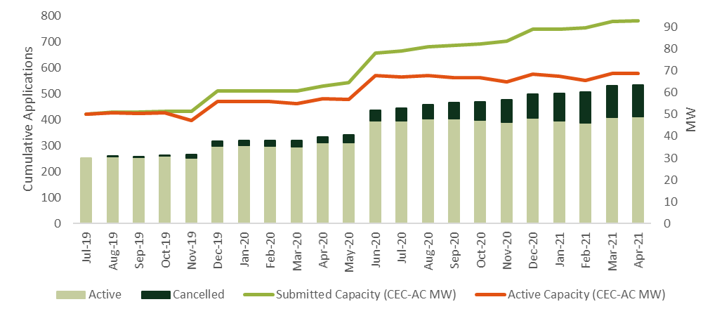
Participation Assessment
Application submission timeline
Notes:
Three of 5 IOUS exhausted year 1 funding on first day of program
Shows impact of cancellations – not only 24% reduction in applications but also more than >20MW of capacity lost
Primary reasons for cancellation (added after Phase I report):
Most frequent reasons was “Not interested in program at this time”
Half were “non-recoverable” (unlikely to become a future SOMAH project as the application was a duplicate, had received a MASH incentive, or did not meet SOMAH eligibility requirements)

Slide 12
Participation Assessment
Applications progress at time of reporting (4/29/2021)
Upfront Technical Assistance
(Track A)
Reservation Request
Energy Efficiency Milestone
Proof of Project Milestone
Incentive Claim
Inspection
Payment
Active Applications in Project Step
4
103
198
48
48
3
1
SOMAH Public Forum Project Statistics (9/1/2021)
6 final incentive payments issued
7 incentive claim milestone, inspection or payment
14 with incentive claim due in Q3 or Q4 2021
Notes:
Track A participation has been low and cancellations have been high – only 20 submitted to date and 4 active (2 that have received solar feasibility study)

Slide 13
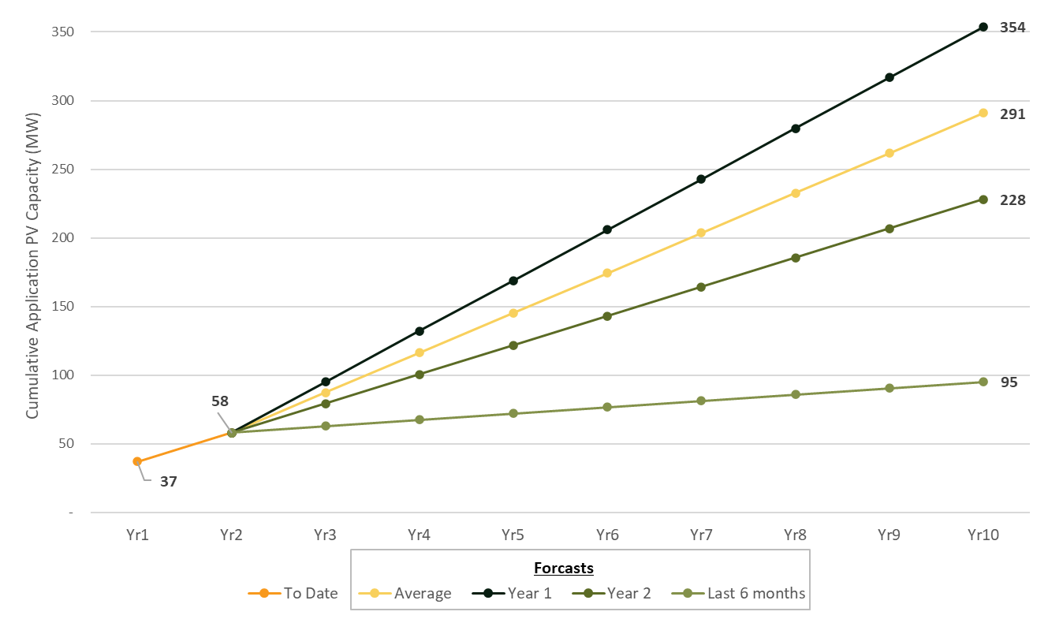
Participation Assessment
Capacity of active applications versus 10-year 300 MW goal
Participation started strong but has decline
  Application Capacity:
    Year 1: 37 MW
    Year 2: 21 MW
    Last 6 months: 4.6 MW
COVID started ~9 months after program launch
Appears capable of achieving goal…. but will not be easy!
Notes:
More than 250 applications submitted during the first week (50 MW_{AC}). Since that time, an additional 300 applications have been submitted (93 MW).
Year 2 of program received half # applications as year one.
Active Applications at this time ~ 366
MW of applications submitted in Yr1 = 37MW, Yr2 = 21MW, Cumulative 58MW
Achieving 300MW goal will require program to focus on marketing and outreach to build pipeline of new applicants, while simultaneously working to address barriers faced by property owners and contractors.
Review eligibility requirements such as exclusion of properties where PO pays tenant bills.

Slide 14
Participation Assessment
Property owner diversity
Participation dominated by multi-application property owners
Majority of applications are from non-profits organizations
Limited participation from housing authorities and for-profit organizations
Notes:
Participation has been dominated by multi-application property owners.
65% of applications submitted by 14 property owners
5% of applications submitted by single application property owner
Cancellation rate much higher for property owners who’ve submitted less than 10 applications (40% vs 13%)
Provide additional support to smaller or newly participating property owners. These applicants may need additional assistance from the SOMAH PA to successfully move through the application process.
Data improvements needed to identify type of organization

Slide 15
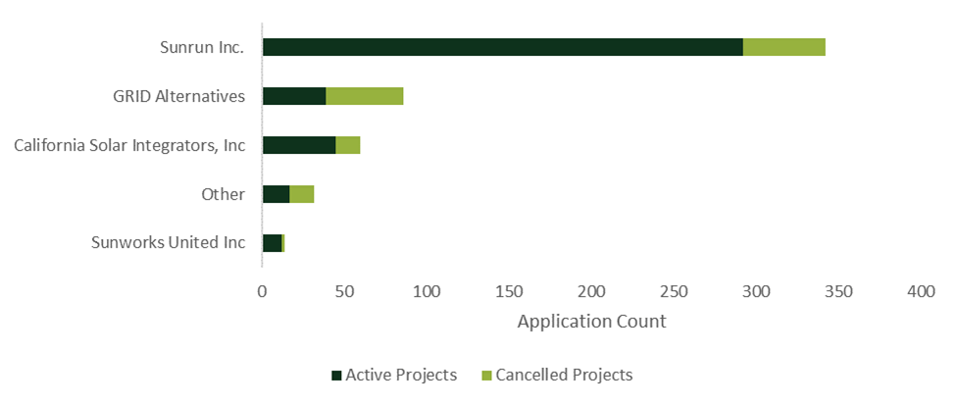
Participation Assessment
Contractor diversity
Diversity of participating contractors is low due to complexities and burdens of participation
  11 of 118 eligible have submitted applications
  One has submitted 2/3 of applications
  Four contractors submitted 94% of applications
Notes:
Participating contractors tend to be large (employing > 250 people, 84% of active applications where data was available] and lack ownership diversity (women or minority owned, 99% of active applications)
Increase SOMAH PA program support for subcontractors. The SOMAH PA can increase contractor diversity in the program by helping small contractors identify subcontracting opportunities on SOMAH projects. This allows subcontractors to gain experience with the program, thereby increasing their likelihood of submitting future applications and ensuring program contracting opportunities are dispersed amongst a diverse set of contractors.
Track diversity of subcontractors. Requiring program contractors to track subcontractor use and diversity status will help to assess the full extent of contractor diversity in the program.

Slide 16
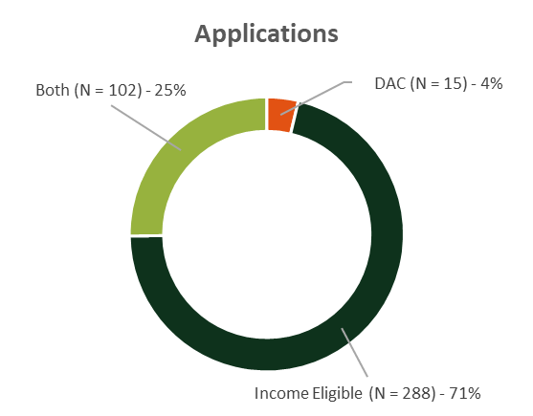
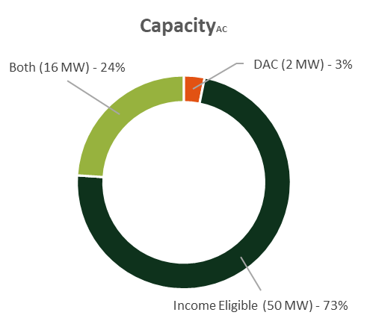
Participation Assessment
Disadvantaged Communities at time of reporting April 2021
Program priority to increase DAC participation
  29% of applications and 32% of eligible properties located in a DAC
Notes:
These figures are updated from the report to show active applications – but results very close (Applications all – 28%, active 29%)
Property eligibility
80% of residents must have incomes <= 60 percent of AMI
Located in a DAC as defined by CalEPA (top 25%) of census tracts statewide in the CalEnviroScreen.
SOMAH PA is currently focused on increasing participation in DACs, however, due to the location of these properties, the smaller potential PV capacity, and the limited contractor pool, increasing DAC participation may require the program to explore other options for these areas (i.e. higher DAC incentives, “direct-install” delivery method, ….)

Slide 17
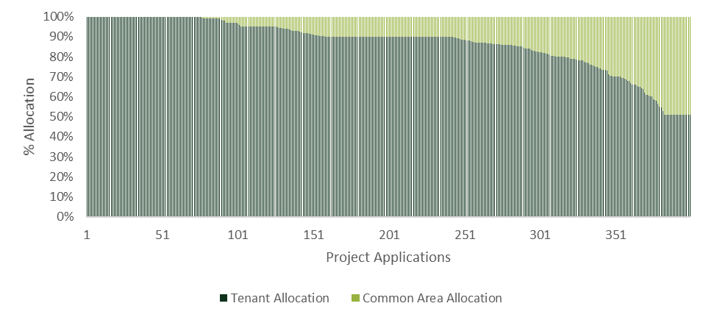
Participation Assessment
VNEM allocation – tenant vs. common area
Minimum tenant allocation of solar is 51%
Average allocation across active projects is 87%, higher than MASH 1.0/2.0
Notes:
Updated from report to only show active (very close 88% vs 87%)
Program requires 51%, average is 87% (non-weighted)
Mash 1.0 was 60% and Mash 2.0 was 45%

Slide 18
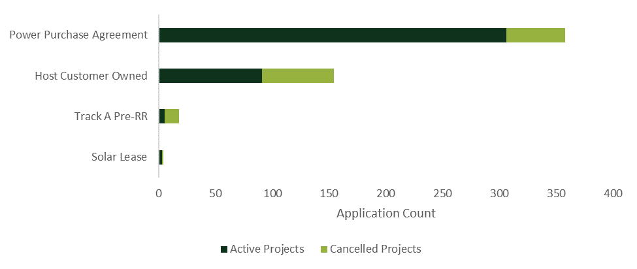
Participation Assessment
System ownership type
Power Purchase Agreement (PPA) ownership most common (69%) - but only 2 contractors
Other PPA benefits observed:
Lower cancellation rate
Higher use of federal Investment Tax Credit
Increased storage pairing
Notes:
PPA vs SSA – will use term PPA in this presentation although according to many property owners and contractors the correct term should be Solar Services Agreement – some technicalities we aren’t going to go into. We’ve recommended the SOMAH PA update the SOMAH handbook to clarify feasible ownership options.
PPA vs HCO :
less likely to be cancelled (15% vs 40%)
More likely to be paired with storage (92% PPA vs 2% HCO)
Increased leveraging of tax credits (94% vs 0%)
larger system sizes per tenant and overall, higher allocation to tenant
Only offered by 2 contractors to date – other contractors could use support
Discuss System ownership further in barriers discussion

Slide 19
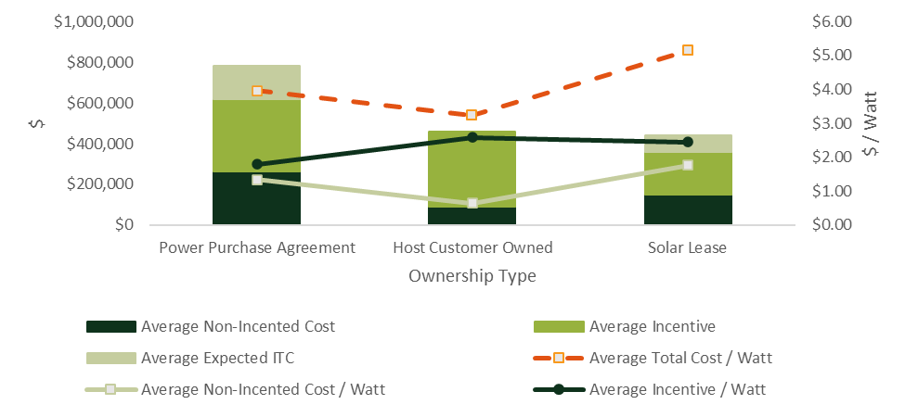
Participation Assessment
Project costs by ownership type
Notes:
Exhibit shows average project costs of PPA systems are higher than other ownership types but projects are bigger and so the average cost per watt is similar. PPAs typically utilize the ITC so the reserve program incentive was slightly lower. While the non-incented costs are larger than HCO they are typically rolled into the the PPA agreement and so the property owner has no out of pocket costs

Slide 20
Participation Assessment
Program expenditures to date
Notes:
SOMAH annual budget is $100M and admin are capped at 10% of total available funds. To date admin costs have been lower than the cap.
Further analysis of SOMAH program spending to date is being conducted as part of an add-on SOMAH Vendor Assessment

Slide 21
Process Assessment

Slide 22
Process Assessment
Property owner program awareness
Awareness primarily from prior solar program participation, existing contractor relationships, or direct contractor outreach
  Recommendations:
    Increase SOMAH co-marketing with IOUs, Community Choice Aggregators (CCAs), or other local government organizations
    Raise SOMAH Program awareness within city and county housing authorities
    Utilize SOMAH case studies to showcase and promote completed SOMAH projects
Notes:
Currently SOMAH PA markets program through numerous channels but few reported these channels as sources of program awareness. This will be important to build pipeline to meet program goals and can also help to increase contractor diversity.
Co-marketing of SOMAH with known/trusted organizations (including the IOUs) lends credibility to program. Increasing local government program interactions can help to improve project permitting.
Case studies can illustrate the benefits SOMAH provides to property owners and tenants and can build trust in the program via testimonials from peers within the affordable housing community. On the last SOMAH forum a call for case study volunteers was issued.

Slide 23
Process Assessment
Property owner motivations to participate
  Recommendation: Ensure marketing and outreach emphasize these and additional benefits to property owners
Notes:
Many property owners focus on the “triple bottom line” – expand performance of org to be judged based on financial, social equity and environmental factors.
Highest rated motivations were ability to install low/no-cost solar (9.4/10) and reduce tenant energy bills (8.9). Common area reductions were 7.8/10
Additional benefits:
Increased ability for tenants to pay rent.
Reductions to properties’ operating expenses increased money available for EE upgrades or other repairs
Important “equalizer” to help older properties be more comparable with new construction properties
Being viewed as “green” by local government is beneficial for permitting and funding – they are helping them meet their sustainability goals.

Slide 24
Process Assessment
Contractor motivations to participate
Contractor motivations included:
  Alignment with organizational mission or company goals
  Large portion of customer base is MF and it benefits their customers
  SOMAH fills market gap of solar in affordable housing sector
Most participating contractors had prior MASH experience

Slide 25
Process Assessment
Property owner barriers to SOMAH participation
Notes:
A primary focus of Phase II evaluation was assessing the barriers property owners and contractors face to participation as addressing these barriers is critical to programs success.
Focus on 3 Primary PO Barriers:
1 – Staff and prioritization amongst competing priorities - many reported they loved the idea of solar but at the end of the day their primary mission was to house people and solar was more of “a nice to have” – not enough hours in the day to do it all. One property owner hired a consultant to manage the project and that seemed to be working out. Could SOMAH PA fill this role? SolSmartProgram (DOE funded program) has an SolSmart Advisors offering - advisors can be embedded within an affordable housing organization to provide additional short-term staffing capacity to help navigate the application process.
Application burden also includes burden associated (especially for those who have submitted multiple applications) the amount of email received and tracking the project status was overwhelming – email opt-outs for nonessential emails or a project dashboard could be helpful.
2 – Project financing – primarily up front/out of pocket costs – this was a primary reason for cancellations for many – PPAs often eliminated these costs but came with some distrust/lack of control and “terms” were problematic. HCO were worried incentives would not cover project cost and didn’t have access to bridge financing (and didn’t want to be responsible for M&O or replacement (vandalism). Finding optimal balance between Tenant/CA allocation to increase incentives and cover monthly SOMAH costs was key. Progress Payment Pathway appears to be helping but still comes after many project costs have been incurred. Exploring way to leverage unreserved incentives (similar to PG&E SGIP financial assistance pilot) could be beneficial.
3 – Trust in program and contractor – as stated previously much of awareness comes from contractor outreach and there is a distrust reported by many affordable housing owners – either SOMAH proposition seemed too good to be true (and so many things to sign) or contractor (smaller ones in particular) would disappear (as many in the past have done)
Many of these could be addressed with additional project support from the SOMAH PA

Slide 26
Process Assessment
Contractor barriers to SOMAH participation
Notes:
Lead generation was #1 barrier for nonparticipating contractors

Slide 27
Process Assessment
Likelihood of future participation
Low likelihood related to:
  Application burden
  Staffing constraints
  Funding concerns
  Incentive timing
Notes:
Roughly one-quarter unlikely to submit an additional application for property in the future.
Reasons for being unlikely:
Participation “must be easy and SOMAH has been hard”…“lots of work, many moving parts, if program could be streamlined” they would be more likely to participate again.
Staff person who managed project left and will not be replaced due to funding.
Current projects that had not received SOMAH funding and concerned incentive would not cover the costs of existing project(s).
Time until the incentive is paid is long – current projects “are impacting their operating budget, their ability to purchase additional properties, and thus they have to consider the time value of money and whether they could use it more effectively elsewhere.”

Slide 28
Process Assessment
Satisfaction with SOMAH and program elements
Property Owner satisfaction:
  High levels of satisfaction with the SOMAH Program, incentive levels, and SOMAH contractors
  Lower satisfaction with eligibility requirements and application process/timeline
  Contractor satisfaction:
  Mixed - SOMAH is important having a large impact on low-income MF solar adoption
  Satisfaction was moderate due to program being overly burdensome
  Contractors rated their interactions with the SOMAH PA highly
Notes:
Contractors stated absent the SOMAH Program none or few of their SOMAH projects would be completed.

Slide 29
Process Assessment
Impacts of COVID-19 on program participation
Project permitting delays - Municipal planning departments were closed, staffed at reduced capacity, or working remotely which led to delays
Supply chain delays - Disruptions in supply chain meant project materials, such as steel from China needed for carports construction/upgrades, required longer lead times
Onsite delays – Onsite procedures to ensure health and safety of residents and contractors were necessary
Notes:
Lead generation was #1 barrier for nonparticipating contractors

Slide 30
Impact Assessment

Slide 31
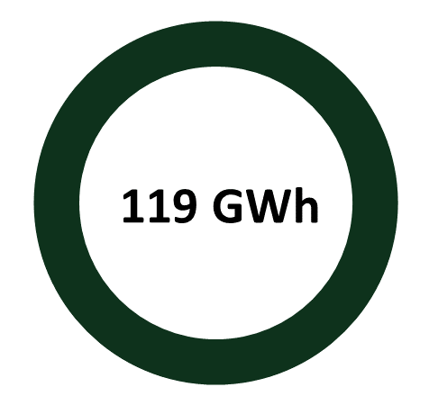
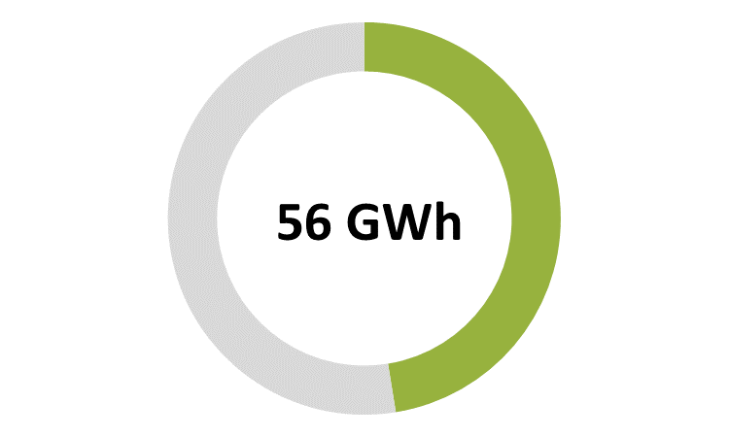
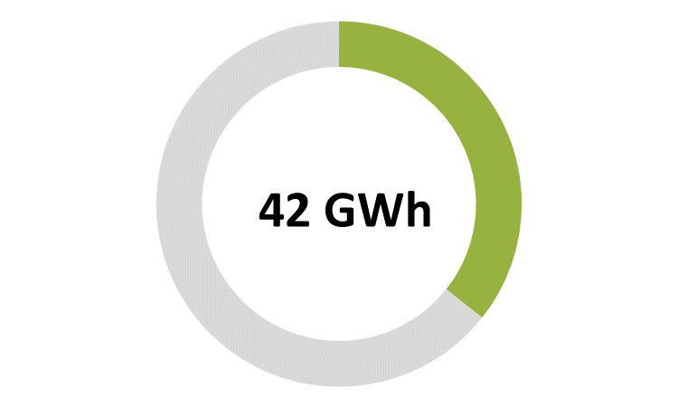
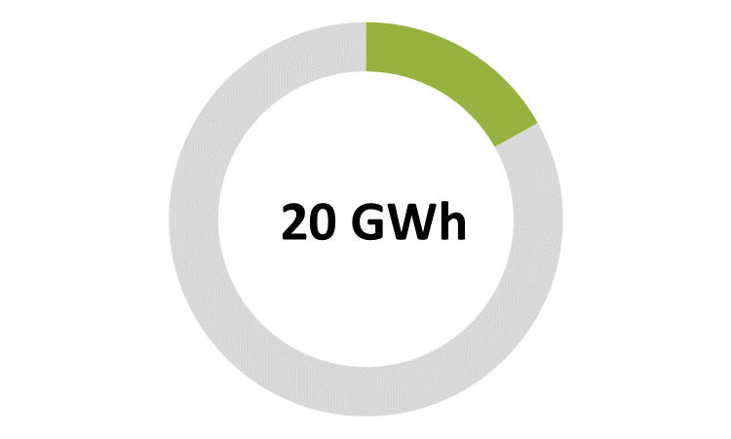
Impact Assessment
Expected Electricity Generation
PG&E
SCE
SDG&E
Notes:
“ex-ante” as they are estimates of the expected future impacts if and when the projects are installed.
Annual estimated ex-ante electric generation across SOMAH applications is 118,816 MWh. PG&E contributes ~ 50% of the total due to their number of systems. Their average impact per project was about 20% lower than SCE or SDG&E/
Annual Capacity Factor is the actual energy output / maximum output (i.e if the solar were operating 24 hours a day)
PG&E’s projects’ lower annual capacity factor is due to inherent differences in climate and typical available solar irradiance between Northern California and Southern California.
Active SOMAH applications would have contributed approximately 43.3 MW and 4.9 MW of generation during the CAISO 2020 gross and net peak hours, respectively.

Slide 32
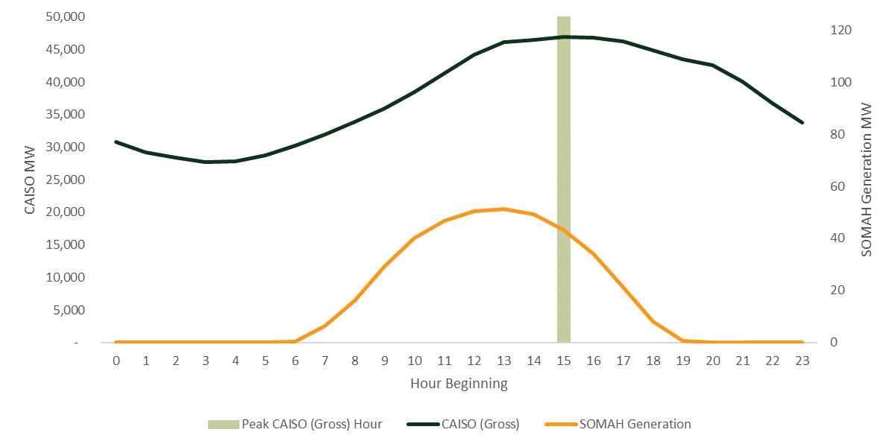
Impact Assessment
Expected CAISO Coincident Peak Demand Generation
Notes:
Estimated coincident peak demand impacts are defined as generation from SOMAH PV systems during hours of CAISO or IOU peak demands. The single largest annual CAISO or IOU peak hours provide brief snapshots of program coincident demand impacts. However, analyzing peak demand over the top 200 peak hours can provide a greater insight into how SOMAH projects impact the grid during hours of highest load.
Active SOMAH applications would have contributed approximately 43.3 MW and 4.9 MW of generation during the CAISO 2020 gross and net peak hours, respectively.

Slide 33
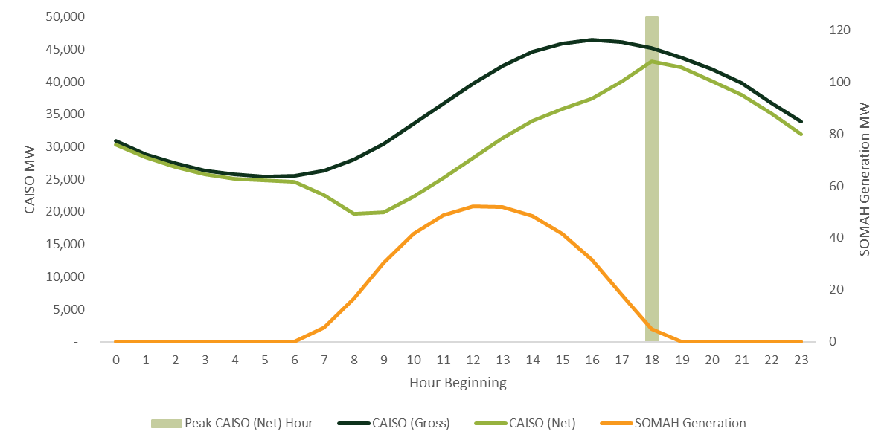
Impact Assessment
Expected CAISO Coincident Peak Demand Generation
Notes:
Estimated coincident peak demand impacts are defined as generation from SOMAH PV systems during hours of CAISO or IOU peak demands. The single largest annual CAISO or IOU peak hours provide brief snapshots of program coincident demand impacts. However, analyzing peak demand over the top 200 peak hours can provide a greater insight into how SOMAH projects impact the grid during hours of highest load.
Active SOMAH applications would have contributed approximately 43.3 MW and 4.9 MW of generation during the CAISO 2020 gross and net peak hours, respectively.

Slide 34
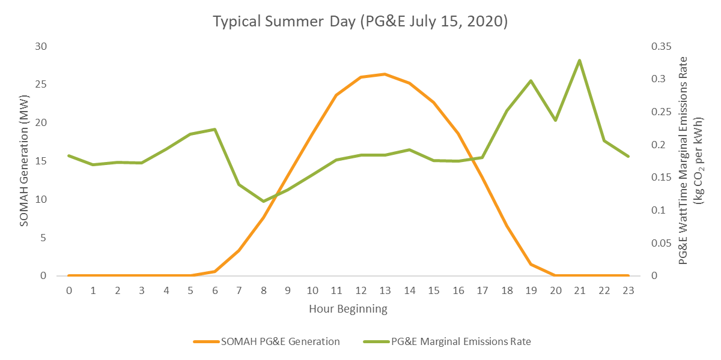
Impact Assessment
Environmental – GHG reductions
Notes:
SOMAH projects are expected to reduce greenhouse gas emissions by 23,670 metric tons during their first year of operation using 2020 emission rates.

Slide 35
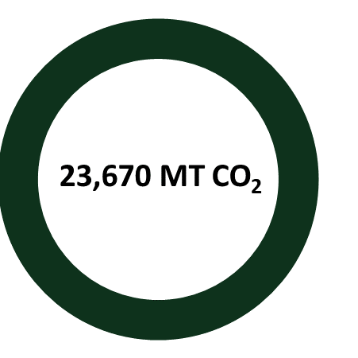
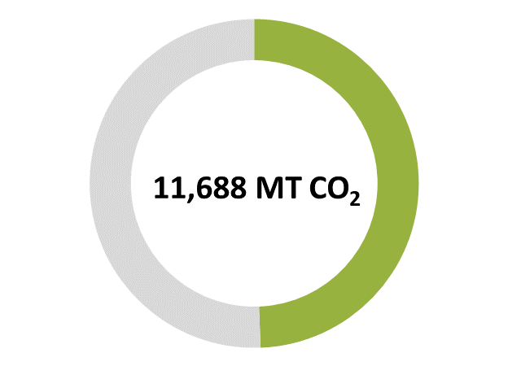
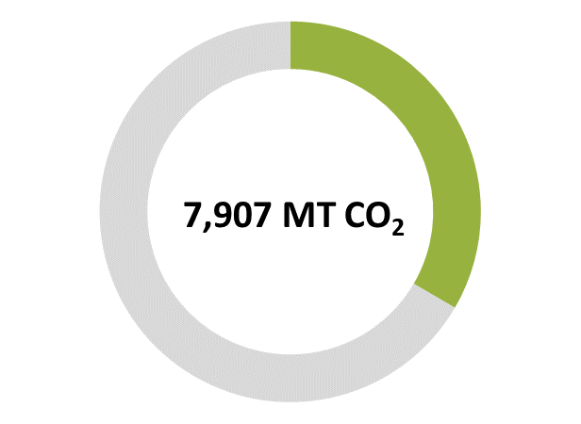
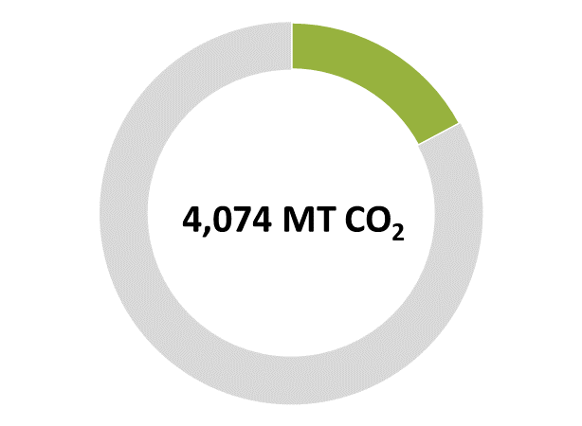
Impact Assessment
Environmental – GHG reductions
PG&E
SCE
SDG&E
Notes:
SOMAH projects are expected to reduce greenhouse gas emissions by 23,670 metric tons during their first year of operation using 2020 emission rates.

Slide 36
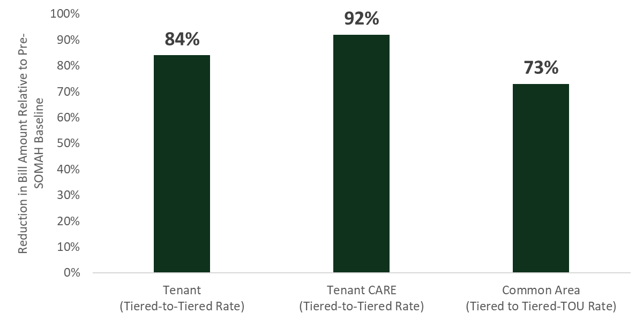
Impact Assessment
Economic – Bill Savings
Notes:
SOMAH project
Once projects are completed and interconnected, the program will have a better understanding of final system configurations (e.g., storage pairing plans). We recommend that future program evaluations leverage actual metered data and customer bills to validate the ex-ante findings presented in this report and shed light on reasons for significant deviations from expected performance if found.
s are expected to reduce tenant monthly bills by round $50/tenant (roughly 80 percent of previous bil
Tracking tenant and common area rates (including CARE) pre and post installation would help ensure the accuracy of the common and tenant area bill savings estimates calculated by program evaluators.
As part of SOMAH’s application process the IOUs provide the SOMAH PA with historical consumption data for the tenant and common area meters associated with a SOMAH project (IOU data request). Retaining the account numbers or meter numbers used to complete the IOU data request queries would ease the burden of pulling the interval data needed for future impact evaluations.
ls).

Slide 37
Recommendations
Participation:
­Ensure ME&O activities are effectively building a robust pipeline of future SOMAH projects
Ensure program incentives are appropriately set to support future SOMAH projects
Examine SOMAH eligibility requirements to ensure all intended properties are included in program
Process:
­­Increase support to contractors and property owners to overcome barriers to participation
Identify opportunities to streamline and reduce burden of SOMAH application process
Meet with new applicants to verify eligibility, ensure adequate program knowledge, and provide program support throughout application process
Impact:
­­Leverage actual meter data and customer bills to validate the ex-ante impact findings
Track pre- and post-SOMAH tenant and common area rates to increase accuracy of bill impacts
Retain IOU-SOMAH data to ease future impact evaluation needs
Notes:
Barriers

