Slide 1
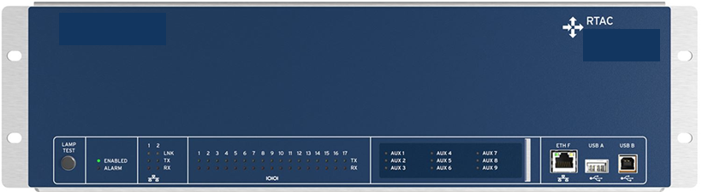
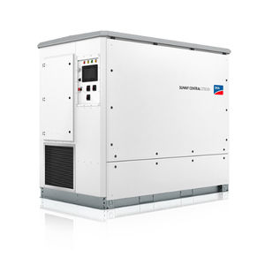
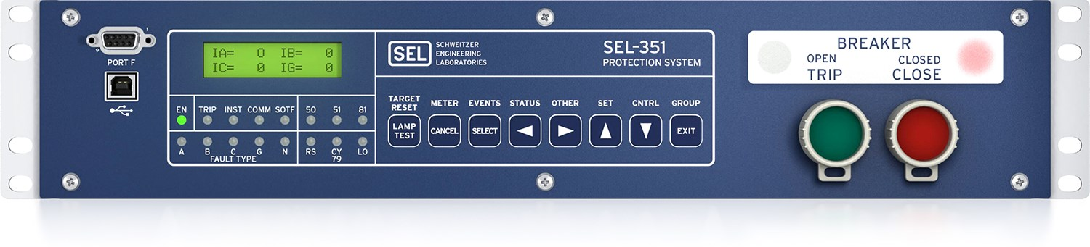

Relay+RTAC Configuration
RTAC (3505 or similar)
Measurement data
Power setpoints
Inverter(s)
Sensor Box*
Trip flag
Measurement data
Relay
M
Breaker
*may not be needed if sensors connected directly
Notes:
More items to track that I won’t go into detail on are

Slide 2
Relay+RTAC Configuration
RTAC (3505 or similar)
Power setpoints
Inverter(s)
Modbus or other protocol
Change/monitor trip variable
DNP or other protocol
Relay
M
Breaker
Notes:
More items to track that I won’t go into detail on are

