Slide 1
Limited Generation Profiles Workshop #3 per Resolution E-5211
December 16, 2022
9:00 AM -- 3:30 PM PST
Please keep yourself muted when not speaking and do NOT put the call on hold. If muted by the leader, press *6 to unmute.

Slide 2
Workshop Logistics & Announcements
Safety reminder. Make a note of your surroundings and exit routes. Reach out if you need help, either during the call or to an attendee
This meeting is being recorded
  Workshop recording and materials will be posted in the CPUC Rule 21 Limited Generation Profiles Web Page.
If you were forwarded the invite and did not receive it directly from Energy Division, and would like to be added to the workshop distribution list, please email Mary Rottman at Mary.Rottman@cpuc.ca.gov
Workshop participants are encouraged to ask questions during the presentation; a dedicated Q&A time slot has also been scheduled after each presentation
Please keep yourself muted when not speaking and do NOT put the call on hold. To speak, unmute yourself from the button at the lower part of your screen
  If calling in by phone, use the mute button on your handset and unmute yourself to speak. If muted by the host, press *6 to unmute. To raise your hand press *3
Resolution E-5230 was issued on December 9, 2022. Subject: ALs (PG&E 6141-E, SCE 4455-E, SDG&E 3721-E) related to OP 15/51 of D.20-09-035 on Limited Generation Profiles.
Questions?
Please keep yourself muted when not speaking and do NOT put the call on hold. If muted by the leader, press *6 to unmute.

Slide 3
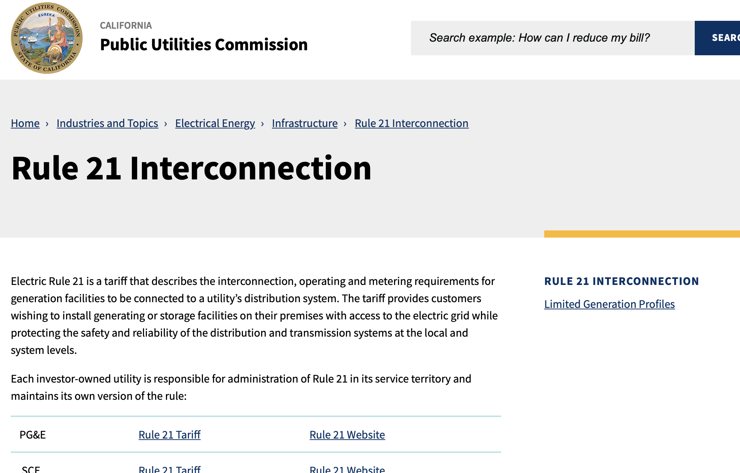
Rule 21 Web Page: Limited Generation Profiles
Main Page: https://www.cpuc.ca.gov/rule21/
Workshop recording and materials will be posted in the Rule 21 Limited Generation Profiles Web Page
Please keep yourself muted when not speaking and do NOT put the call on hold. If muted by the leader, press *6 to unmute.

Slide 4
Agenda
Please keep yourself muted when not speaking and do NOT put the call on hold. If muted by the leader, press *6 to unmute.

Slide 5
Workshop Goals
Arrive at a consensus proposal on “the specifics of whether and how reductions to a customer’s Limited Generation Profile are determined," the process to implement a reduction of export power (OP 15), and address that “Retroactive alterations to generation profiles shall not reduce generation to below a pre-defined static level, i.e., the lowest Integrated Capacity Analysis – Static Grid typical profile value identified at the time of the Interconnection Application.” (OP 16)
The IOU presentation contain the IOUs' proposals but should not be taken as final solutions
Stakeholders are welcome to, based on the information gathered, propose a different process
Rule 21 is an end user of the ICA and changes to the ICA are out of scope--Discussions on the ICA should not center on changes to the ICA
Please keep yourself muted when not speaking and do NOT put the call on hold. If muted by the leader, press *6 to unmute. ​

Slide 6
Resolution E-5211 (Issued Oct. 10, 2022)
ALs due by January 8, 2023
  D.20-09-035 and Resolution E-5211 will be used as guidance to evaluate the ALs
  IOUs should, and non-IOU parties encouraged to, review all sections of Res. E-5211 to ensure compliance of requirements
  Per Resolution E-5211: These ALs shall specify which items have reached consensus within the workshop participants and which items have not reached consensus. If an item has not reached consensus, the Large IOUs shall provide details as to the bases for lack of consensus and the alternative proposals, if any. (Res. E-5211 at 9-10)​
    IOUs should include any write-up as provided by non-IOU parties when presenting alternative proposals.
    More guidance to follow.

Slide 7
Resolution E-5211
Of note, but not inclusive of all requirements to be met:
  These ALs shall specify which items have reached consensus within the workshop participants and which items have not reached consensus. If an item has not reached consensus, the Large IOUs shall provide details as to the bases for lack of consensus and the alternative proposals, if any. (Res. E-5211 at 9-10)
  These Tier 3 ALs shall fulfill the direction given in OP 16 by articulating specific and defined conditions (the “whether”) under which a LGP customer may be required to reduce export power to the lowest ICA-SG value identified at the time of interconnection or other value and shall propose a process (the “how”) to reduce a customer’s LGP. These conditions and this process proposal shall be actionable and described at a level of detail such that they do not require further stakeholder discussions to address policy or technical questions for implementation. (Res. E-5211 at 13)
  Any reference to profile reductions needed for ensuring safe and reliable service shall be clearly substantiated and justified. Use cases that would result in such reductions shall be specified and enumerated. The underlying concern, triggering condition(s) and parameters that must be satisfied to justify a reduction in profile values for each prospective use case shall be explicitly specified. The Commission will not entertain arguments from the Large IOUs that merely state a reference to safety and reliability concerns without proper discourse articulating how profile reduction proposals ensure safety and reliability. This discourse shall include clear detailed examples and shall articulate the most likely outcomes of adopting or not adopting the proposals. This requirement applies to any topic where safety and reliability is concerned. (Res. E-5211 at 23)

Slide 8
Next Steps
ALs due Jan. 8, 2022
E-mail Energy Division with any topics that need addressing in ALs by 12/22/22.
  Topics should conform to requirements of D.20-09-035 OP 15/16 and Resolution E-5211
  Energy Division will circulate items to IOUs

Slide 9
Background: OP 16 and 15 Requirements of D.20-09-035
OP 16 required the IOUs to provide “the specifics of whether and how reductions to a customer’s Limited Generation Profile are determined. The Advice Letter shall include a description of how the Utilities will implement Ordering Paragraph 15.”
OP 15 adopted the IOUs’ counter proposal for Issue 9 (Limited Generation Profile) with modifications and stated “Retroactive alterations to generation profiles shall not reduce generation to below a pre-defined static level, i.e., the lowest Integrated Capacity Analysis – Static Grid typical profile value identified at the time of the Interconnection Application. As part of the proposal, Utilities shall: i) allow customers to utilize a smart inverter’s ability to increase its output on a monthly basis; and ii) use a10 percent buffer, which shall be revisited.”
Please keep yourself muted when not speaking and do NOT put the call on hold. If muted by the leader, press *6 to unmute.

Slide 10
Questions?

Slide 11


