Slide 1
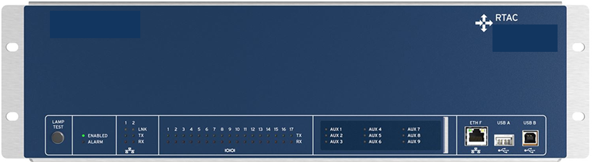
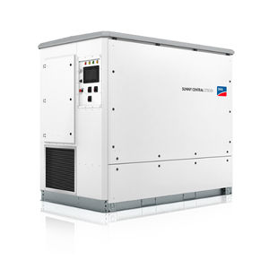
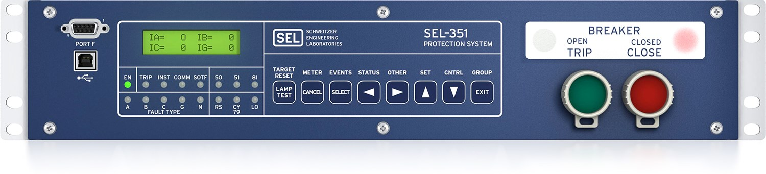

Relay+RTAC Configuration
RTAC
Measurement data
Power setpoints
Inverter(s)
Sensor Box*
Trip flag or group change
Measurement data
Relay
M
Breaker
*may not be needed if sensors connected directly
Notes:
More items to track that I won’t go into detail on are

