Slide 1
MASH Program Evaluation Report
DNV presents its evaluation of the Multifamily Affordable Solar Housing (MASH) Program.
Hosted by Energy Division
May 4, 2023, Webinar
This webinar will start at 11:05 am. Thank you for your patience.

Slide 2
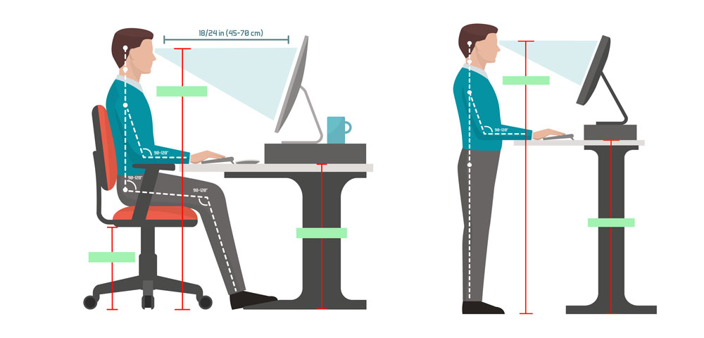
Webinar Logistics and Safety
Online only
  Audio through computer is recommended
  Dial by phone : 1-855-282-6330
  Access Code: 2493 945 4721
  This webinar is not being recorded
Hosts
  Energy Division Staff:
    Tory Francisco, Supervisor
    Sarah Lerhaupt
Safety
  Note your surroundings and closest exits
  Ergonomic Check

Slide 3
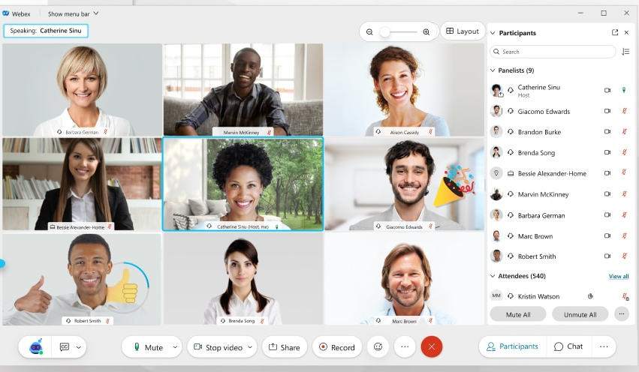

Webex Participant Guide
Change Layout
All attendees are automatically muted
Open the chat box and participant panel
Locate “Raise Hand” button the participant panel to ask a question and be unmuted
Closed Captioning
Mute/ Unmute
Not Available During a Webinar
Audio Options
Leave Meeting
Participant List
Chat
Image Credit: Cisco Webex

Slide 4

Regulatory Information: https://www.cpuc.ca.gov/mash
CPUC Contact: Sarah Lerhaupt, sarah.lerhaupt@cpuc.ca.gov
Interested in a job at the CPUC? We’re hiring!
www.cpuc.ca.gov/careers/

Slide 5
DNV MASH Evaluation Presentation
DNV will now present their slides showing their findings.

Slide 6
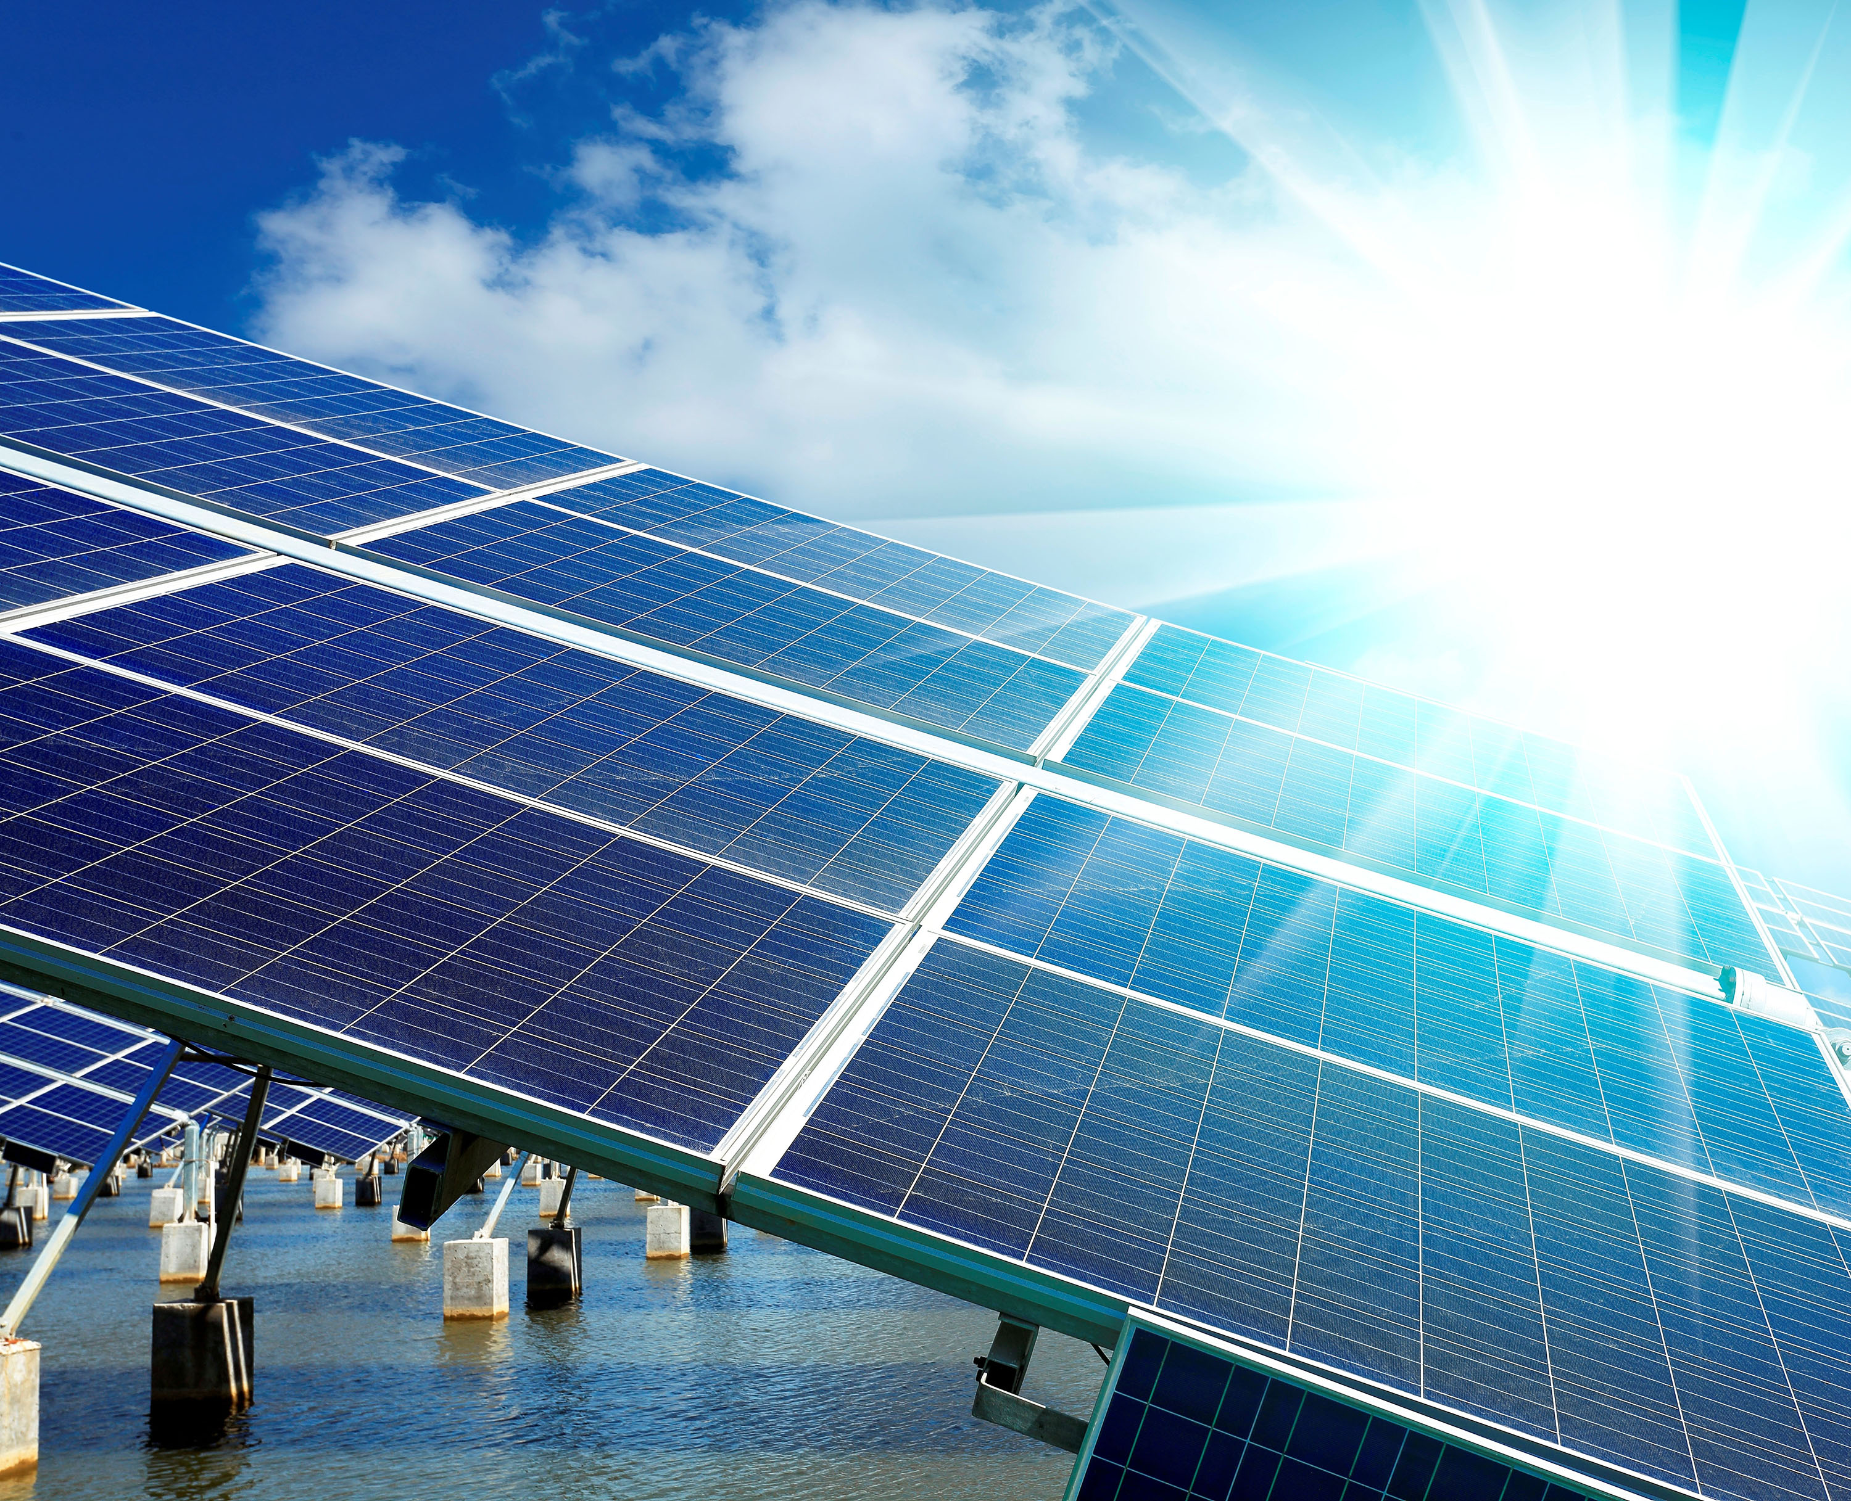
California Solar Initiative Multifamily Affordable Solar Housing (MASH) Evaluation
Draft Evaluation Report Presentation
May 4, 2023

Slide 7

Agenda
Evaluation team
Program background
Evaluation objectives
Evaluation tasks and outcomes
Cost assessment
Evaluation Summary
Environmental benefits
Program delivery metrics
Workforce outcomes
System characteristics
Customers served
Bill impacts
Electrical system benefits
Questions

Slide 8

Evaluation Team
Megan Ovaska
Project Manager
Paula
Ham-Su
Customer Impacts and Data Management
Carrie Webber
Environmental Impact
Kytson McNeil
Cost Assessment
Karen Cramton
Program Outcomes
CPUC Team:
Sarah Lerhaupt, Tory Francisco

Slide 9
Program background

Slide 10
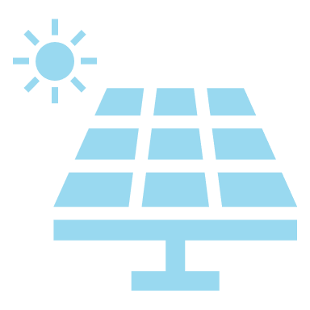
Introduction to MASH Program
Program Background
CSI MASH program provided upfront solar incentives in the form of a one-time rebate paid at the time of project completion to qualifying affordable multifamily housing residences
The program was overseen by the CPUC PG&E, SCE, and The Center for Sustainable Energy in SDG&E)
Two incentive tracks
2005-2006: CSI established
October 2008: D.08-10-036 issued, adopting framework for MASH
2013: AB 217 set additional program goals
2016: Start of MASH 2.0
December 31, 2021: Close of program

Slide 11
Program Goals
Initial Goals (D. 08-10-036)
Stimulate the adoption of solar power in the affordable housing sector;
Improve energy utilization and overall quality of affordable housing through the application of solar and energy efficiency technologies;
Decrease electricity use and costs without increasing monthly household expenses for affordable housing building occupants; and
Increase awareness and appreciation of the benefits of solar among affordable housing occupants and developers.
Goals added in 2013 (AB 217)
Maximize the overall benefit to ratepayers;
Provide job training and employment opportunities in the solar energy and energy efficiency sectors of the economy.
Require participants who receive monetary incentives to enroll in the Energy Savings Assistance (ESA) program.

Slide 12
Evaluation objectives

Slide 13


Reason for evaluation
To satisfy the evaluation requirement of D.15-01-027, DNV performed an end of program assessment to determine whether MASH achieved their program goals and assess benefits to customers, the environment and the electrical system

Slide 14
Evaluation tasks and outcomes

Slide 15
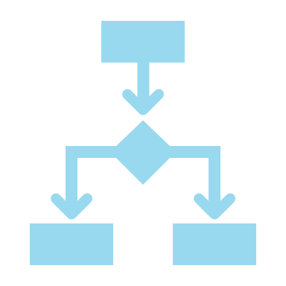
Program Delivery Metrics - Approach
Applications, Program Participation, and Workforce Outcomes
Summarization of program process, and applications received, approved, declined, and withdrawn
Assessment of training program, including analysis of total number trained, hours trained, and type of work done (job categories)
Examination of projects by location, type and size, number of benefitting households, projects in disadvantaged communities

Slide 16
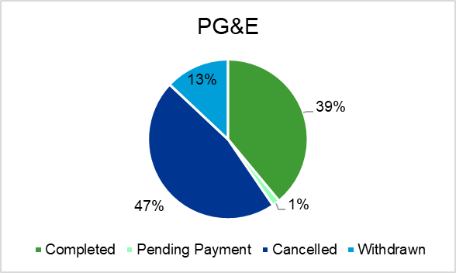
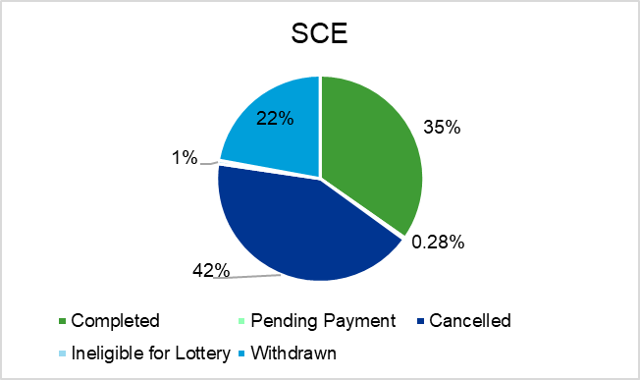
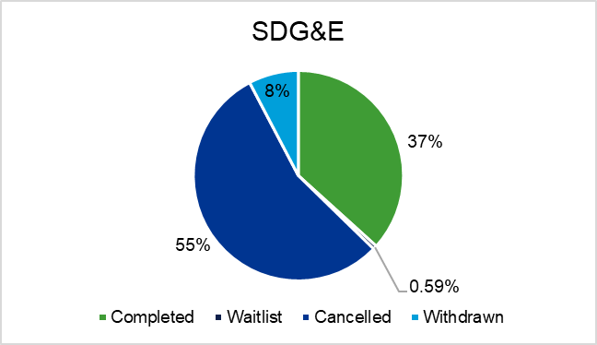
Program Delivery Metrics: Application status
Overall, 38% of all applications resulted in completed projects
62% of applications were cancelled, withdrawn, waitlisted, ineligible for lottery

Slide 17
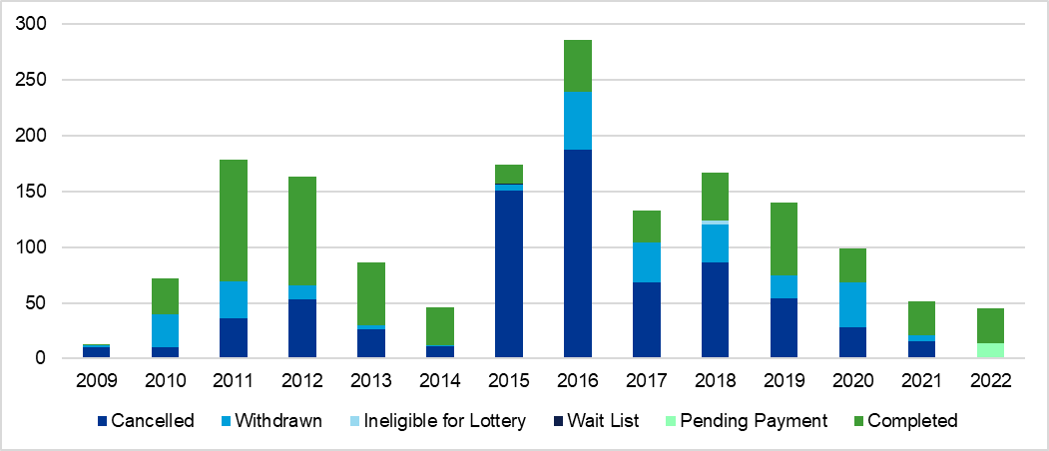
Program Delivery Metrics: Applications by year

Slide 18

Customers Served
Overall, 9% of the projects served mobile home properties
A notable 31% of SDG&E MASH installations at mobile homes
More than 16,000 households are directly benefitting from MASH projects
Majority of MASH projects support medium properties (11 - 99 units), followed by large-sized properties (>= 100 units), then small properties (<=10).

Slide 19
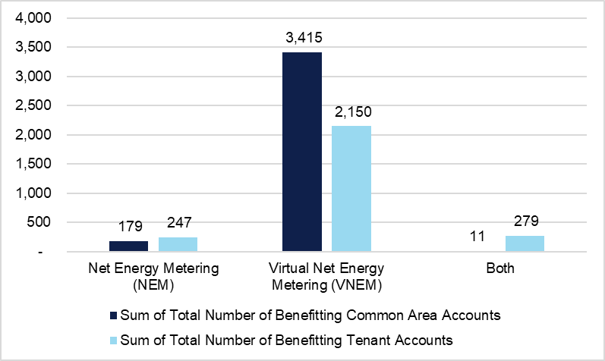
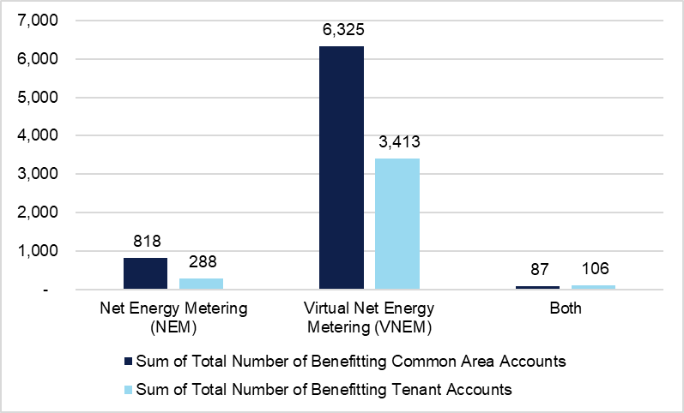
Customers Served: MASH 1.0 v. 2.0
MASH 1.0
MASH 2.0
More installations and customers served in MASH 2.0
NEM metering types were most frequently offset common area load
VNEM metering types mostly served both common area and tenant loads

Slide 20
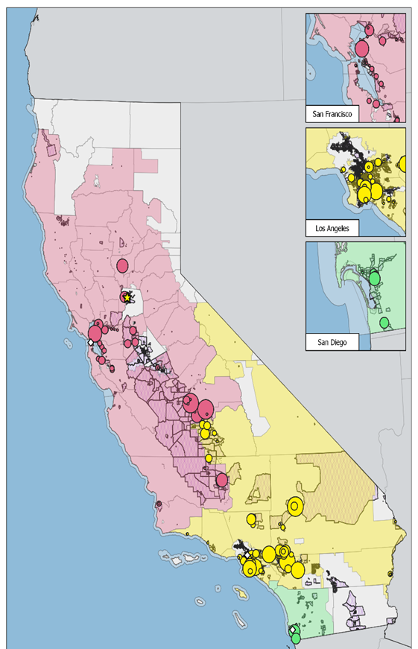
Customers Served: Projects located in DACs
  Projects were concentrated near major metropolitan areas: San Francisco, Los Angeles, and San Diego
  Larger capacity projects were more likely to be installed outside major metropolitan areas
  Overall, 1/3 of projects were installed in DACs
  Projects not located in DACs were located near DACs

Slide 21
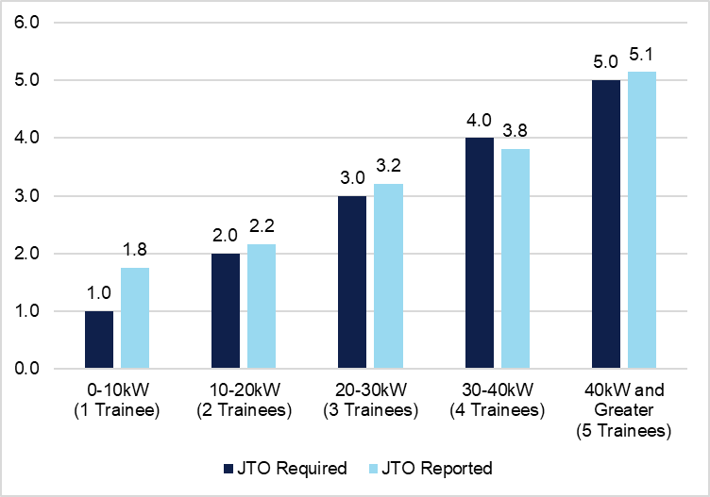
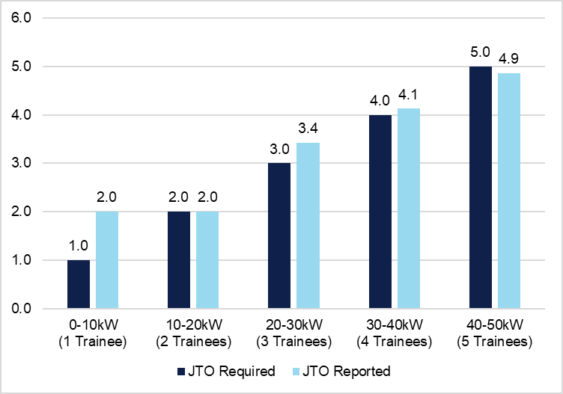
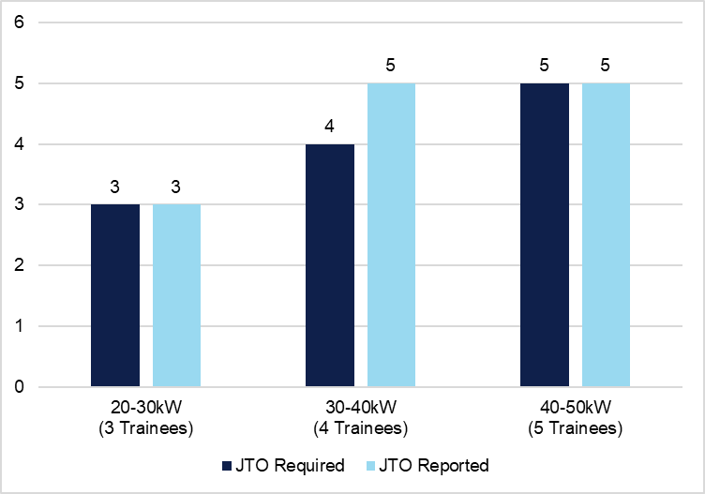
Total Workforce Outcomes: JTO required vs. average
PG&E
SCE
SDG&E
Job training requirements based on project capacity (system size)
  < 10 kw = 1 trainee
  10-20 kw = 2 trainees
  20-30 kw = 3 trainees
  30-40 kw = 4 trainees
  > 50 kw = 5 trainees
Average number of trainees per project size category generally met or exceeded program requirements
When exceeding program requirement, the excess was minimal
Recommendation: Adjust system size ranges to encourage more training on larger jobs

Slide 22

Total Workforce Outcomes: Job categories
Majority of trainees participated in solar installation or project management/coordination training
Most of training hours were dedicated to solar installation training
Project design and engineering trained the fewest workers but provided the greatest number of training hours per trainee
Evaluation could neither confirm nor deny if an individual received training on multiple projects, due to the lack of trainee names in tracking documentation

Slide 23

System Characteristics - Approach
Summarize the dollar value of award, interconnected solar generation capacity (kWAC), property type, and interconnection meter type
Compare incentive level/system capacity by meter type
Compute post-installation consumption for common area metered accounts, tenant accounts and tenant metered accounts participating through VNEM, compare pre-installation consumption to post-installation consumption by program and by meter type

Slide 24
System Characteristics by Program Phase
MASH 2.0 projects on average received lower incentives
MASH 2.0 projects were on average larger than MASH 1.0 projects

Slide 25
System Characteristics by Metering Type
55% of the completed projects were interconnected under NEM, 44% were VNEM, and 1% employed both metering types
NEM projects were on average the smallest in size.
VNEM systems were approximately 50% larger with an average system size of 118.79 kW.

Slide 26
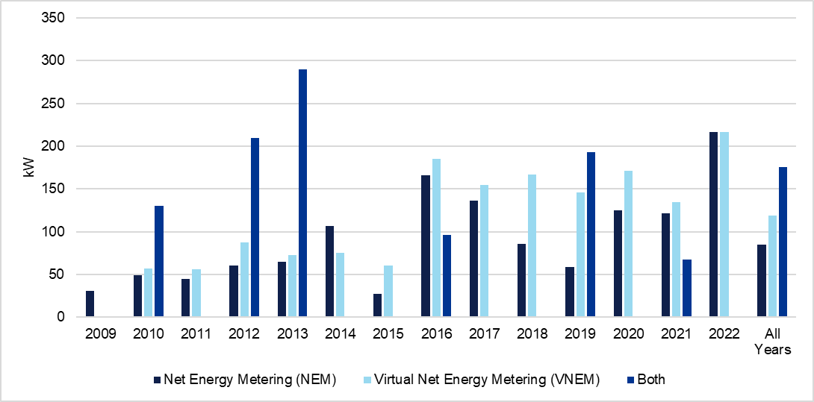
Average system capacity by year by metering type
Projects with both NEM and VNEM meters on average received the highest incentives

Slide 27

Bill Impacts Methodology
Model energy use, individually for each benefiter, and separately for one-year pre- and one-year post-PV installation.
Apply normal weather to each model. These makes both periods comparable.
Energy use impacts are the difference between pre- and post- weather-normalized use.
COVID changed the energy use landscape. To address this important factor, we estimated impacts separately for groups affected by COVID.

Slide 28
Data Needed
AMI data for VNEM benefiters –this data reflects their actual kWh use
Billing data for VNEM benefiters –this data reflects the kWh they paid for, and starting in 2016, how much
Weather data: actual to model energy use, and normal to make the pre- and post-installation periods comparable

Slide 29
Data Challenges
IOUs had trouble identifying the MASH projects in their billing and AMI data. The IOUs do not need this to bill customers correctly.
Most available interval data is from 2015 or later, which means that we missed at least one of the years we needed for all earlier installations.
The PG&E dataset had enough resolution to conduct the billing analysis on a subset of their participants.

Slide 30
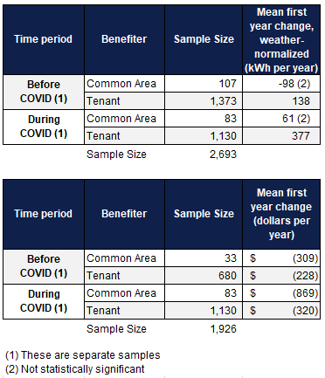
Bill Impacts
For installations before COVID, tenants used 138 kWh more per year and paid $228 per year. This is a 3.2% increase in energy use
For the installations affected by COVID, tenants used 377 kWh more per year, an 8.6% increase in energy use
COMMON AREAS: there was no statistically significant change in energy use. However, the change in dollars paid is significant.

Slide 31
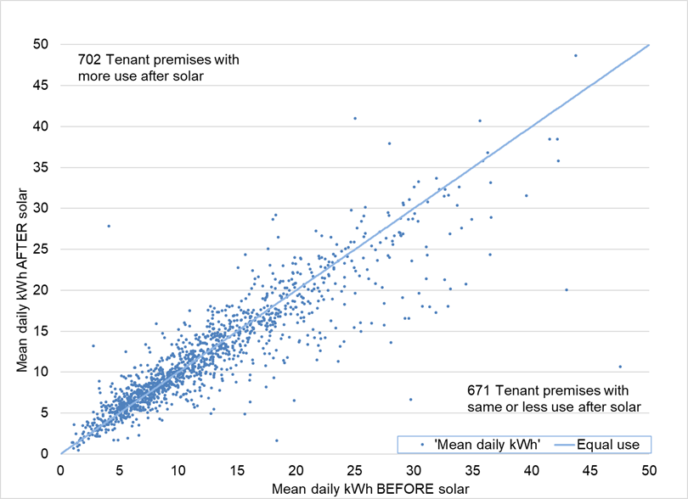
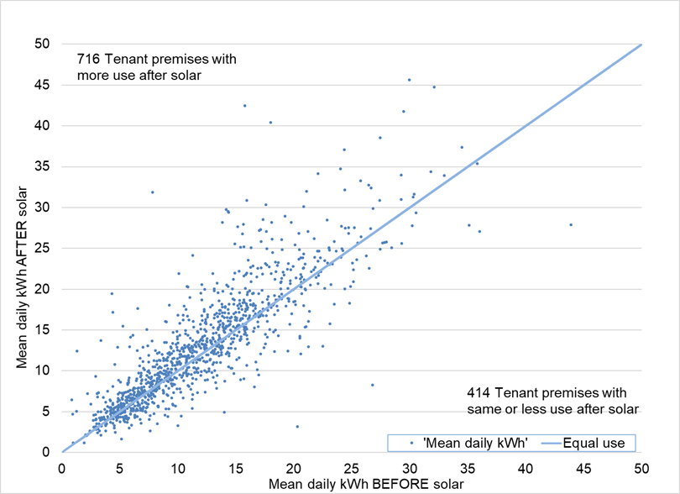
Bill Impacts
– First-year tenant daily kWh, pre- and post-
Before COVID
During COVID

Slide 32
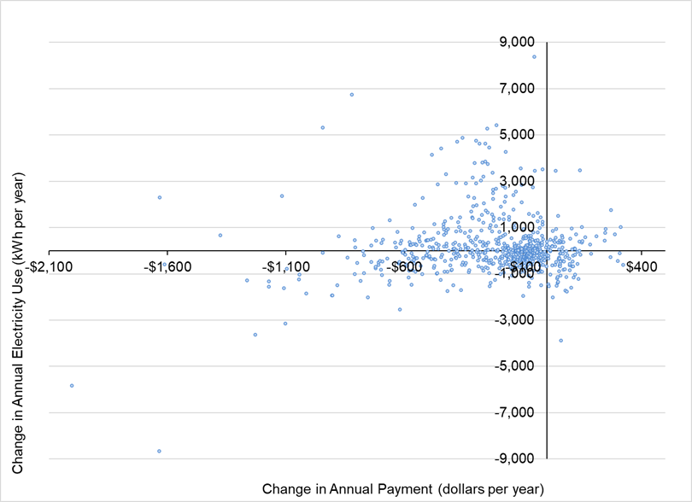
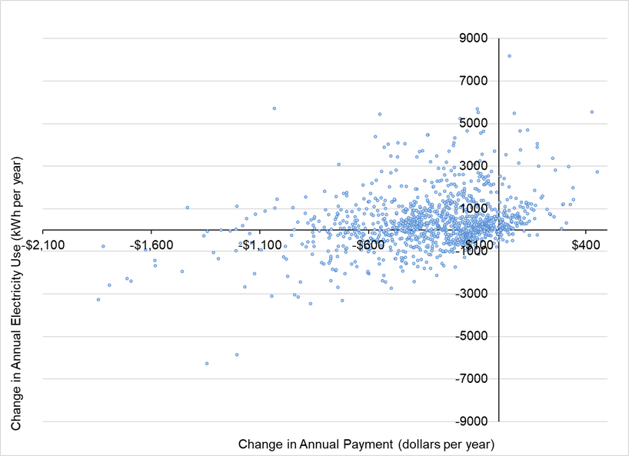
Bill Impacts
- Tenant change in annual kWh Vs change in annual bill
Before COVID
During COVID

Slide 33
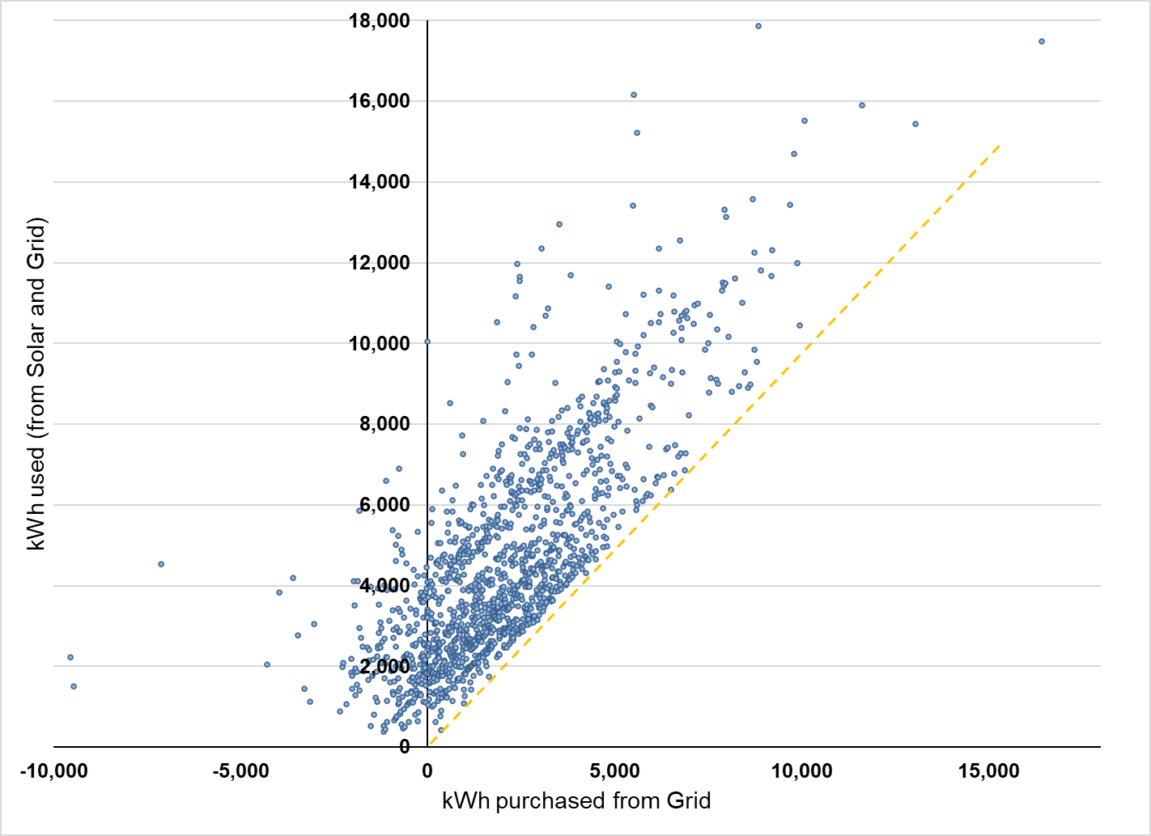
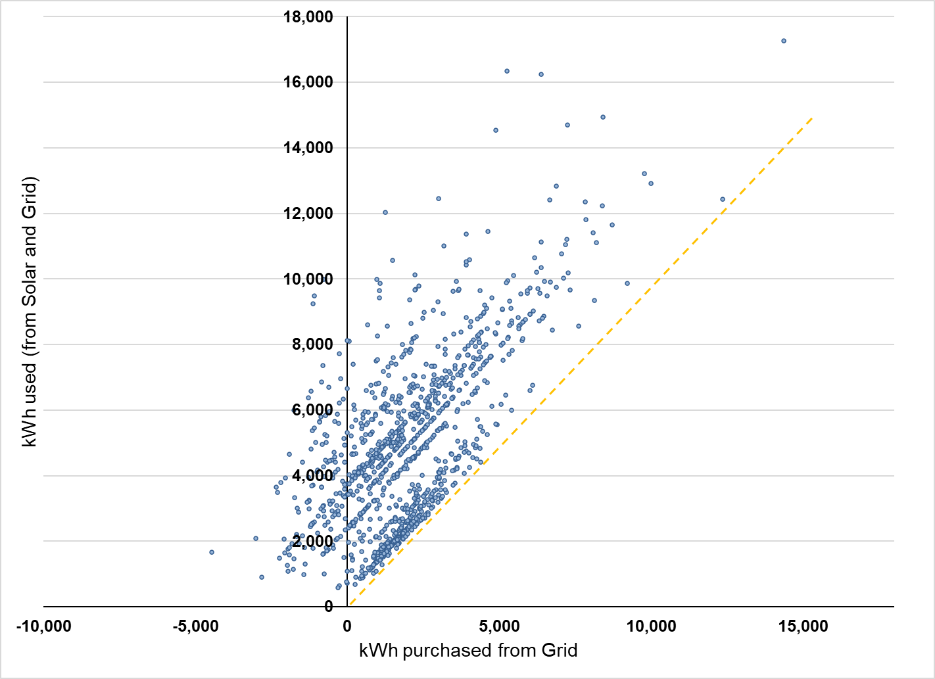
Bill Impacts - Tenant kWh used (from solar and grid) Vs kWh purchased (from grid)
Before COVID
During COVID

Slide 34
Bill Impacts – CARE V. non-CARE
For tenants where the first year occurred before COVID, non-CARE customers experienced an increase in energy use, while CARE customers did not. Both groups experienced a reduction in payments.
For tenants where the first year occurred during COVID, both CARE and non-CARE customers experienced a similar increase in energy use. The reduction in payments was greater for non-CARE customers, because they pay more for energy.

Slide 35
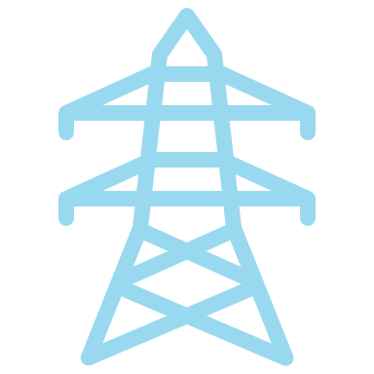
Total Electrical System Benefits - Approach
Created 8760 generation profiles using either
Individual system generation using AMI data for VNEM interconnections
Calculate avoided costs using 2021 DER Avoided Cost Calculator
Calculate GHG emissions using
California Self-Generation Incentive Program marginal emissions data (WattTime)
California Air Resource Board (CARB) Calculators for PV
PV system output simulation using DNV Solar Compass Resource for NET interconnections

Slide 36
Total Electrical System Benefits
VNEM MASH installations achieved 67% of expected production
Across all IOUs and all metering types, MASH installations achieved 65% of their estimated production
Larger systems fell short of expectations to a greater degree than that for small and medium systems

Slide 37
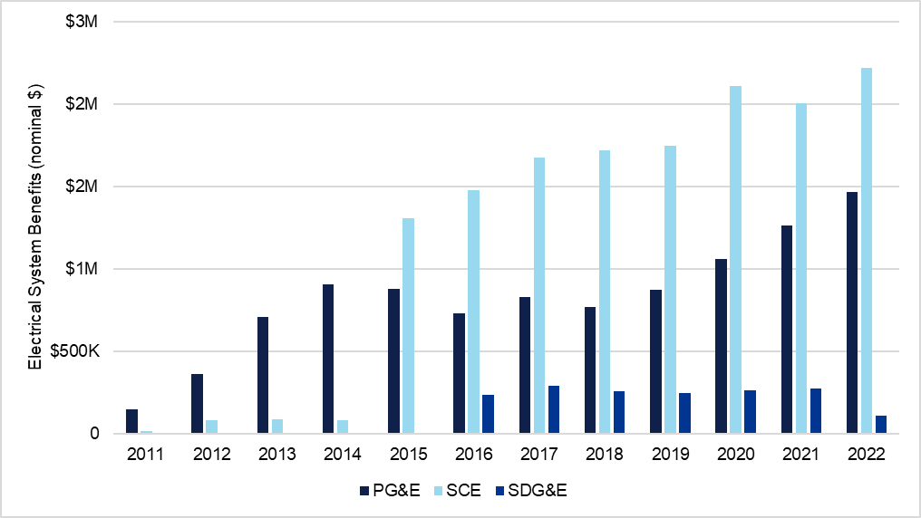
Total Electrical System Benefits – Avoided cost
Between 2011 and 2022, PG&E accrued cumulative electrical system benefits (in 2022 dollars) of $11.5M, SCE accrued $16.4M, and SDG&E accrued $2M

Slide 38

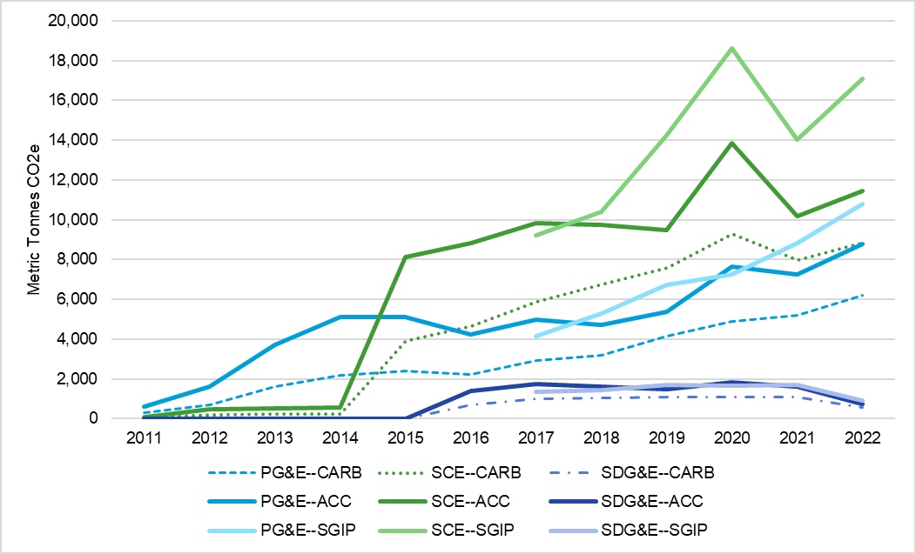
Total Environmental Benefits
The CARB estimates (dotted/dashed) are lower than the SGIP and ACC estimates for all three utilities.
Avoided CO₂
  PG&E: 63,000 metric tons
  SCE: 102,000 metric tons
  SDG&E: 10,000 metric tons

Slide 39
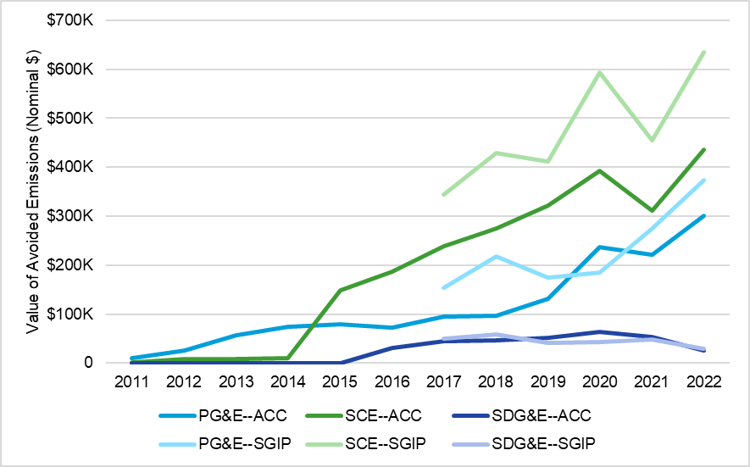
Total Environmental Benefits
Avoided emissions in 2022 dollars:
  PG&E:
  $1.9 million
  SCE:
  $3.6 million
  SDG&E:
  $340,000

Slide 40

Program Cost Assessment - Approach
Reviewed program reports and data
PA interviews
Supplemented data with insights from interviews
Multifamily Affordable Solar Housing (MASH) semi-annual reports
Powerclerk data
MASH Handbook

Slide 41
Program Cost Assessment: Completed projects
Total MASH program spending was $142.6M over the life of the program
Incentives accounted for 93.7% of the total program expenditures

Slide 42
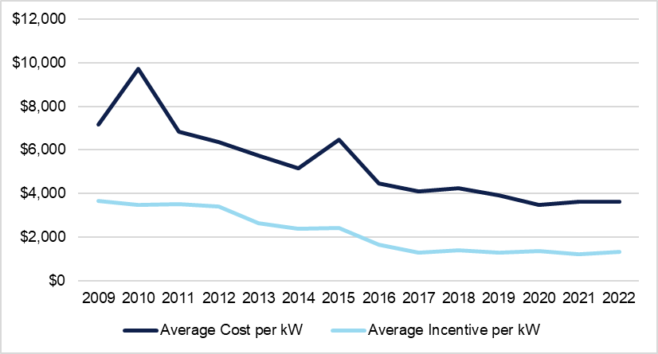
Program Cost Assessment: Completed projects
Average incentives and average project cost per kW installed generally declined over the life of the program

Slide 43
Program Cost Assessment: Administrative Costs
Years with high administrative costs coincided with year with high project completions
Average administrative costs were lower in the MASH 2.0
*Line delineates MASH 1.0 and MASH 2.0

Slide 44
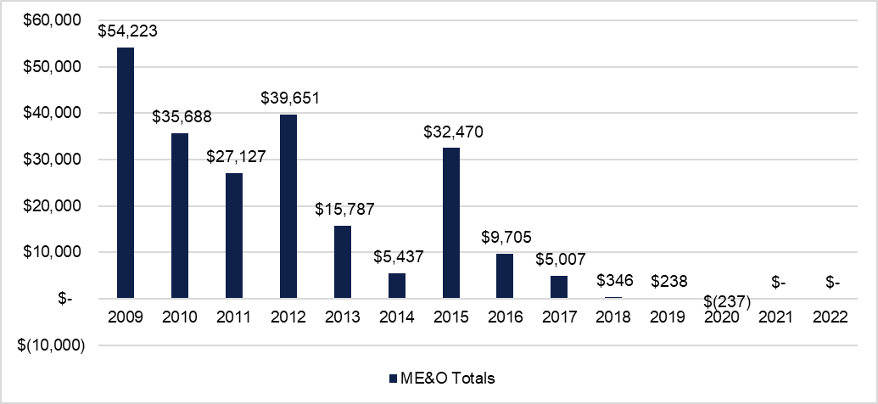
Program Cost Assessment: Marketing, Education, and Outreach
93% of marketing, education, and outreach (ME&O) expenditures occurred prior to 2016 in the MASH 1.0 program

Slide 45
Benefit Cost Assessment - Approach
The evaluation spans 2009-2022, the years in which costs or benefits were incurred in the program.
Costs are the sum of total system costs, program administration costs, and estimated operation expenses.
The analysis assumed a 30-year life of the installed system. Annual operating expenses were estimated annually at 1% of the total system costs.
The annual streams of benefits a and costs were converted to 2022 dollars by using the GDP Price Deflator.
The annual benefits and costs were discounted using each utilities’ Weight Average Cost of Capital (WACC).

Slide 46
Benefit Cost Assessment
Total Resource Cost Test Inputs | Modeling Assumptions and Notes
Administrative costs | Costs reported in MASH semi-annual California Solar Initiative (CSI) reports as of June 2022 report.
Avoided costs of electricity – energy | Evaluation estimates
Avoided costs of electricity – generation capacity
Avoided costs of electricity – transmission & distribution (T&D)
Avoided costs – avoided ancillary services procurement
Avoided costs of electricity – GHG
Federal Tax Incentives | Credit available for solar PV investments assumed to be 30% of the total system costs
Participant costs – equipment/ installation (measure costs) | Total system costs reported in utility data files. Costs (including financing costs and taxes) were self-reported by applicants/developers and may not be accurate.
Operating and maintenance (O&M) costs | Estimated to be 1% of the total reported system costs for each year.

Slide 47
Benefit Cost Assessment
The overall benefit cost ratio using the TRC was 0.43
  benefit generated by the program were less than the costs incurred by the utility and program participants

Slide 48
In Summary…
Program installs (64MW) exceeded combined MASH and SASH goal
Of the 636 projects, 30% were installed in DACs
Data issues
The benefit cost ratio using the TRC over the entire program was 0.43
Workforce development goals were met
Customers used more energy under the program but paid less on their electricity bills
Combined CO₂ savings of 175,680 metric tons
First-year production realization rate was 65%

Slide 49
Thank you. Questions?
Paula Ham-Su Megan Ovaska
Paula.Ham-Su@dnv.com Megan.ovaska@dnv.com
Report Comments? Send Feedback Comment Template via email to Sarah Lerhaupt, Sarah.Lerhaupt@cpuc.ca.gov by May 16th, 2023

