Slide 1

Fuel Substitution Infrastructure Market Study
Stakeholder Presentation
Conducted in Coordination with Guidehouse under the Potential and Goals Study (Group E)
March 5, 2024

Slide 2
Agenda
Introductions (5 min)
Study Overview (15 min)
Study Results (20 min)
Data Tool Demo (20 min)
Q&A (30 min)

Slide 3
STudy Overview

Slide 4
Key Research Questions
What percentage of buildings require an infrastructure upgrade to install a fuel substitution measure or combination of fuel substitution measures?
What are the average costs for infrastructure upgrades needed to support the installation of fuel substitution measures?
What other electrification measures (e.g., PV, EV chargers, etc.) have been installed in the past, or will be installed in the future, that will be impacted by fuel substitution infrastructure upgrades?

Slide 5

Key Research Tasks
Fuel substitution scenario development
  Identify the relevant fuel substitution scenarios to be considered as part of this study
  Limited to current list of approved fuel substitution measures
Three web-based survey efforts
  Residential Occupant Survey
  Nonresidential Customer Survey
  Electrician Survey

Slide 6
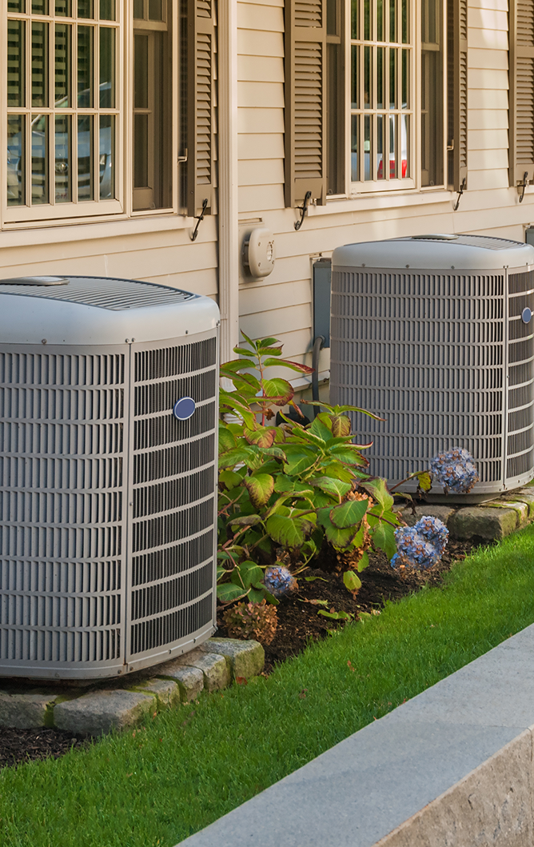
Residential Occupant Survey
Targeted completions with 427 SF and 213 MF occupants
  Geographically distributed across CA CZs
  Ultimately completed surveys with 395 SF and 160 MF market-rate occupants
Inventory major equipment and fuel types
Presence of EV chargers, solar PV, battery storage
Determine the current electric panel size
Inform fractional attribution assessment
  What electrification measures are currently installed, when were they purchased, and in what order?
  What electrification measures are of interest moving forward? In what order?

Slide 7
Residential Occupant Survey – Panel Calculations
Document current electric panel size
  Self-report plus panel photos
Use equipment list to calculate current electrical load
  Use 2023 NFPA 70 National Electrical Code load calculations
Calculate remaining panel capacity available
Apply fuel substitution scenarios
Determine which fuel substitution scenarios trigger substantial infrastructure upgrades (i.e., panel upgrade or optimization)

Slide 8
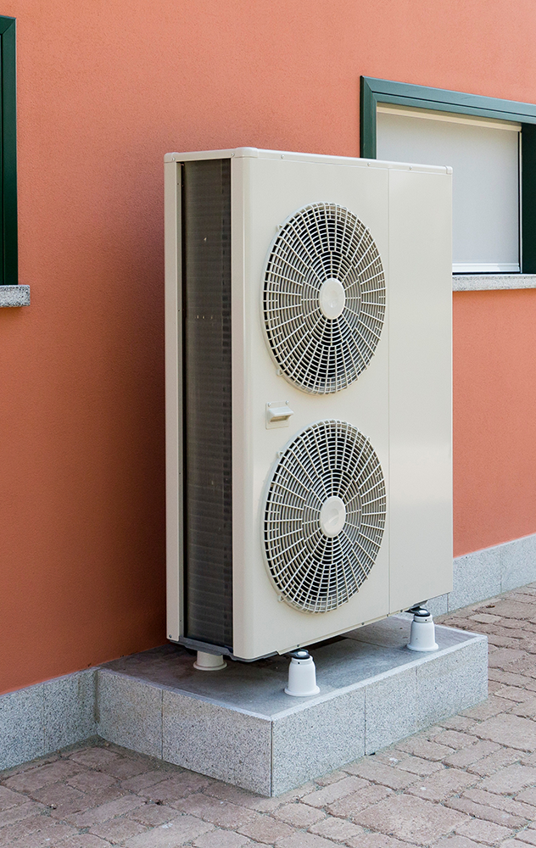
Residential Fuel Substitution Scenarios
Replace gas heating equipment with HVAC heat pump(s)
  Number of units depends on pre-existing equipment
  Heat pump technology dependent on current HVAC distribution system
  Conventional cooling equipment also replaced by HVAC heat pumps
Replace gas water heating equipment with HPWH
  Number of units depends on pre-existing equipment
Replace gas heating equipment AND water heating equipment with fuel substitution measures
  Combination of scenario 1 and 2 where applicable
Replace all eligible gas equipment with fuel substitution measures
  HVAC
  DHW
  Cooktops
  Dryers
  Pool heaters

Slide 9

Nonresidential Customer Survey
Targeted 600 completions
  Geographically distributed across CA CZs
  Ultimately completed surveys with 579 customers
Verify building type
Determine size of the building/business in question
Determine current electric panel size
Inventory key HVAC, water heating, and cooking equipment
Presence of EV chargers, PV
Inform fractional attribution assessment
  What electrification measures are currently installed, when were they purchased, and in what order?
  What electrification measures are of interest moving forward? In what order?

Slide 10
Nonresidential Customer Survey – Panel Calculations
Document current electric panel size
  Self-report plus panel photos
Use 2022 peak demand data to calculate current electrical load
Calculate remaining panel capacity available
Apply fuel substitution scenarios
Determine which fuel substitution scenarios trigger panel upgrades

Slide 11

Nonresidential Fuel Substitution Scenarios
Replace gas heating equipment with HVAC heat pump(s)
  Number of units depends on pre-existing equipment
  Heat pump technology (packaged vs. split) dependent on current HVAC distribution system
  Conventional cooling equipment also replaced by HVAC heat pumps
Replace gas water heating equipment with HPWH
  Number of units depends on pre-existing equipment
  Individual and central HPWH system scenarios
    Central systems limited to MF applications
Replace gas fryers with electric fryers
Replace gas convection ovens with electric convection ovens
Replace gas fryers and convection ovens with electric systems
Replace all eligible gas heating and DHW equipment
Replace all eligible gas equipment
  HVAC
  DHW
  Cooking

Slide 12
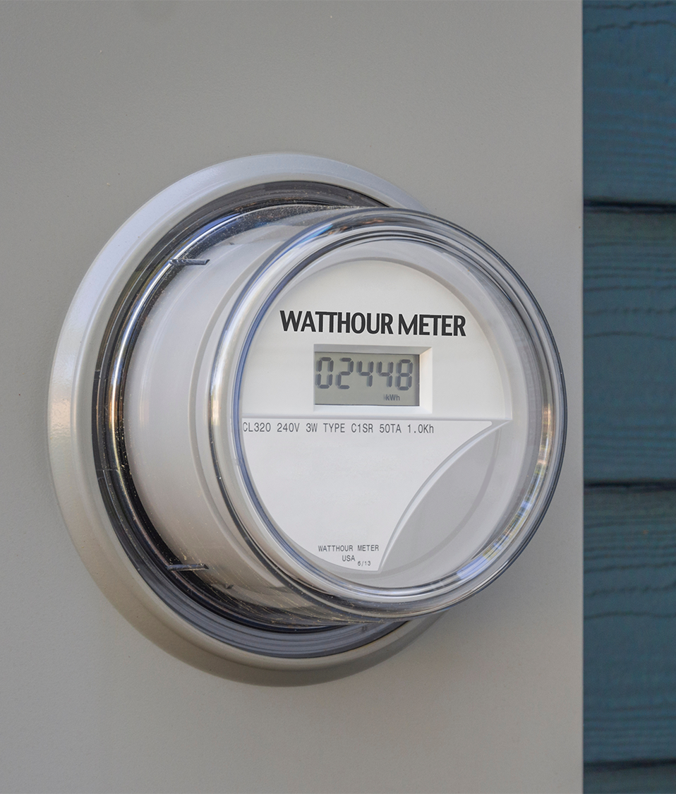
Electrician Survey
Targeted 70 completes
  Split between residential and nonresidential
  Respondents could answer for both sectors
  Sampled from D&B Hoovers licensed electrician list
  Completed surveys with 45 residential and 33 nonresidential electricians
Geographically distributed across the state
Provided cost estimates for various fuel substitution scenarios.
  Labor
  Materials
  Miscellaneous (e.g., permits)
  Total

Slide 13
Sample Overview

Slide 14
Summary of Survey Completes
Aggregated CA climate zones into climate regions used by the EE Potential and Goals Study
Comparable representation among ‘Hot-Dry’ and ‘Marine’ climate regions
Cold climate region is the smallest but also only represents CZ16
Climate Region | Single-Family* | Multifamily* | Nonresidential | Residential Electricians | Nonresidential Electricians
Cold | 29 | 14 | 29 | 2 | 2
Hot-Dry | 155 | 55 | 288 | 25 | 19
Marine | 211 | 91 | 262 | 18 | 12
Total | 395 | 160 | 579 | 45 | 33
Climate Zone | 2023 PG Study CZ Reference Location | Mapping CZ to Climate Region
1 | CZ01 - Arcata | Marine
2 | CZ02 - Santa Rosa | Marine
3 | CZ03 - Oakland | Marine
4 | CZ04 - Sunnyvale | Marine
5 | CZ05 - Santa Maria | Marine
6 | CZ06 - Los Angeles | Marine
7 | CZ07 - San Diego | Hot-Dry
8 | CZ08 - El Toro | Hot-Dry
9 | CZ09 - Pasadena | Hot-Dry
10 | CZ10 - Riverside | Hot-Dry
11 | CZ11 - Red Bluff | Hot-Dry
12 | CZ12 - Sacramento | Hot-Dry
13 | CZ13 - Fresno | Hot-Dry
14 | CZ14 - China Lake | Hot-Dry
15 | CZ15 - El Centro | Hot-Dry
16 | CZ16 - Mount Shasta | Cold
*Excludes 87 completes that were identified as equity customers and are being included in equity infrastructure cost study

Slide 15
Residential Results

Slide 16
Residential Analysis Overview and Adjustments
Residential survey results were used to assess the technical need for infrastructure upgrades through panel upgrades or panel optimization
  Outputs were adjusted to reflect the fact that not all sites receive panel optimization services when that is technically feasible
Residential electrician survey provided costs for various fuel substitution scenarios
  Scenarios focused on SF, but MF questions were used to create an adjustment factor to develop MF costs
Residential electrician survey asked about costs for various optimization strategies
  Based on responses the price of a sub-panel was used to inform optimization costs

Slide 17
Residential Existing Panel Size Distributions
Predominant panel size is 200A
Other common panel sizes are 100A ,125A, and 150A
A smattering of other rare panel sizes
Most residential panels are located on the exterior of the building

Slide 18
Residential Heating Scenario Results
Climate Region | Sample Size | Relative Precision @ 90% CI | Panel Optimization Likelihood | Panel Upgrade Likelihood | Simple Connection Likelihood | Weighted Average Infrastructure Cost
Single-family
Cold | 16 | 19% | 13% | 18% | 69% | $ 2,599.09
Hot-Dry | 84 | 9% | 17% | 20% | 63% | $ 2,748.14
Marine | 143 | 7% | 21% | 29% | 50% | $ 3,221.48
Multifamily
Cold | 5 | -- | 21% | 19% | 60% | $ 3,223.27
Hot-Dry | 23 | 16% | 34% | 31% | 35% | $ 4,132.30
Marine | 44 | 12% | 24% | 29% | 48% | $ 3,730.28
Costs are weighted by outcome results and represent one piece of heating equipment
Infrastructure needs are highest in ‘Marine’ CR for SF and ‘Hot-Dry’ for MF
  Split fairly evenly between panel upgrade and panel optimization
Statewide weighted costs per unit of heating equipment
  SF - $2,814
  MF - $4,020
  All - $3,562

Slide 19
Residential Water Heating Scenario Results
Costs are weighted by outcome results and represent one piece of water heating equipment
Upgrade needs highest in ‘Marine’ CR for SF and ‘Hot-Dry’ for MF
  More panel upgrade needs than panel optimization needs
Statewide weighted costs per unit of water heating equipment
  SF - $4,003
  MF - $4,927
  All - $4,589
Climate Region | Sample Size | Relative Precision @ 90% CI | Panel Optimization Likelihood | Panel Upgrade Likelihood | Simple Connection Likelihood | Weighted Average Infrastructure Cost
Single-family
Cold | 19 | 18% | 11% | 21% | 68% | $ 3,615.42
Hot-Dry | 109 | 8% | 15% | 28% | 57% | $ 3,984.91
Marine | 150 | 7% | 19% | 33% | 48% | $ 4,256.21
Multifamily
Cold | 5 | -- | 10% | 30% | 60% | $ 4,495.84
Hot-Dry | 28 | 15% | 22% | 35% | 43% | $ 5,063.44
Marine | 45 | 12% | 21% | 24% | 56% | $ 4,539.93

Slide 20
Residential Multifamily Pricing
Would your cost estimates change if the heat pump was installed in an apartment with its own electrical panel in the unit?
Asked about MF pricing relative to SF
Mixed results
  Lower prices primarily attributed to shorter electrical runs
  Higher prices attributed to lack of attic or crawl space access, dealing with landlords/property managers
Weighted average of responses indicates MF is 13% more expensive than SF
 | n | Yes, decrease | Yes, increase | No, unlikely to change
MF Pricing | 35 | 40% | 34% | 26%
By what percent would you increase/decrease your costs for a heat pump installation at an apartment in a multifamily building compared to the single-family estimates provided earlier?
 | n | % Decrease | % Increase
MF Pricing | 26 | 15.9% | 55.5%

Slide 21
Residential Panel Optimization Pricing
Outside of sub-panels, electricians reported never using many of the panel optimization strategies identified in the survey
The team used the sub-panel costs as the value for all optimization pricing in the data tool given this is the strategy that is used in most circumstances
How often do you use each of the following panel optimization options when you have constrained space in a panel?
What is the typical cost (labor and materials) associated with the panel optimization options you have experience with?
Optimization Approach | n | Most often | Often | Sometimes | Rarely | Never | Don’t know | Pricing
Smart circuit breakers | 45 | 4% | 4% | 13% | 24% | 48% | 4% | $1,064
Smart panel | 45 | 0% | 4% | 18% | 24% | 51% | 2% | $4,424
Circuit pausers | 45 | 2% | 4% | 9% | 18% | 58% | 9% | $1,435
Load-sharing | 45 | 7% | 9% | 20% | 22% | 40% | 2% | $1,186
Sub-panel | 45 | 31% | 40% | 29% | 0% | 0% | 0% | $2,211
Meter collars | 45 | 0% | 2% | 2% | 18% | 67% | 11% | $1,831
Other | 45 | 11% | 7% | 4% | 13% | 20% | 44% | $1,077

Slide 22
Residential Electrician Pricing Variance
Scenario
Gas Fired Furnace w/CAC to ASHP | n | Average Cost | CV
Connect ASHP to panel (A*) | 42 | $1,576 | 0.87
Upgrade wiring and connect ASHP to panel (B) | 42 | $2,068 | 0.87
Gas Fired Furnace w/no CAC to ASHP
Install 200A panel, install 240V circuit and disconnect, connect ASHP to panel | 42 | $5,605 | 0.52
Gas Wall Furnace w/no CAC to Mini-Split ASHP
Install 240V circuit and disconnect, connect ASHP to panel (A) | 41 | $2,083 | 0.83
Install 200A panel, install 240V circuit and disconnect, connect ASHP to panel (B) | 44 | $6,158 | 0.46
Install 200A panel, install 240V circuit and disconnect, upgrade wiring, connect ASHP to panel (C) | 45 | $7,060 | 0.46
50-gallon gas DHW to HPWH
Install 240V circuit and disconnect, connect HPWH to panel (A) | 44 | $2,591 | 0.56
Install 200A panel, install 240V circuit and disconnect, connect HPWH to panel (B) | 42 | $6,385 | 0.43
Install 200A panel, install 240V circuit and disconnect, upgrade wiring, connect HPWH to panel (C) | 42 | $7,004 | 0.42
Gas Furnace w/CAC AND Gas DHW to ASHP and HPWH
Install 240V circuit and disconnect for HPWH, connect both ASHP and HPWH to panel (A) | 41 | $3,433 | 0.85
Install 200A panel, install 240V circuit and disconnect for HPWH, connect both ASHP and HPWH to panel (B) | 41 | $7,247 | 0.55
Install 200A panel, install 240V circuit and disconnect for HPWH, upgrade wiring, connect both ASHP and HPWH to panel (C) | 43 | $8,219 | 0.52
Gas-powered Range to Induction Range
Connect induction range to panel (A) | 43 | $1,726 | 0.81
Install 200A panel and connect induction range to panel (B) | 44 | $6,240 | 0.49
Install 200A panel, install 240V circuit and disconnect for new induction range, upgrade wiring, connect induction range to panel (C) | 42 | $6,923 | 0.49
Coefficient of Variation (CV) tells us the relative size of the standard deviation compared to the mean
CV ranges from 0.42 to 0.87 across all residential pricing scenarios
Individual price responses differ from the mean by 42% to 87%, on average, depending on the scenario
CV < 1.0 is indicative of relatively low variability within the responses

Slide 23
NonResidential Results

Slide 24
Nonresidential Analysis Overview and Adjustments
Similar to the residential survey, nonresidential survey results were used to assess the technical need for infrastructure upgrades through panel upgrades or panel optimization
  Outputs were adjusted to reflect the fact that not all sites receive panel optimization services when that is technically feasible
Nonresidential electrician survey asked about costs for various optimization strategies
  Based on responses the price of a sub-panel was used to inform optimization costs

Slide 25
Nonresidential Existing Panel Size Distributions
Wide range of existing panel sizes within different building types
Education, industrial, and lodging building types have the largest panel sizes
Most building types have an average panel size between 200A and 400A, suggesting a strong mix of the two panel sizes
Marine climate region has the largest average panel size

Slide 26
Nonresidential Heating Scenario Results
Again, costs represent a weighted average of the scenario outcomes and represent one piece of heating equipment
Infrastructure needs are relatively modest in comparison to residential heating results
Statewide weighted costs
  $5,522 per unit of heating equipment
Climate Region | Sample Size | Relative Precision @ 90% CI | Panel Optimization Likelihood | Panel Upgrade Likelihood | Simple Connection Likelihood | Weighted Average Infrastructure Cost
Cold | 12 | -- | 18% | 16% | 67% | $ 4,285.55
Hot-Dry | 64 | 7% | 7% | 7% | 86% | $ 3,021.70
Marine | 67 | 9% | 5% | 21% | 75% | $ 4,497.46

Slide 27
Nonresidential Water Heating Scenario Results
Infrastructure needs are substantially higher in the ‘Marine’ and ‘Cold’ climate regions than in the ‘Hot-Dry’ in the water heating scenario
The need for panel upgrades vs. optimization services are split fairly evenly
Statewide weighted costs
  $6,956 per unit of water heating equipment
Climate Region | Sample Size | Relative Precision @ 90% CI | Panel Optimization Likelihood | Panel Upgrade Likelihood | Simple Connection Likelihood | Weighted Average Infrastructure Cost
Cold | 11 | -- | 34% | 30% | 36% | $ 7,205.35
Hot-Dry | 67 | 10% | 15% | 19% | 66% | $ 5,691.28
Marine | 71 | 10% | 25% | 22% | 54% | $ 6,187.38

Slide 28
Nonresidential Cooking Scenario Results
Infrastructure needs substantial in the cooking scenario with more than half of ‘Hot-Dry’ and ‘Marine’ climate region projects needing a panel upgrade or optimization services
Upgrade needs outweigh optimization needs in this scenario
Statewide weighted costs
  $9,211 per unit of cooking equipment
Climate Region | Sample Size | Relative Precision @ 90% CI | Panel Optimization Likelihood | Panel Upgrade Likelihood | Simple Connection Likelihood | Weighted Average Infrastructure Cost
Cold | 1 | -- | 0% | 100% | 0% | $ 13,624.40
Hot-Dry | 32 | 14% | 17% | 37% | 47% | $ 7,550.05
Marine | 33 | 14% | 18% | 34% | 48% | $ 7,300.44

Slide 29
Nonresidential Panel Optimization Pricing
Outside of sub-panels, electricians reported never using many of the panel optimization strategies identified in the survey
As with residential, the team used the sub-panel costs as the value for all optimization pricing in the data tool given this is the strategy that is used in most circumstances
How often do you use each of the following panel optimization options when you have constrained space in a panel?
What is the typical cost (labor and materials) associated with the panel optimization options you have experience with?
Optimization Approach | Most often | Often | Sometimes | Rarely | Never | Don’t know | Pricing
Smart circuit breakers | 3% | 12% | 9% | 27% | 48% | 0% | $971
Smart panel | 3% | 0% | 6% | 24% | 67% | 0% | $3,720
Circuit pausers | 0% | 0% | 12% | 21% | 67% | 0% | $1,300
Load-sharing | 0% | 9% | 27% | 18% | 45% | 0% | $3,688
Sub-panel | 21% | 45% | 33% | 0% | 0% | 0% | $2,594
Meter collars | 3% | 0% | 3% | 12% | 73% | 9% | $1,792
Other | 0% | 0% | 24% | 3% | 33% | 39% | $1,647

Slide 30
Nonresidential Electrician Pricing Variance
Scenario | n | Total Mean | CV
Packaged AC/Gas Furnace to Packaged HP with Electric Resistance Back-up
Connect packaged HP to panel (A) | 29 | $2,099 | 0.84
Install 600A panel and connect packaged HP to panel (B) | 31 | $16,799 | 0.63
Add 200A panel and connect packaged HP to panel (C) | 25 | $5,616 | 0.70
Install 600A panel, upgrade wiring, connect packaged HP to panel (D) | 30 | $16,367 | 0.56
60-gallon gas DHW to 80-gallon HPWH
Install 240V circuit and disconnect, connect HPWH to panel (A) | 33 | $3,430 | 0.54
Install 400A panel, install 240V circuit and disconnect, connect HPWH to panel (B) | 28 | $9,458 | 0.32
Add 200A panel and connect packaged HP to panel (C) | 17 | $4,946 | 0.45
Install 400A panel, install 240V circuit and disconnect, upgrade wiring, connect HPWH to panel (D) | 32 | $15,100 | 0.57
Gas Fryer to Electric Fryer
Add circuit and disconnect, connect fryer to panel (A) | 32 | $2,904 | 0.63
Install 400A panel, add circuit and disconnect, connect fryer to panel (B) | 27 | $10,108 | 0.41
Add 200A panel, add circuit and disconnect, connect fryer to panel (C) | 24 | $7,407 | 0.62
Install 400A panel, upgrade wiring, add circuit and disconnect, connect fryer to panel (D) | 32 | $15,610 | 0.59
Gas Oven to Electric Convection Oven
Add circuit and disconnect, connect oven to panel (A) | 32 | $3,840 | 0.59
Install 600A panel, add circuit and disconnect, connect oven to panel (B) | 32 | $17,141 | 0.60
Add 200A panel, add circuit and disconnect, connect oven to panel (C) | 25 | $7,385 | 0.62
Install 600A panel, upgrade wiring, add circuit and disconnect, connect oven to panel (D) | 32 | $18,262 | 0.59
Gas Oven AND Gas Fryer to Electric Convection Oven and Electric Fryer
Add circuit and disconnect, connect oven and fryer to panel (A) | 31 | $5,405 | 0.60
Install 600A panel, add circuit and disconnect, connect oven and fryer to panel (B) | 31 | $18,160 | 0.61
Add 200A panel, add circuit and disconnect, connect oven and fryer to panel (C) | 24 | $7,156 | 0.54
Install 600A panel, upgrade wiring, add circuit and disconnect, connect oven and fryer to panel (D) | 33 | $20,092 | 0.63
Forced Air Gas Fired Furnace AND 60-gallon DHW to ASHP and 80-gallon HPWH
Add circuit and disconnect, connect HPWH and ASHP to panel (A) | 32 | $5,334 | 0.67
Install 400A panel, add circuit and disconnect, connect HPWH and ASHP to panel (B) | 33 | $15,680 | 0.60
Add 200A panel, add circuit and disconnect, connect HPWH and ASHP to panel (C) | 25 | $9,190 | 0.71
Install 400A panel, upgrade wiring, add circuit and disconnect, connect HPWH and ASHP to panel (D) | 33 | $17,190 | 0.55
Coefficient of Variation (CV) tells us the relative size of the standard deviation compared to the mean
CV ranges from 0.32 to 0.84 across all nonresidential pricing scenarios
Individual price responses differ from the mean by 32% to 84%, on average, depending on the scenario
CV < 1.0 is indicative of relatively low variability within the responses

Slide 31
Regression Overview and Results

Slide 32
Regression Methodology
Explored the relationship of various inputs on the likelihood of needing substantial infrastructure work (e.g., panel upgrade or optimization)
Ran a two-stage analysis to understand drivers of the panel upgrade/optimization outcome
  Stage 1: correlation analysis to understand the extent and direction of individual relationships of variables of interest and panel upgrade/optimization outcome
  Stage 2: multivariate regression to assess combined relationship between variables of interest and panel upgrade/optimization outcome
  Multivariate approach is more appropriate for explaining the outcome as it accounts for a variety of customer characteristics that interact to affect the outcome

Slide 33
Residential Multivariate Regression Results
Age of home and climate region are the best predictors of panel upgrade/optimization outcome
  Older homes (primarily 1976-1999) much more likely than newer homes (2000 or later)
    1.7 – 2.1x more likely
  Marine climate region much more likely than cold region
    2.1 – 3.8x more likely
Baseline equipment is also a statistical predictor though less influential than age of home or climate region
    Homes with existing AC 1.3x more likely to need upgrade
Characteristic | Heating Only |  | Water Heating Only |  | Heating and Water Heating |  | All Applicable Equipment
 | Direction | Adjusted Odds Ratio | Direction | Adjusted Odds Ratio | Direction | Adjusted Odds Ratio | Direction | Adjusted Odds Ratio
Age of Home (Reference: 2000 or later)
Before 1950
1950-1975 | Positive | 2.1
1976-1999 | Positive | 2.1 | Positive | 1.6 |  |  | Positive | 1.7
Unsure
Climate Region (Reference: Cold)
Hot-Dry |  |  |  |  |  |  | Positive | 2.4
Marine | Positive | 2.3 | Positive | 2.1 | Positive | 2.9 | Positive | 3.8
Baseline Equipment & Systems
Electrical Cooling System | Positive | 1.3 | Positive | 1.2 | Positive | 1.4 | Positive | 1.3
Electrical Heating System | Negative | 0.6 |  |  | Negative | 0.4 | Negative | 0.7
Electrical Water Heating System |  |  | Negative | 0.1 | Negative | 0.1
Panel Size | Negative | 0.99 | Negative | 0.99 | Negative | 0.99 | Negative | 0.99
Solar Panels
Electric Vehicle
Inculded in multivariate analysis and effect is significant
Included in multivariate analysis but effect not significant
Excluded from multivariate analysis because effect not significant in univariate analysis

Slide 34
Nonresidential Multivariate Regression Results
Multivariate results for nonresidential are more limited in terms of explaining what is driving the need for infrastructure upgrades
  This is likely driven by the wide diversity of buildings within the nonresidential market. Even within a specific building type (e.g., Healthcare), we can see a huge range of building sizes, technologies, etc.
Climate region and the presence of existing electrical heating/water heating equipment do exhibit statistically significant relationships with the panel upgrade/optimization outcome
Characteristic | Water Heating Only |  | Heating and Water Heating Equipment |  | All Applicable Equipment
 | Direction | Adjusted Odds Ratio | Direction | Adjusted Odds Ratio | Direction | Adjusted Odds Ratio
Building Type (Reference: Retail,Restaurant & Supermarket)
Agriculture, Automotive & Industrial |  |  |  |  | Negative | 0.3
Education, Lodging & Offices
Healthcare
Miscellaneous, Religious & Storage
Climate Region (Reference: Cold)
Hot-Dry | Negative | 0.2 | Negative | 0.3 | Negative | 0.3
Marine | Negative | 0.3 | Negative | 0.3
Baseline Equipment & Systems
Electrical Cooling System
Electrical Heating System | Positive | 1.3 | Negative | 0.4
Electrical Water Heating System | Negative | 0.1 | Negative | 0.4 | Negative | 0.5
Panel Size
Solar Panels
EV Chargers
Inculded in multivariate analysis and effect is significant
Included in multivariate analysis but effect not significant
Excluded from multivariate analysis because effect not significant in univariate analysis

Slide 35
Key Takeaways

Slide 36
Key Takeaways
Infrastructure upgrade needs are significant in the residential sector
  Statewide results, weighted by climate region and building type, indicate 27% to 41% of housing units, depending on the scenario, are likely to receive a panel upgrade to accommodate fuel substitution measures
  Another 19% to 27% are likely to receive panel optimization services
  The costs associated with residential fuel substitution measures are substantial
  Simple connection costs exceed $1,000
  Optimization services start above $3,500
  Panel upgrade costs exceed $5,000

Slide 37
Key Takeaways Cont.
Nonresidential infrastructure upgrade needs are also substantial, though the needs vary quite a bit by scenario
  Statewide results, weighted by building type, suggest that more than 40% of sites are likely to need a panel upgrade in the ‘Heating and DHW’ and ‘Cooking Only’ scenarios
  Under these same scenarios, 27% of sites and 15% of sites, respectively, are likely to require panel optimization services
  Under the ‘Heating Only’ scenario, the percentage of sites likely need a panel upgrade (12%) or panel optimization services (7%) are low compared to all other scenarios
The costs associated with these needs are substantial
  Simple connection costs exceed $2,000
  Optimization services start above $4,500
  Panel upgrade costs exceed $13,000

Slide 38
Future Research Opportunities
Conduct site visits to refine the electrical panel load and remaining capacity calculations
  More accurate assessment of current electric equipment and wattages
  Particularly valuable for nonresidential buildings
Conduct more thorough cost research
  Consider validating cost data through alternative approaches such as mystery shopping visits or contractor bid templates
  Focus future research efforts on measures/building types with the largest infrastructure needs

Slide 39
Data Tool Demo

Slide 40
Questions?
Contact:
Zack Tyler
ztyler@opiniondynamics.com
617-301-4611

